Slide 1
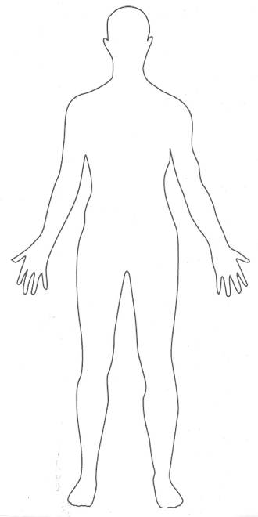
BODY
ТЕЛО

Slide 2
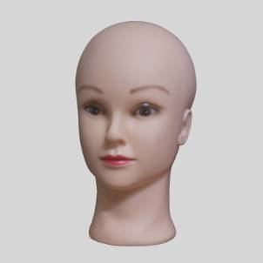
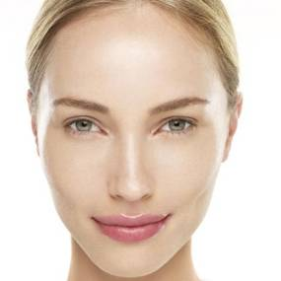
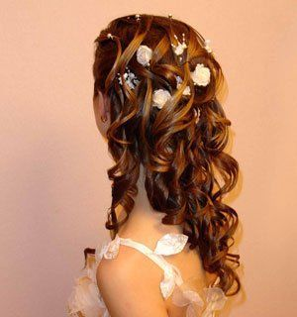
face
head
hair

Slide 3
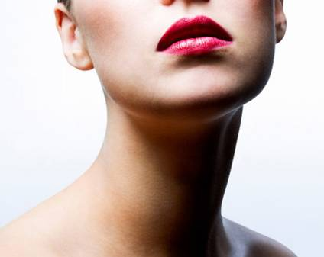
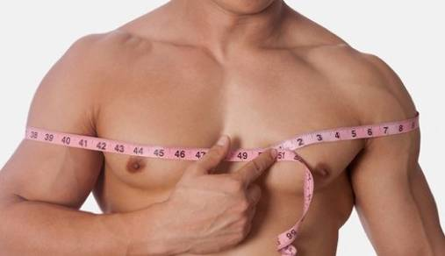
neck
shoulders

Slide 4
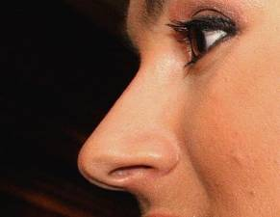
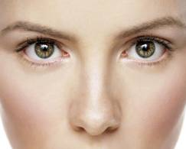
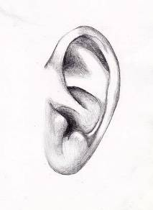
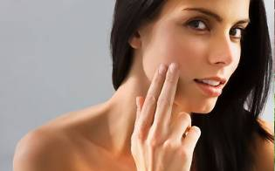
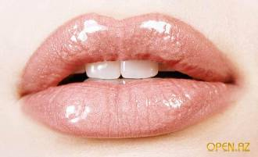
nose
eyes
ear
cheek
mouth

Slide 5
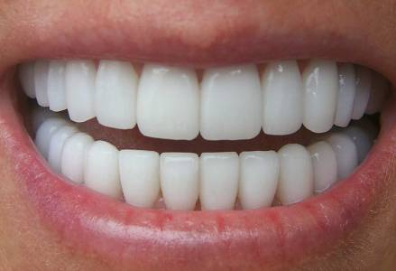
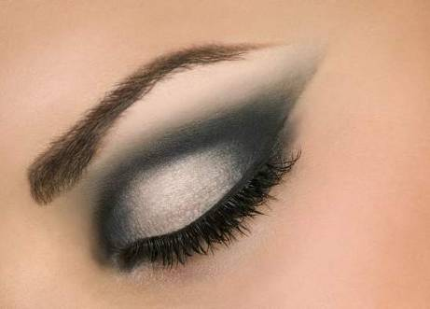
teeth
eyebrow

Slide 6
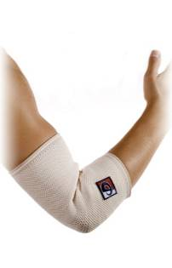
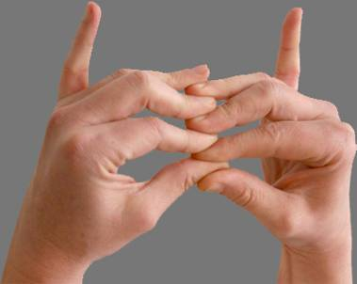
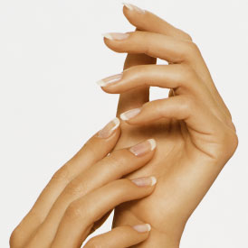
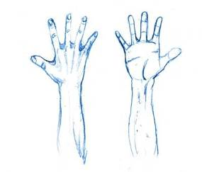
fingers
elbow
hands
arms

Slide 7
knees
legs
foot (feet)

Slide 8
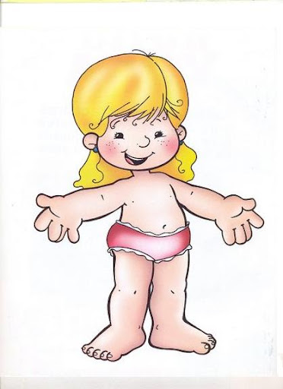
name parts of body
nose
mouth
eyes
neck
hair
arm
foot
hand
leg
eyebrows
knee
fingers
shoulders
ears
cheek
teeth

Slide 9
Complete the sentences:
1. A foot has five …………… .
2. We have one ……… , one ………. , one ……… and one ………… .
3. We have two eyes, two ……… , two . . . . . . . . , two . . . . . . . . . . , two . . . . . . . . . . . ,two . . . . . . . . . and two. . . . . . . . .
4. A man has thirty-two . . . . . . . . . . . .
cheeks
shoulders
teeth
knees
fingers
head
nose
mouth
face
ears
hands
legs

