Slide 1
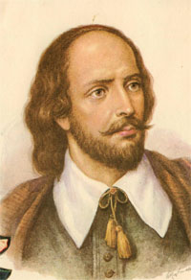
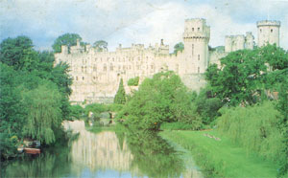
Memorial Theatre in Stratford-on-Avon.
William Shakespeare. The greatest English poet and dramatist.

Slide 2
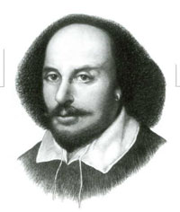
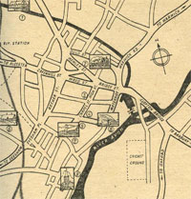
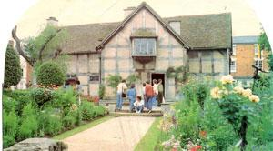
William Shakespeare, the greatest English poet and dramatist. He was born in April 1564 at Stratford-upon-Avon.
Mary Arden, the poet’s mother, was a daughter of rich man.
John Shakespeare, the poet’s father, was the town officers and dealer in corn and meat.

Slide 3
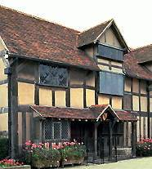
This is the most famous house in England and the most famous house in the world.
Shakespeare was born here.
The appearance of the house is the same as it looked at that time.

Slide 4
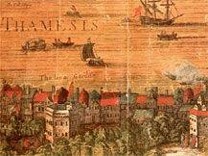
The Globe Theatre.
William Shakespeare wrote most of his plays for the Globe Theatre.
In those days the people of London, young and old, rich and poor, loved the Globe Theatre very much..

Slide 5
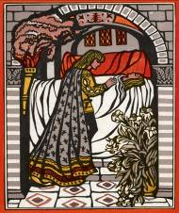
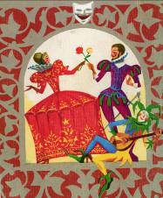
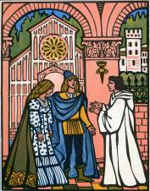
“Romeo and Juliet”- an optimistic tragedy, staged in all kinds of theatres.
This wonderful love story is about two lovers Romeo and Juliet. Unfortunately, they died, but they didn’t stop loving each other. They stayed young forever!

Slide 6
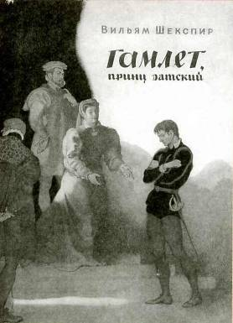
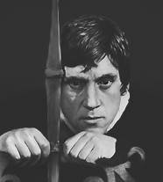
“Hamlet” is a great philosophical tragedy
The character of Hamlet is one of the most difficult in world literature.
This role was played by the best actors of all times and peoples.
John Gielgud was the best in the role of Hamlet in England.
Russian poet and actor Vladimir Vysotsky was brilliant in our country.

Slide 7
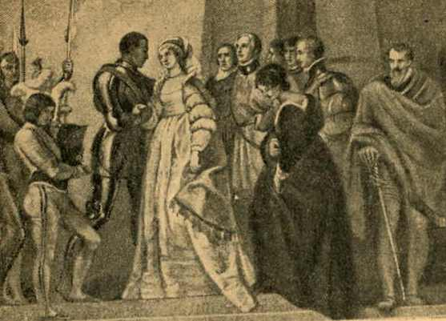
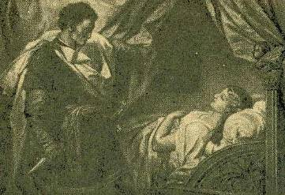
“Othello” is a play about love and jealousy, a play about a person who believed the lie and killed his wife whom he loved dearly.

Slide 8
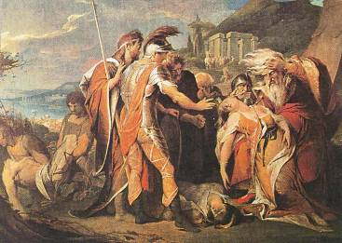
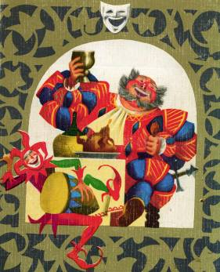
“King Lear” is the story of a man who was so proud so egoistic that he could not understand a world around him. He heard only what he wanted to hear; he saw only what he wanted to see.

Slide 9
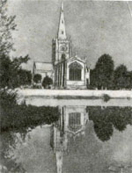
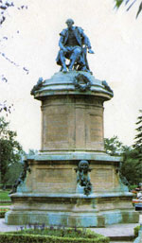
William Shakespeare was buried here in 1616.
Shakespeare's monument in Westminster Abbey.
A memorial statue of Shakespeare is set up in Poet’s Corner.

Slide 10
Mach the name of the party with the translation.
1. «Комедия ошибок»
2. «Виндзорские насмешницы»
3. «Венецианский купец»
4. «Лукреция»
5. «Все хорошо, что хорошо»
6. «Мера за меру»
7. «Сон в летнюю ночь»
A. “A Midsummer Night's Dream”
B. “Measure for Measure”
C. “The Rape of Lucrece”
D. “All’s well that Ends well”
E. “The Comedy of Errors”
F. “The Merry Wives of Windsor”
G. “The Merchant of Venice”

