Slide 1
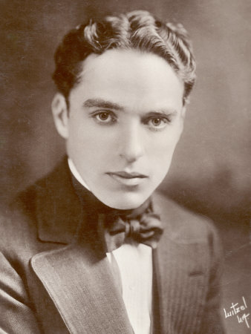
Charles Spenser Chaplin

Slide 2
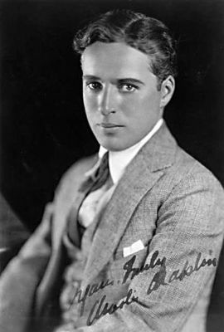
He was born on the 16th of April in London, England.
His parents worked in Music Hall.

Slide 3
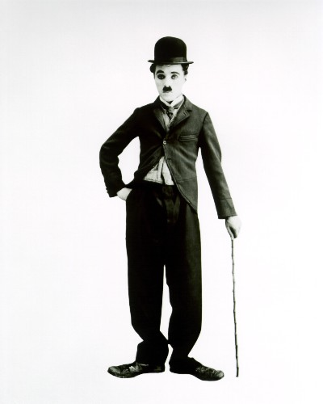
His parents separated soon after his birth.
After that
Charles lived with his mother.

Slide 4
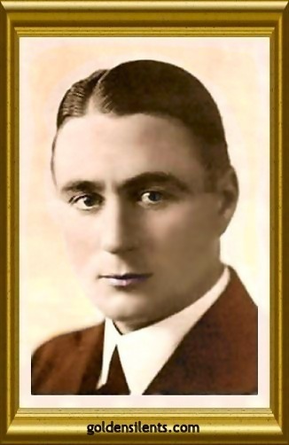
Charlie first performed in Music Hall in 1894 at the age 5.
As a child, he was often seriously ill.

Slide 5
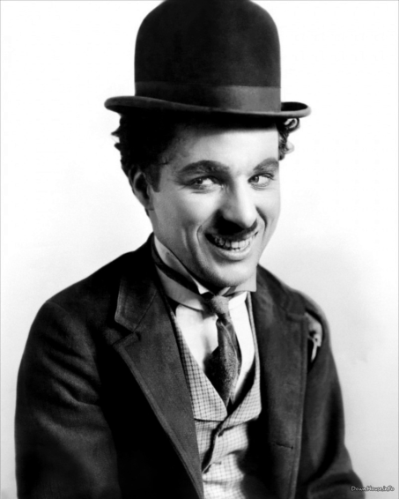
In 1900,
aged 11,
his brother helped get him the role of
a comic cat in the pantomime Cinderella at the London Hippodrome.

Slide 6
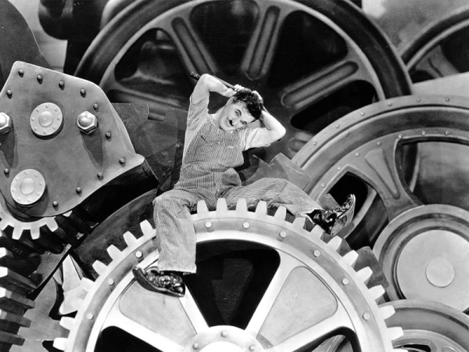
He became a clown in Fred
Karno's Fun Factory comedy company in 1907.

Slide 7
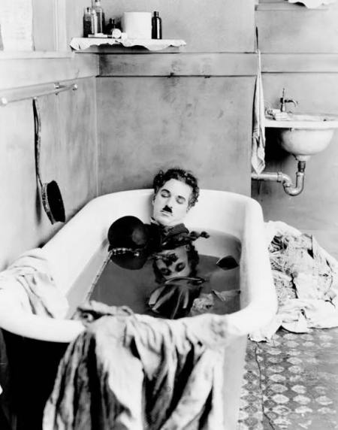
Charlie arrived in the USA with the Karno troupe on October 2, 1912.

Slide 8
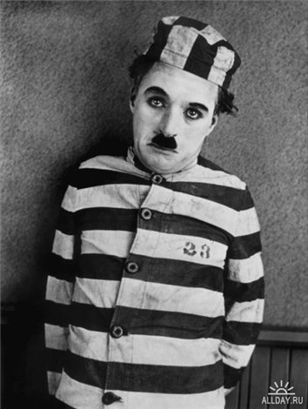
He became world famous very quickly. His brother, Sydney, was his business manager.

Slide 9
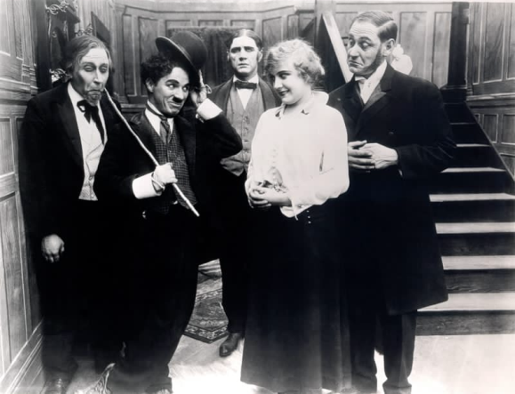
He also formed his own independent production company in 1918, the Charles Chaplin Film Corporation, which made him a very wealthy man.

Slide 10
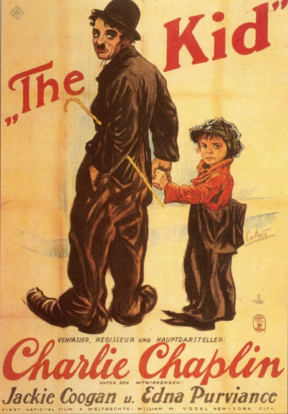
These are comedy shorts (such as A Dog's Life (1918)
and Pay Day (1922and his great silent feature length films: The Kid (1921),

Slide 11
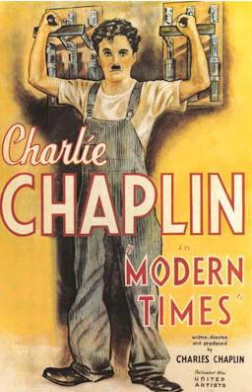
His silent films with his own music and sound effects:
City Lights (1931) and Modern Times (1936),

Slide 12
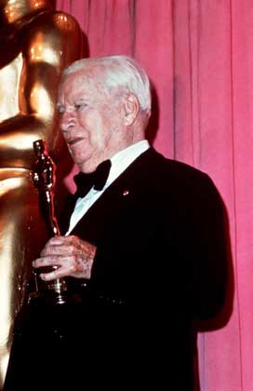
Chaplin won Oscar twice the first Oscar on
May 16, 1929,
the second award came 44 years later in 1972.

Slide 13
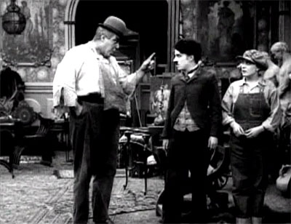
On March 4, 1975 he was knighted as a Knight of the British Empire by Queen Elizabeth II.
Эрик Кэмпбелл,
Чарли Чаплин и
Эдна Перваэнс
в фильме
"За экраном.

Slide 14
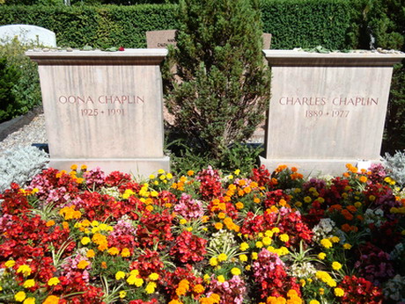
Chaplin died on Christmas Day, 1977 in Vevey, Switzerland, aged 88.

