Slide 1
The Animal's World

Slide 8
To feed
To clean the cage
To buy food
To take to the vet
To brush
To take for a walk
To talk

Slide 9
Explain why the pets are so busy now. What have you done for them? Use your phrases in Present Perfect.
Example: 1.____________________, so Rex is gnawing it in the corner now. - I have bought a bone for my dog in the Pet Shop, so Rex is gnawing it in the corner now.
2. _______________________ and the cat is sleeping in the basket now.
3. _______________________, so the hamsters are eating and eating.
4. _______________________ and the kittens are running and jumping now.
5. _______________________, so the canaries are singing a beautiful song.
6. _______________________, so the tortoise is moving to the water.
7. _______________________, so the parrot is talking to my friends.

Slide 10
1. Listen to the story and fill in the table.
 |  | 1 st cat | 2 nd cat | dog
name
2. age
3. colour
4. favourite pastime
2. Answer the question:
How does the author explain the role of pets in our life?

Slide 11
Choose the correct animal.
1) Which animals are domestic? (wolves, monkeys, horses)
2) Which of the birds doesn’t fly and lives in Antarctica? (an eagle, a penguin, a duck)
3) Who is the cleverest animal? (a lion, a dolphin, a leopard)
4) Which is the biggest animal in the seas and oceans? (a whale, a dolphin, a leopard)
5) Which animal is the national symbol of Australia? (a panda, a kangaroo, an elephant)
6) Who can carry people and things? (a giraffe, a tiger, a camel)
7) Which of these animals are endangered? (giant pandas, sharks, snakes)
8) _________________ is the national symbol of Berlin. (a wolf, a cockerel, a bear)

Slide 16
The Fox, the Hare and the Cock

Slide 17
Baa, Baa, Black Sheep
Baa, baa, black sheep, Baa, baa, white sheep, Have you any wool? Have you any wool? Yes sir, yes sir, Yes sir, yes sir, Three bags full. Three bags full. One for my master, One for my master, One for my dame, One for my dame, And one for the little boy One for the little boy Who lives down the lane. Who lives down the lane.
Baa, baa, black sheep, Baa, baa, white sheep, Have you any wool? Have you any wool? Yes sir, yes sir, Yes sir, yes sir, Three bags full. Three bags full.

Slide 18
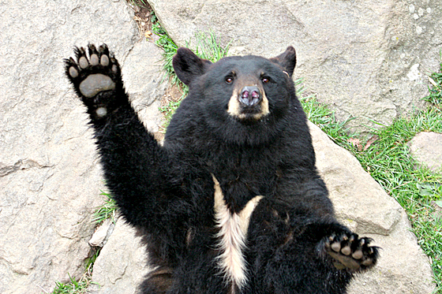
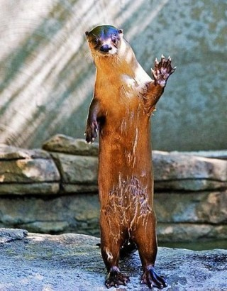
Good-bye, children and our dear guests!

