Slide 1
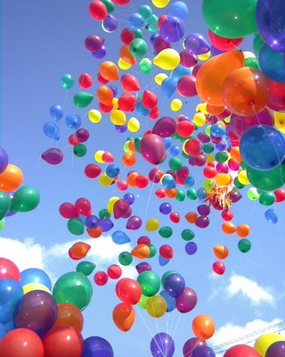
WELCOME TO
The ABC Party!!!!!!

Slide 3
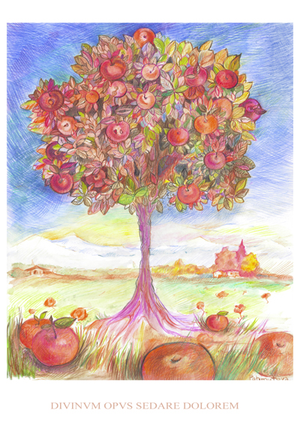
A is for Apples and Apple-trees You can see apples on apple trees.
A

Slide 4
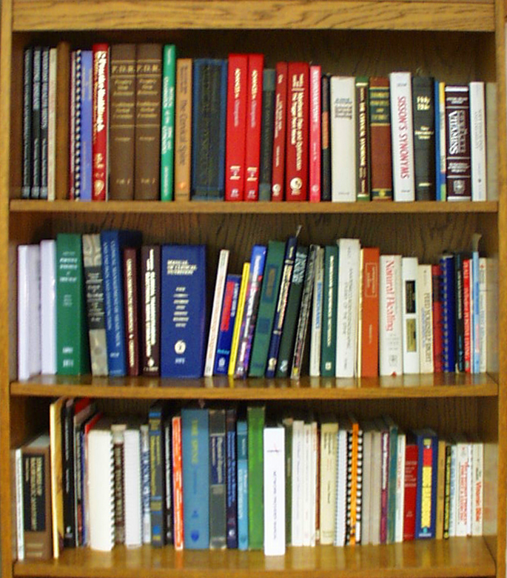
B is for Books and for Bookcase. I have many books in my bookcase.
B

Slide 5
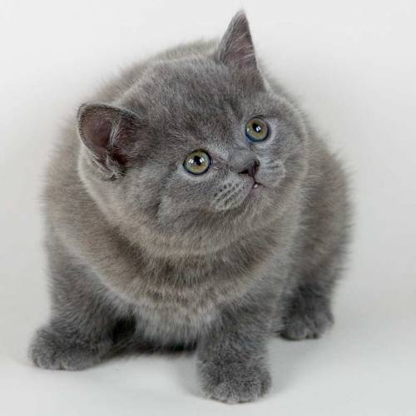
C is for Cat. My Cat is grey, And with me it likes to play.
C

Slide 6
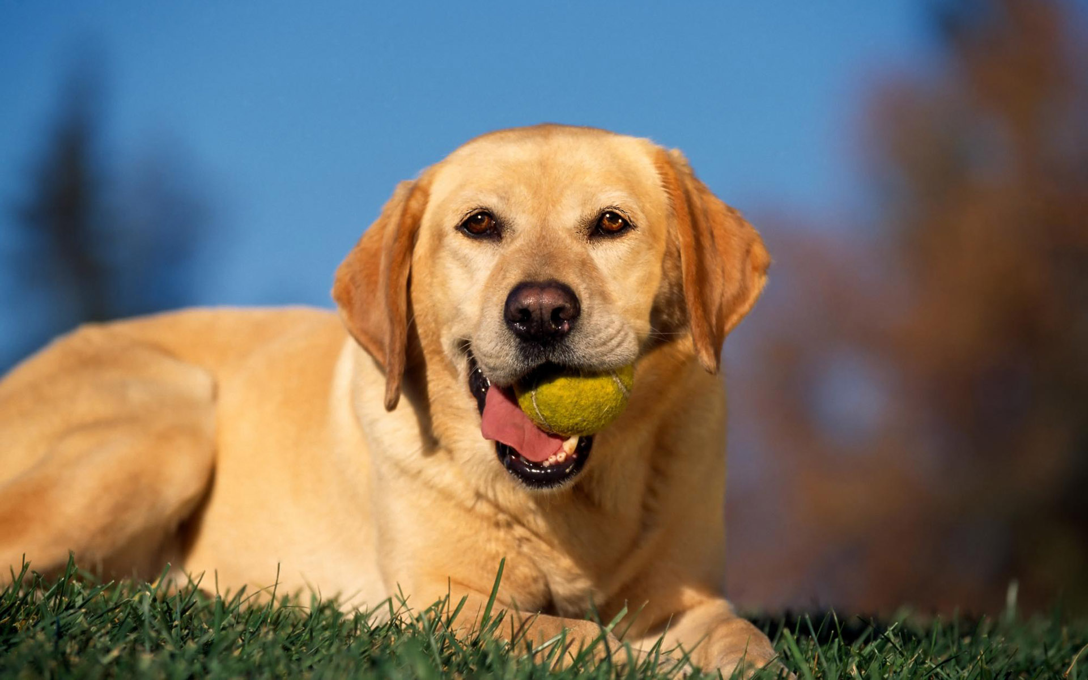
D is for Dog and for Doggy. I have a dog, not a doggy.
D

Slide 7
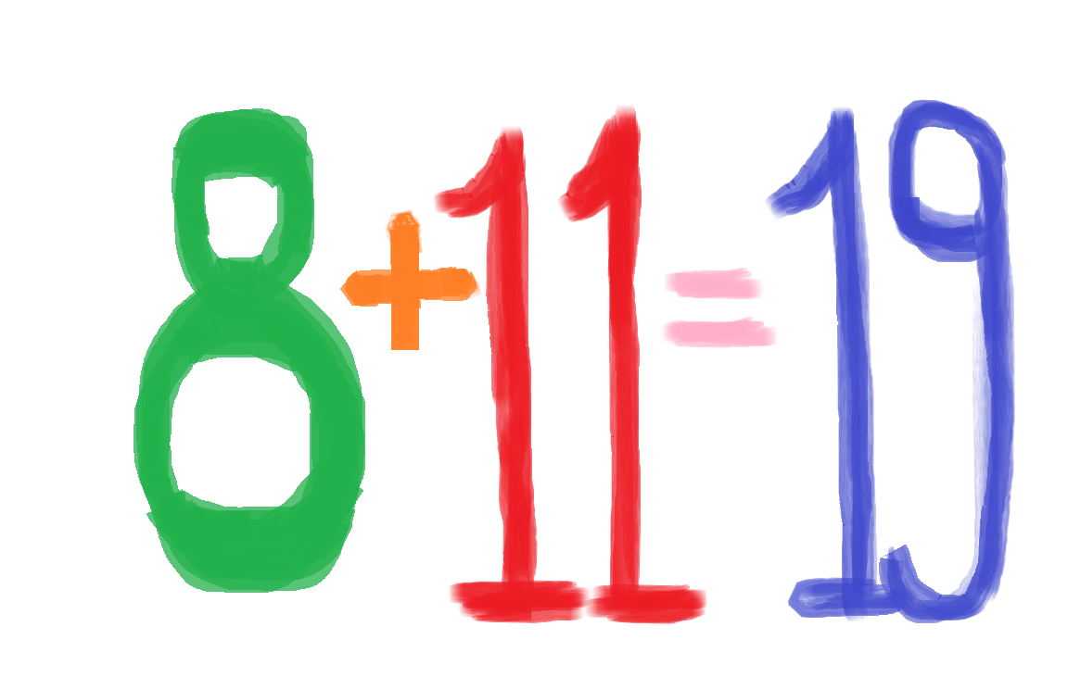
E is for eight and for eleven. How much is eight and eleven?
E

Slide 8
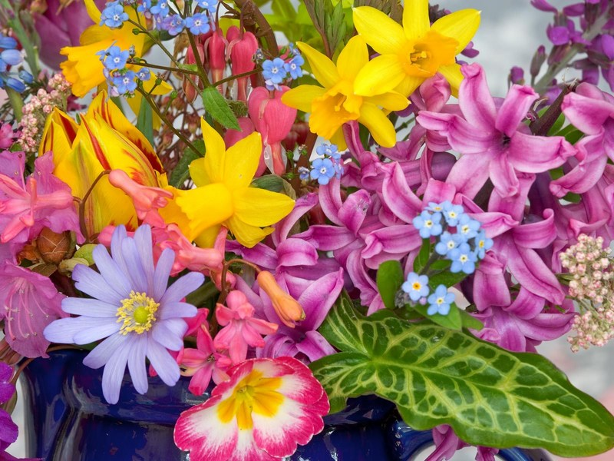
F is for flowers: red and blue, White and yellow and rosy, too.
F

Slide 9
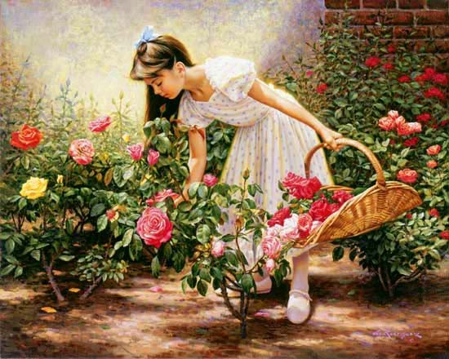
G is for Girl, and also for garden. I see a girl going to the garden.
G

Slide 10
H is for hand. I have two hands. This is the way I clap my hands.
H

Slide 11
I is for I. I’m a boy, and I’m ten. I like to play with my brother Ben.
I

Slide 12
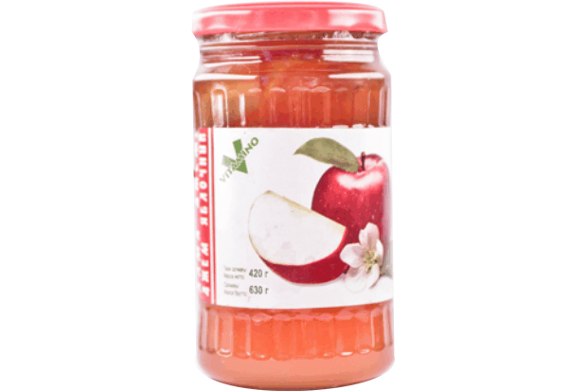
J is for Jam. This is apple jam. Jimmy likes it, and so does Sam.
J

Slide 13
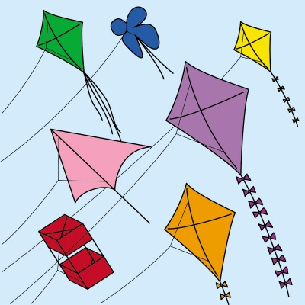
K is for kite. Kate has a kite. It is little, and it is white
K

Slide 14
L is for letter. This letter is for me. It is from my sister, as you can see.
L

Slide 15
M is for May and for May Day. For March and for Mother’s day.
M

Slide 16
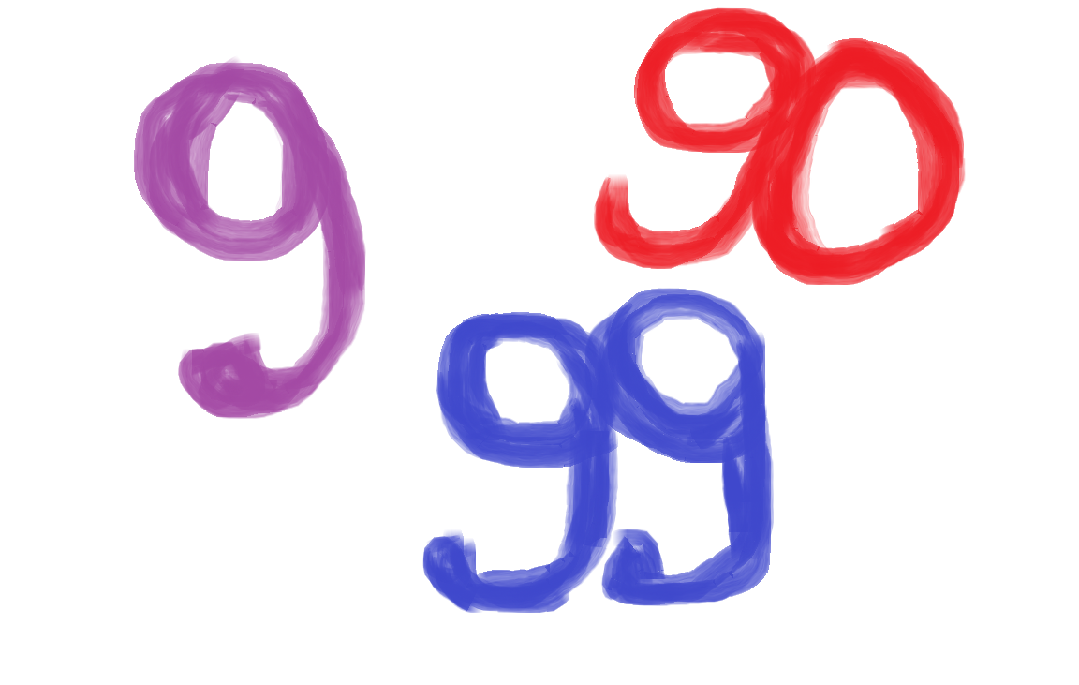
N is for nine, ninety and ninety-nine. Children, how much is ninety and nine?
N

Slide 17
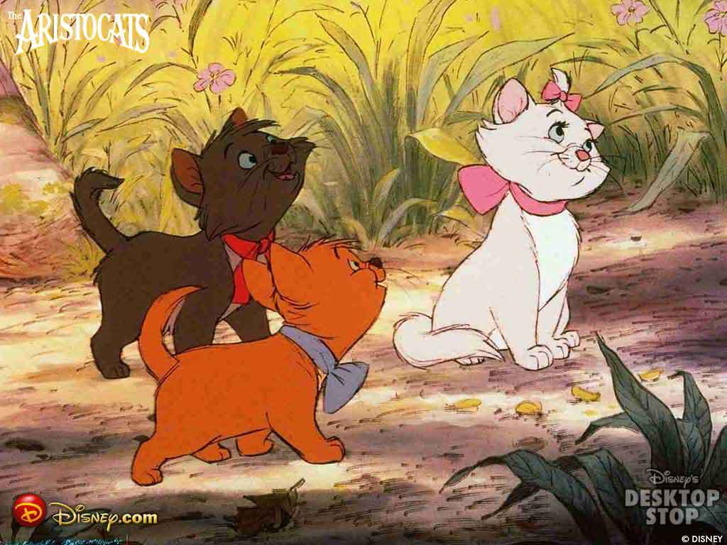
O is for one. One and two is three. Three little cats are in a tree.
O

Slide 18
P is for pencils. With them I draw: a red pen, a green tree and a blue door.
P

Slide 19
Q is for Questions. How are you? How old are you?And how do you do?
Q

Slide 20
R is for red. Many things are red. What can be red? Do you know, Fred?
R

Slide 21
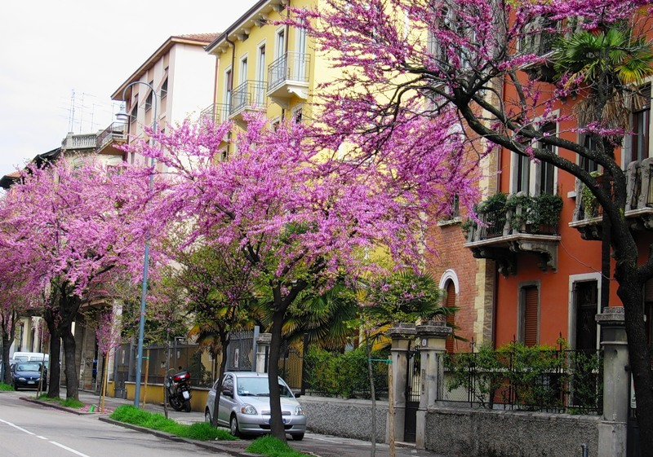
S is for street. This is my street. I have many trees in my street.
S

Slide 22
T is for Tick and for Tock. “Tick-tock”, - says the clock.
T

Slide 23
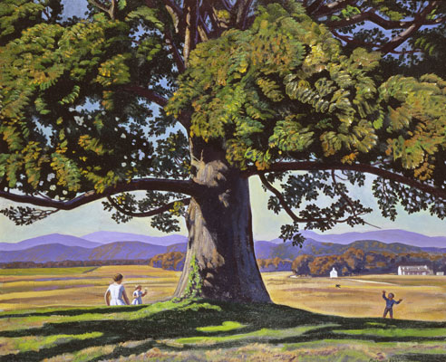
U is for Under, but not for At. “I’m under the tree”, - says Pat.
U

Slide 24
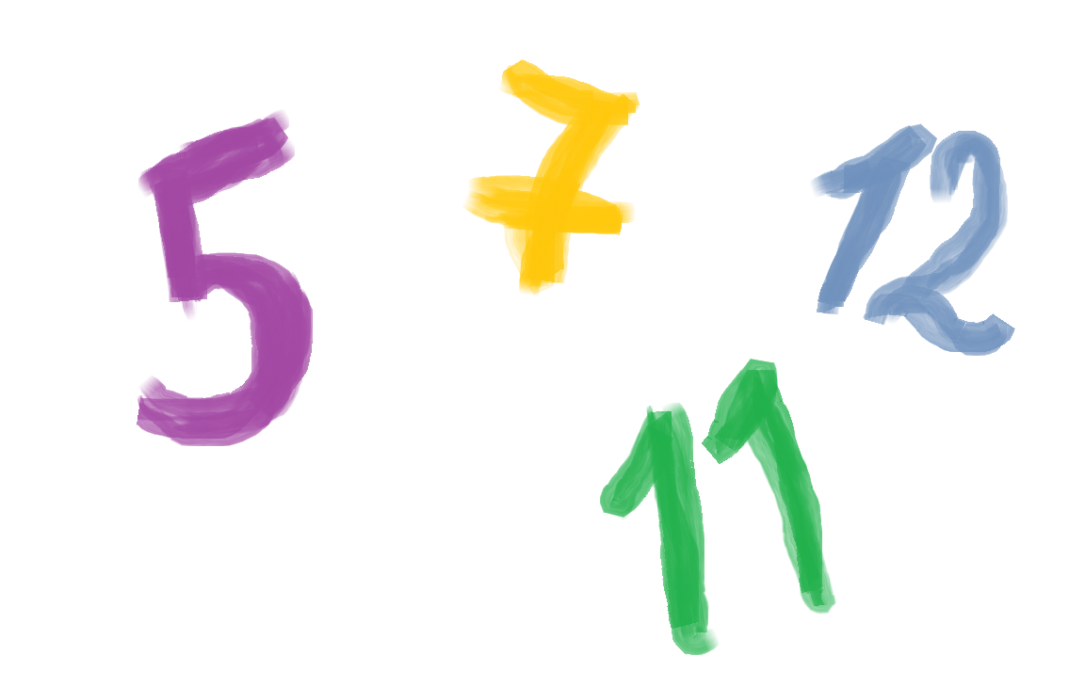
V is in five and also in seven. It is in twelve and eleven
V

Slide 25
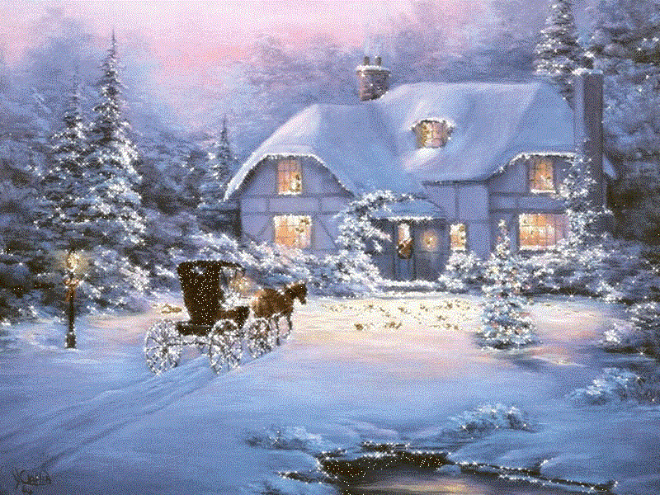
W is for Winter, when it is cold. But I like winter and I like cold.
W

Slide 26
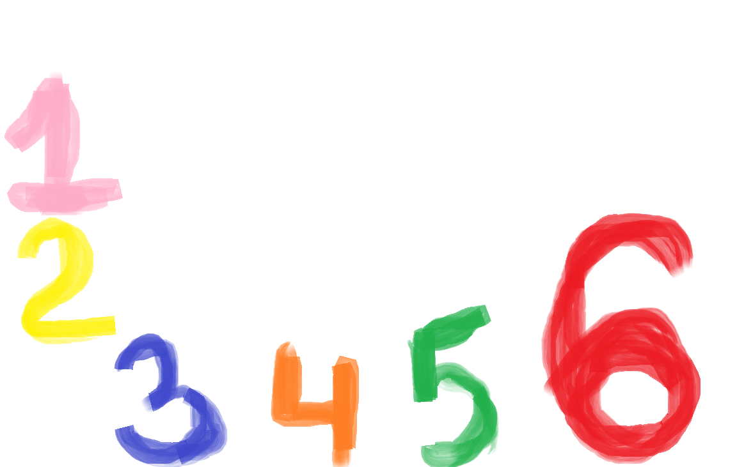
X is in six. Let’s count up to six! One, two, three, four, five, six!
x

Slide 27
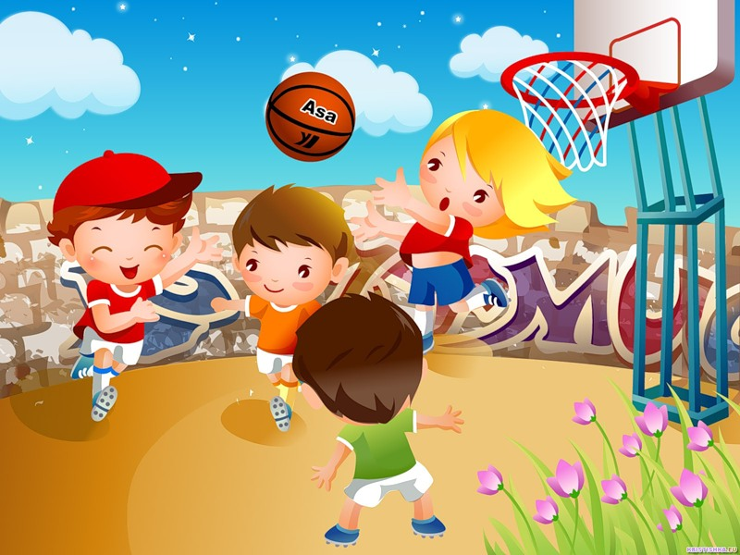
Y is for Yard where children play. They play in the yard every day.
Y

Slide 28
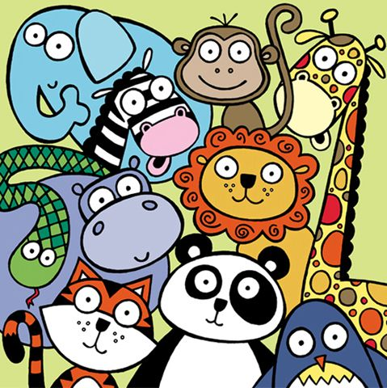
Z is for zoo. Let’s go to the Zoo. I like to go to the Zoo. And you?
Z

Slide 30
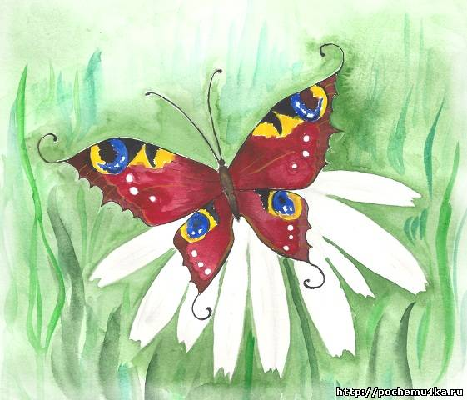

Slide 33
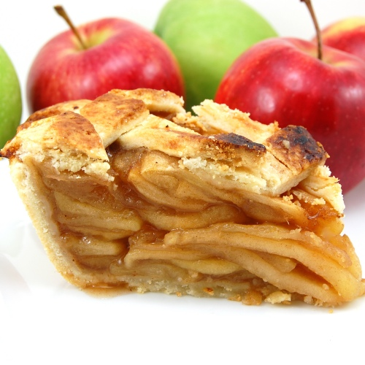
A was once an apple pie,
Pidy
Widy
Tidy
Pidy
Nice insidy
Apple pie!

Slide 34
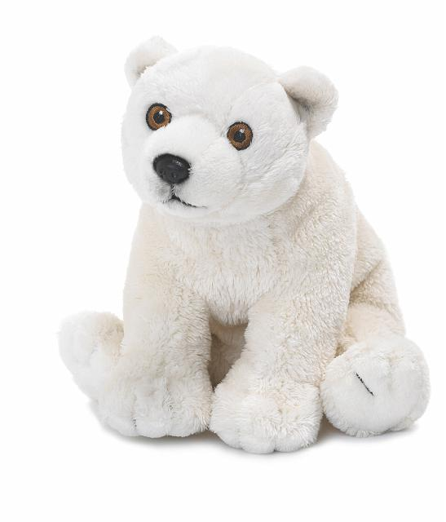
B was once a little bear,
Beary!
Wary!
Hairy!
Beary!
Take cary!
Little bear!

Slide 35
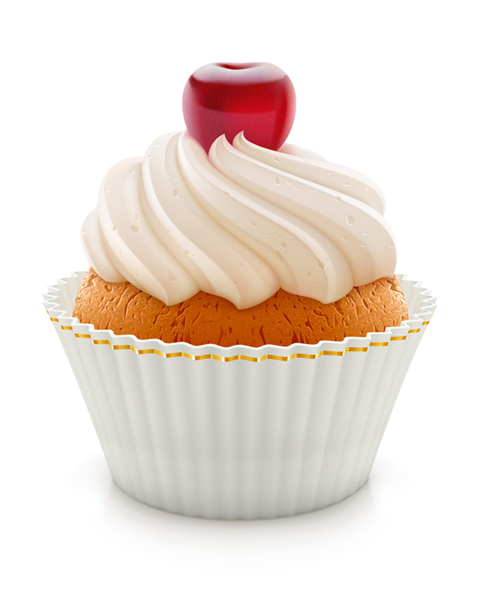
C was once a little cake
Caky
Baky
Maky
Caky
Taky caky,
Little Cake!

Slide 36
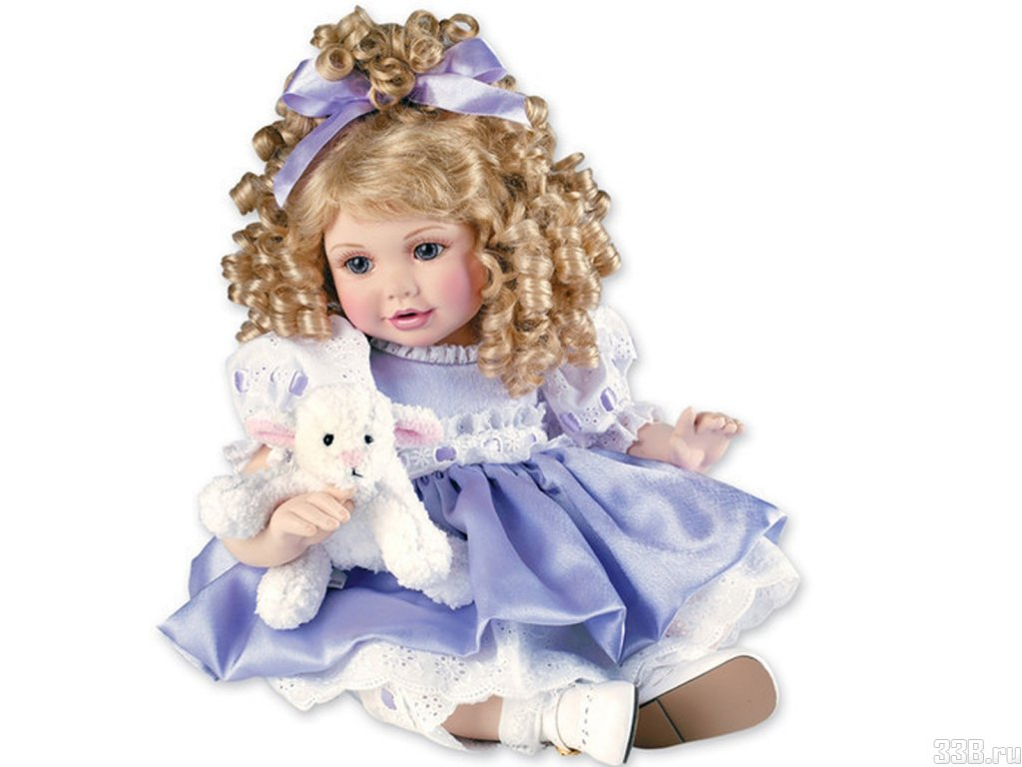
D was once a little doll,
Dolly
Molly
Polly
Nolly
Nursy Dolly
Little Doll!

Slide 37
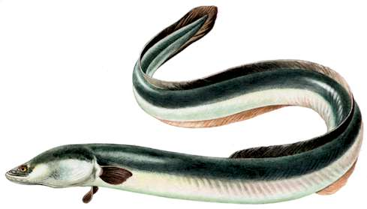
E was once a little eel,
Eely,
Weely
Peely
Eely
Twirly,tweedy
Little Eel!

Slide 38
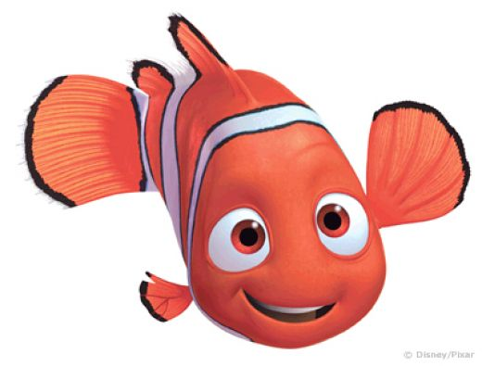
F was once a little fish,
Fishy
Wishy
Squishy
Fishy
In a Dishy
Little fish!

Slide 39
G was once a little goose,
Goosy,
Moosy
Boosy
Goosey
Waddly 0woosy
Little Goose!

Slide 40
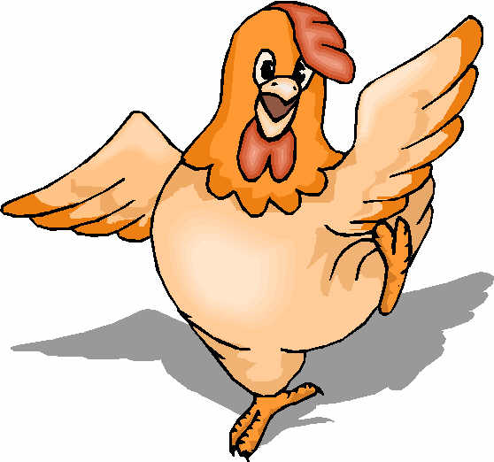
H was once a little hen,
Henny
Chenny
Tenny
Henny
Eggs-any
Little Hen?

Slide 41
I was once a bottle of ink,
Inky
Dinky
Thinky
Inky
Black Minky
Bottle of Ink!

Slide 42
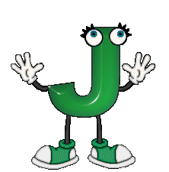
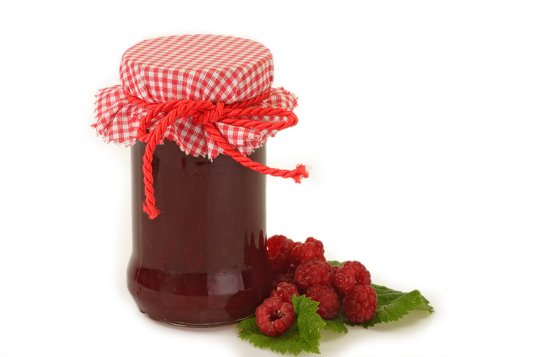
J Was once a jar of jam,
Jammy
Mammy
Clammy
Jammy
Sweety-Swammy
Jar or Jam!

Slide 43
K was once a little kite,
Kity
Whity
Flightly
Kity
Out of sighty-
Little Kite!

Slide 44
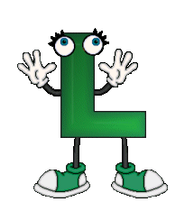
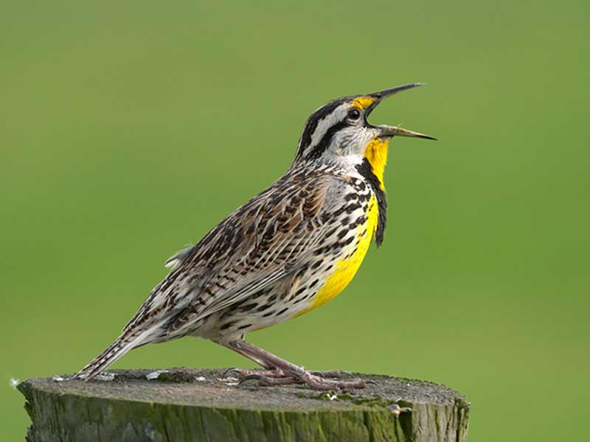
L was once a little lark,
Larky!
Marky!
Harky!
Larky!
In the parky,
Little Lark!

Slide 45
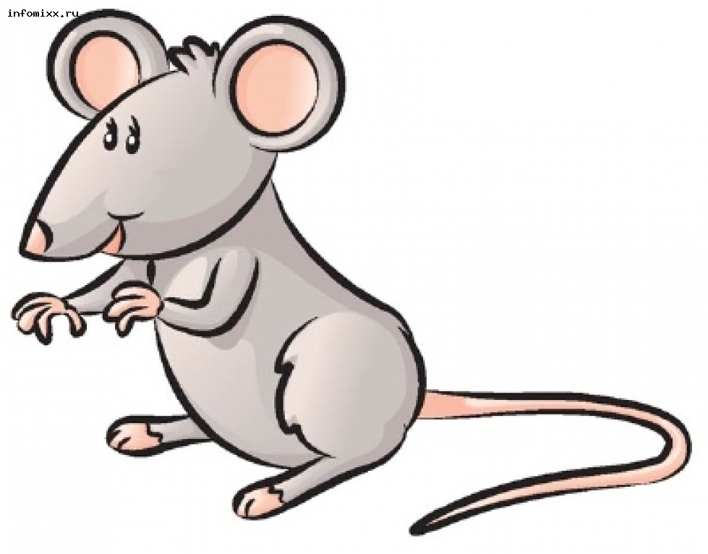
M was once a little mouse,
Mousey
Bousey
Sousy
Mousy
In the Housy
Little Mouse!

Slide 46
N was once a little needle,
Needly
Tweedly
Threedly
Needly
Wisky-wheedly
Little needle!

Slide 47
O was once a little owl,
Owly
Prowly
Howly
Owly
Browny fowly
Little owl!

Slide 48
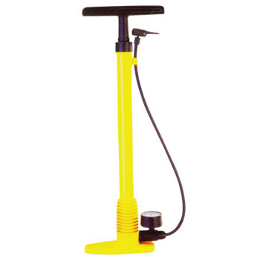
P was once a little pump
Pumpy
Slumpy
Flumpy
Pumpy
Dumpy,Thumpy
Little Pump!

Slide 49
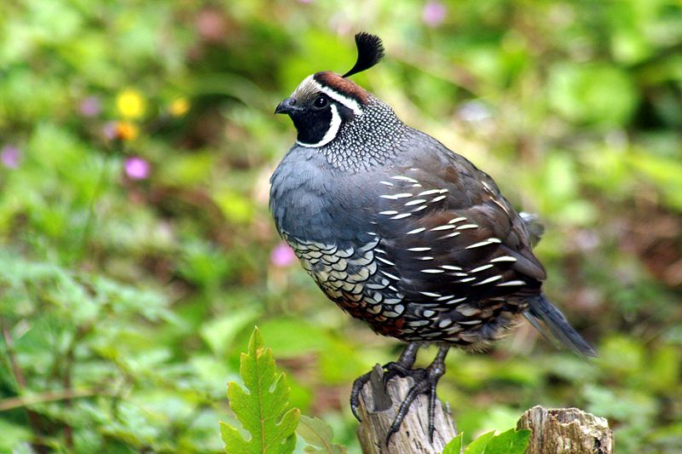
Q was once a little quail,
Quaily
Faily
Daily
Quaily
Stumpy-taily
Little Quail!

Slide 50
R was once a little rose,
Rosy
Posy
Nosy
Rosy
Bows-y-grows-y
Little Rose!

Slide 51
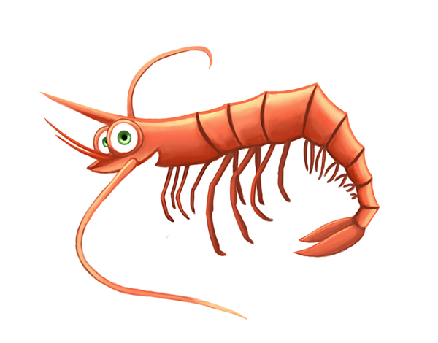
S was once a little shrimp,
Shrimpy
Nimpy
Flimpy
Shrimpy
Jumpy-jimpy
Little Shrimp!

Slide 52
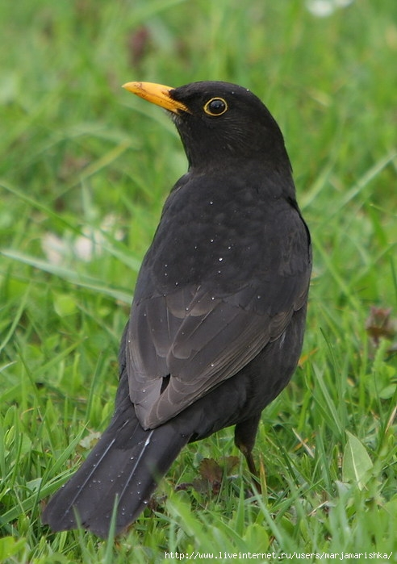
T was once a little thrush,
Thrushy!
Hushy!
Bushy!
Thrushy!
Flitty-Flushy
Little Thrush!

Slide 53
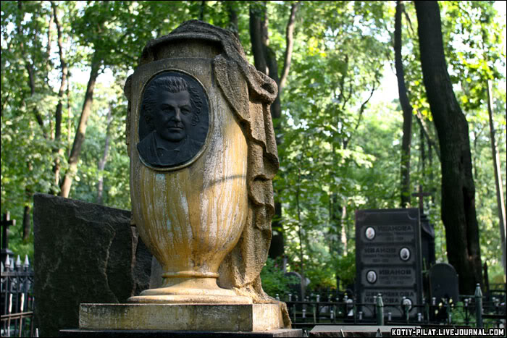
U was once a little urn,
Urny
Burny
Turny
Urny
Bubby-burnUy
Little Urn!

Slide 54
V was a little vine,
Viny
Winy
Twiny
Viny
Twisty-twiny
Little Vine!

Slide 55
W was once a little whale,
Whaly
Scaly
Shaly
Whaly
Tumby-taily
Mightly Whale!

Slide 56
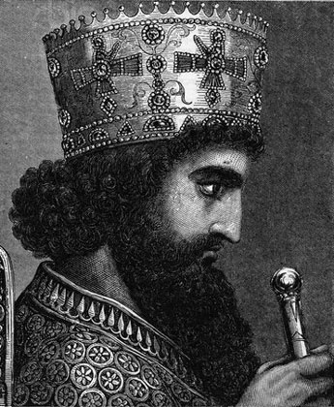
X was once a great
king Xerxes,
Xerxy
Perxy
Turxy
Xerxy
Linxy Lurxy
Great King Xerxes!

Slide 57
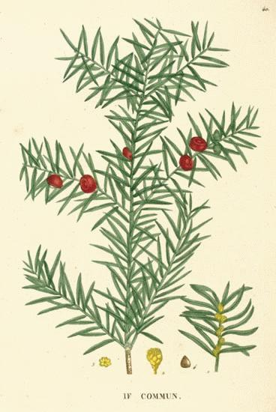
Y was once a little yew,
Yewdy
Fewdy
Crudy
Yewdy
Growdy,grewdy,
Little Yew

Slide 58
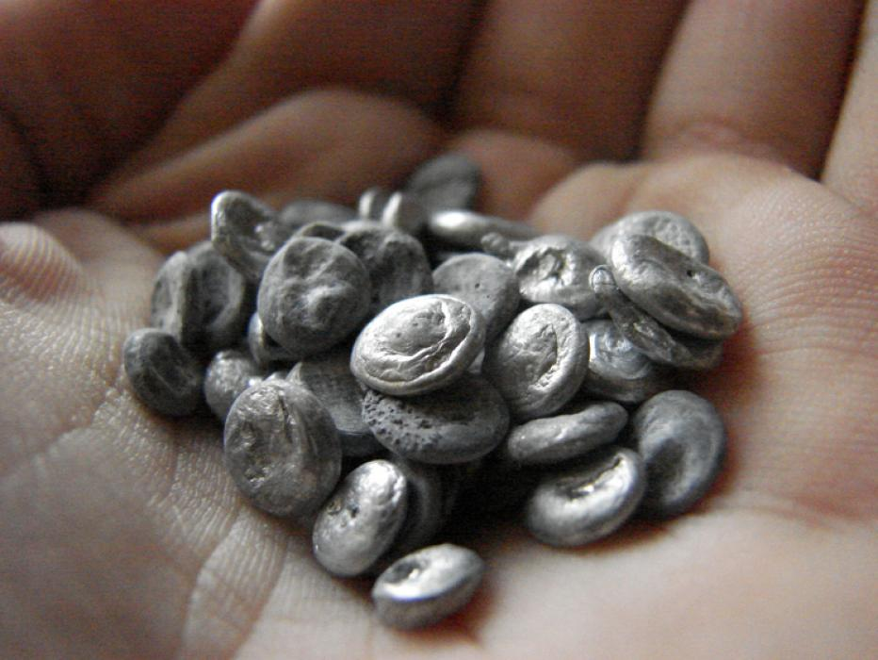
Z was once a piece of zinc,
Tinky
Winky
Blinky
Tinky
Tinkly Minky
Piece of Zinc!

Slide 60
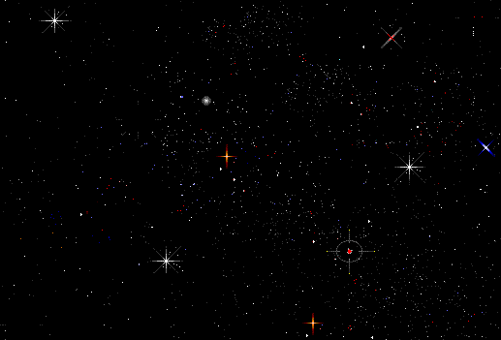

Slide 62
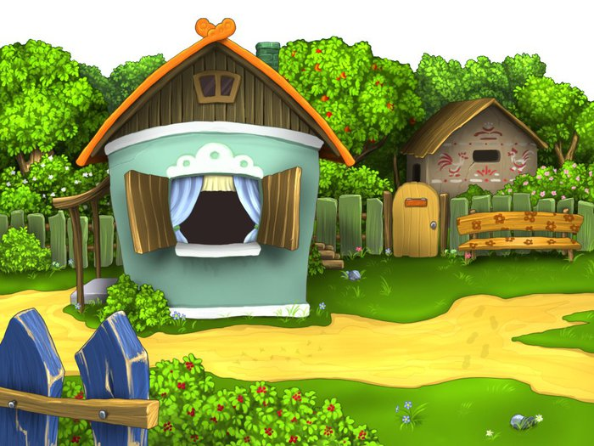

Slide 63
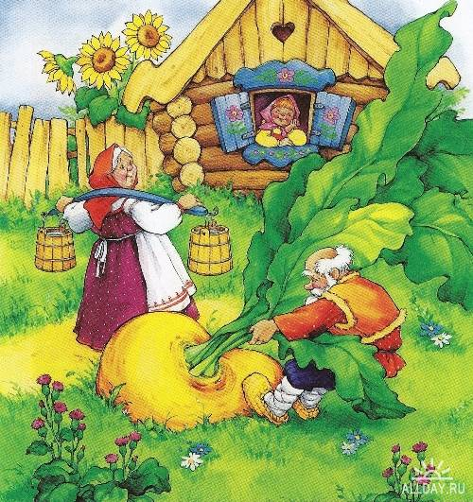

Slide 64
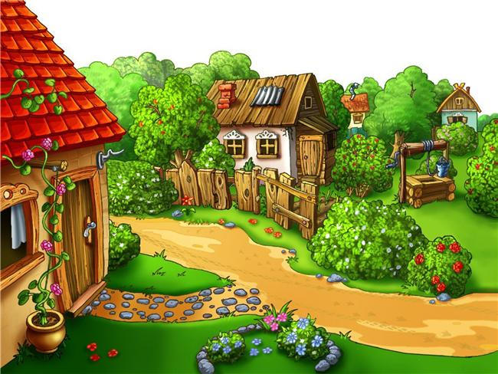

Slide 66
Rainbow purple , rainbow blue ,
Rainbow green and yellow , too.

Slide 67
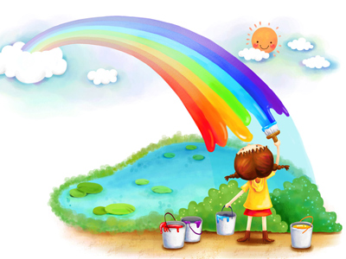
Rainbow orange , rainbow red ,
Rainbow shining over head.

Slide 68
Come and count the colours with me.
How many colours can you see?
One , two , three , on down to green ,
Four , five , six colours can be seen!

Slide 69
Rainbow purple , rainbow blue ,
Rainbow green and yellow , too.

Slide 70
Rainbow orange , rainbow red ,
Rainbow shining over head.

