Slide 1
Тема «Путешествие» Контрольное задание по теме «Великобритания»
(тест)
Автор: А.А.Ли
Учитель ГОУ СОШ №731, Москва

Slide 2
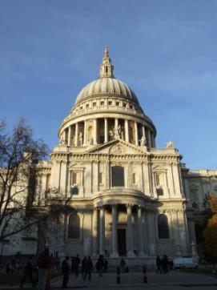
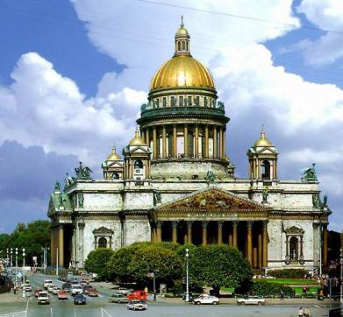
Which of this cathedrals is situated in England?
1
2

Slide 3
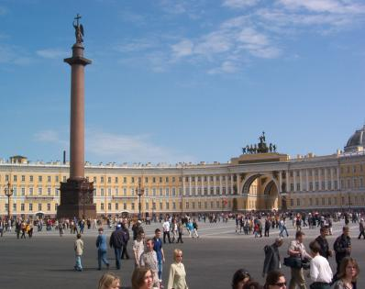
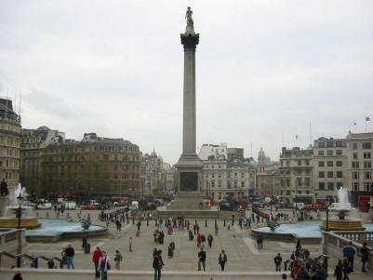
One of this squares is located in London. Which one?
1
2

Slide 4
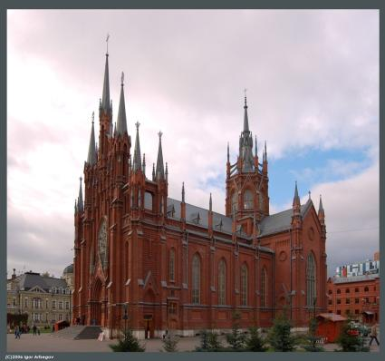
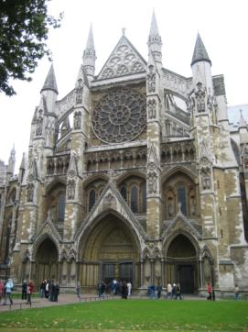
Which of this sights is situated in Britain?
1
2

Slide 5
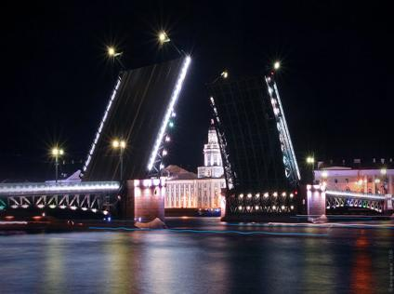
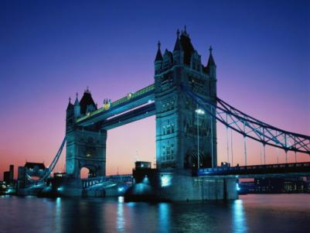
Which of this bridges goes over the Thames?
1
2
1

Slide 6
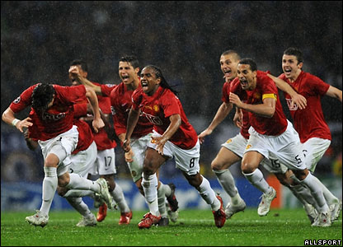
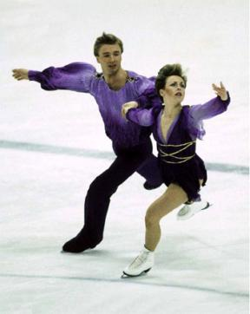
Which sport is the most popular in Britain?
2
1

Slide 7
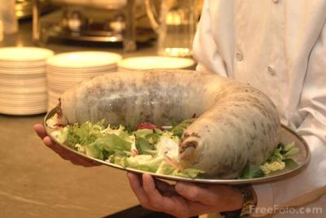
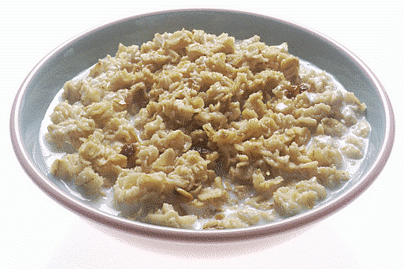
What meal do the British eat for breakfast?
1
2

Slide 8
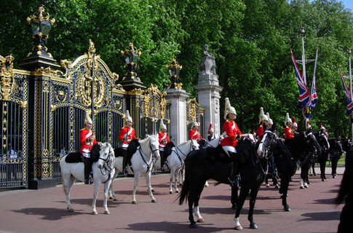
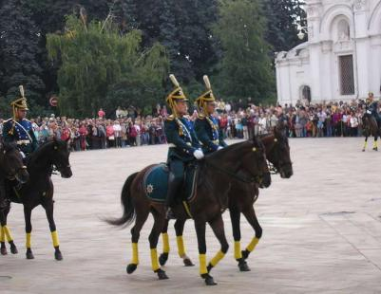
Queen’s guardsman is on the left/right.
2
1

