Slide 1
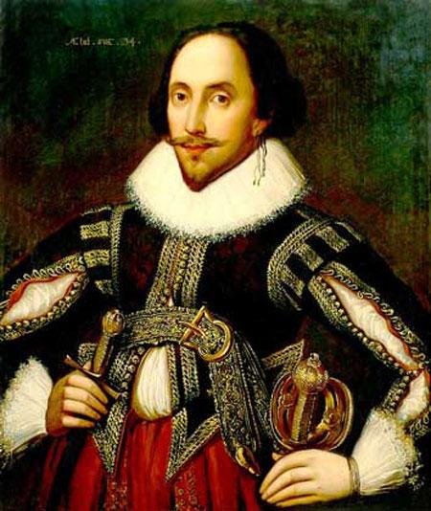
WILLIAM SHAKESPEARE
William Shakespeare, was born on April 26, 1564, in Stratford-upon-Avon, England.
English poet, dramatist, and actor, often called the English national poet and considered by many to be the greatest dramatist of all time.

Slide 2
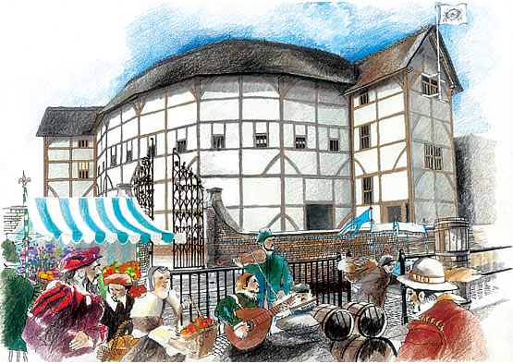
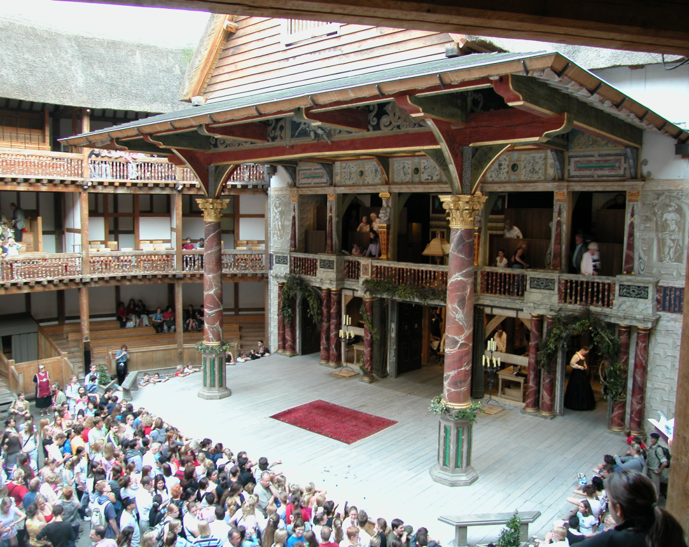
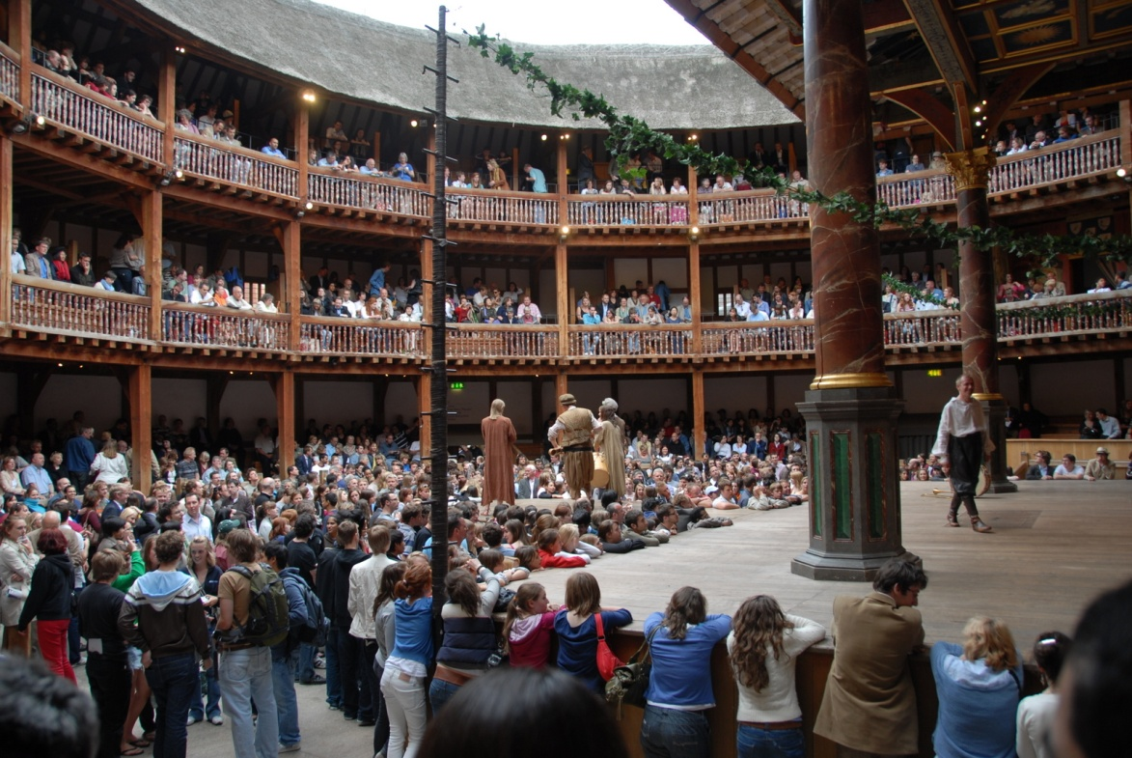
GLOBE THEATRE
The Globe Theatre was a theatre in London associated with William Shakespeare. It was built in 1599 by Shakespeare's playing company, the Lord Chamberlain's Men.

Slide 3
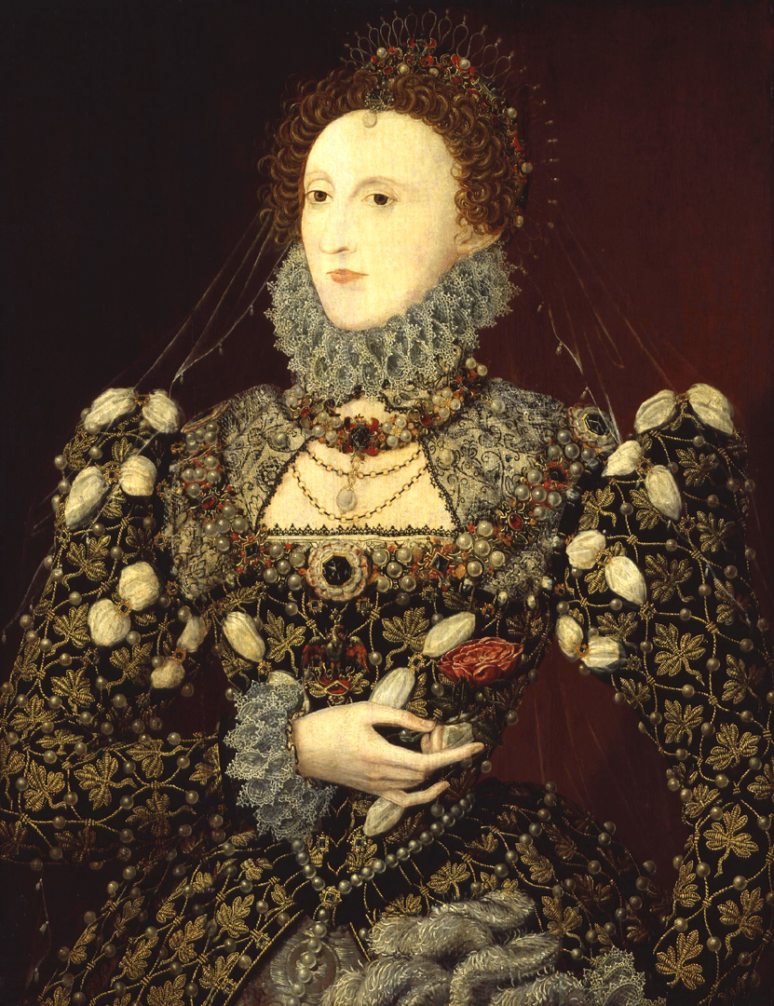
QUEEN ELIZABETH I OF ENGLAND
Elizabeth I (7 September 1533 – 24 March 1603)
Elizabeth's reign is known as the Elizabethan era, famous above all for the flourishing of English drama, led by playwrights such as William Shakespeare and Christopher Marlowe.

Slide 4
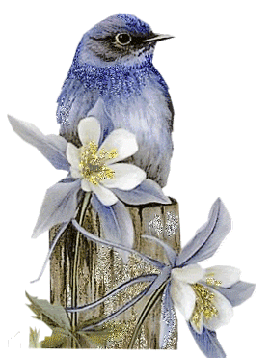
SHAKESPEARE’S SONNETS

Slide 5
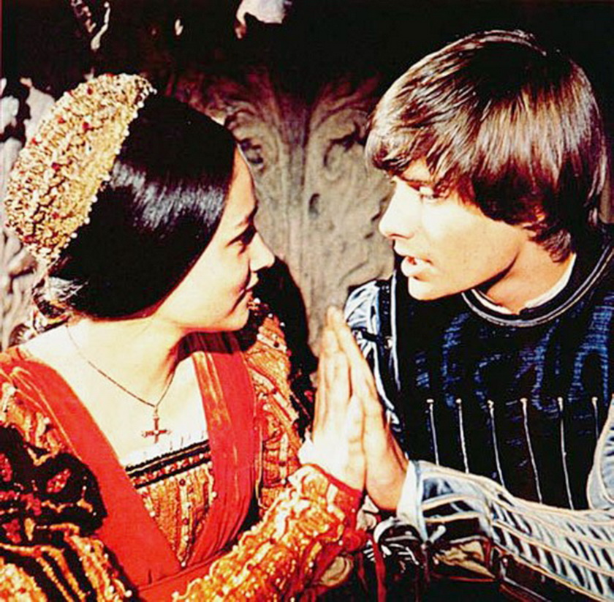
ROMEO AND JULIET

Slide 6
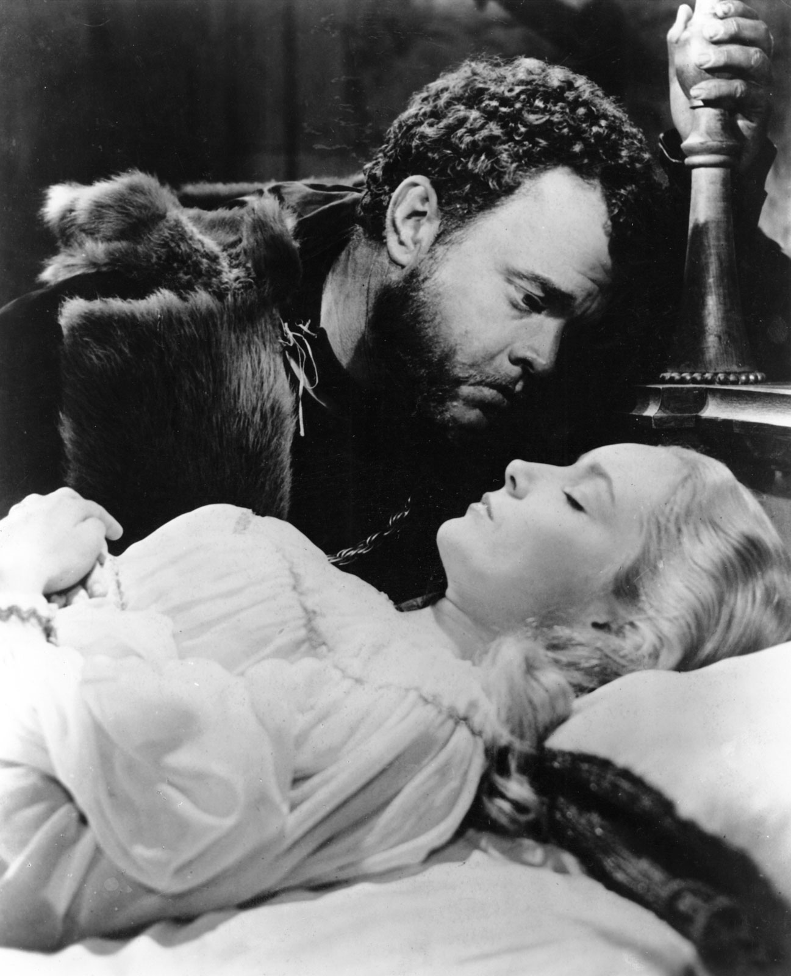
OTHELLO

Slide 7
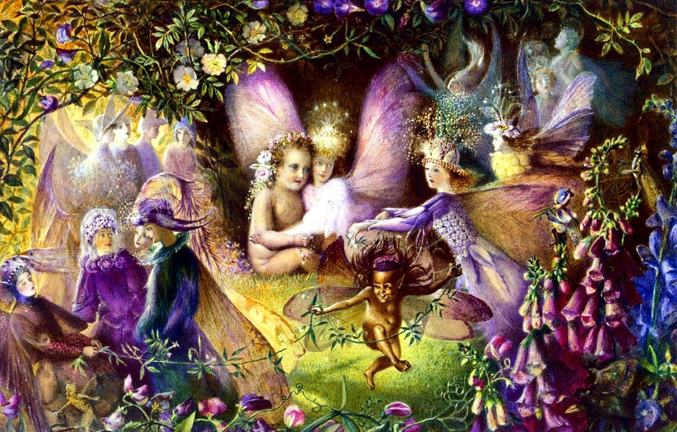
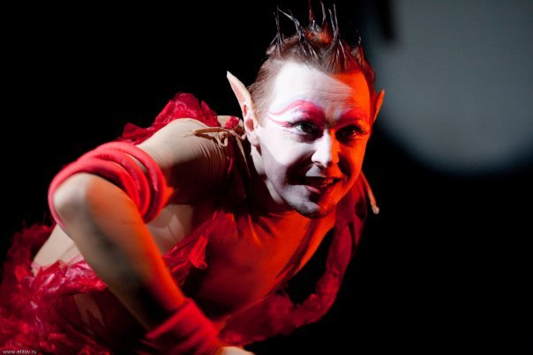
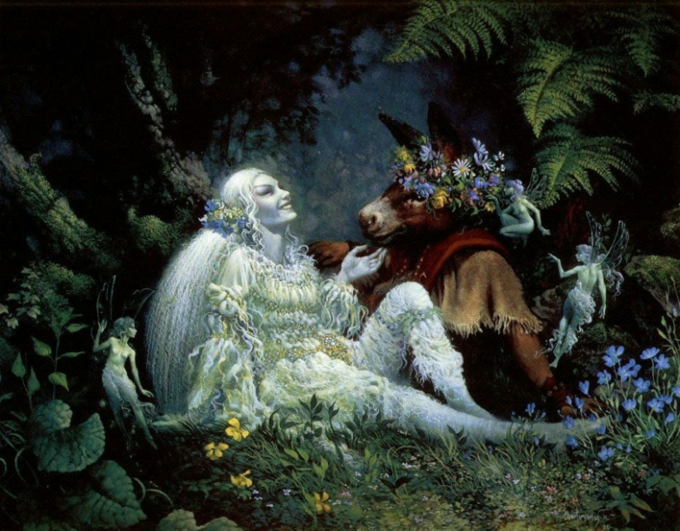
A MIDSUMMER-NIGHT’S DREAM

Slide 8
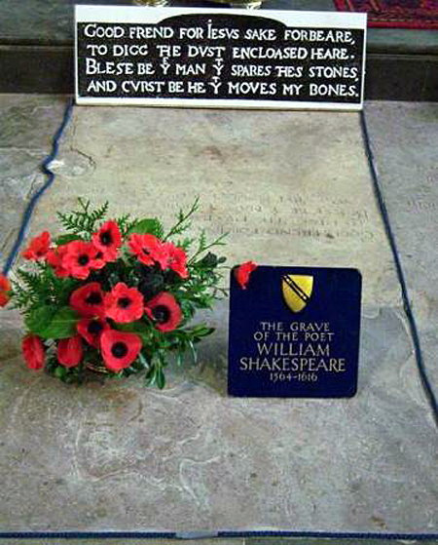
1564 - 1616

Slide 9
THANKS FOR YOUR ATTENTION

