Slide 1
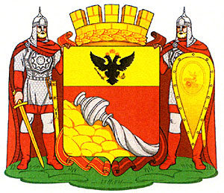
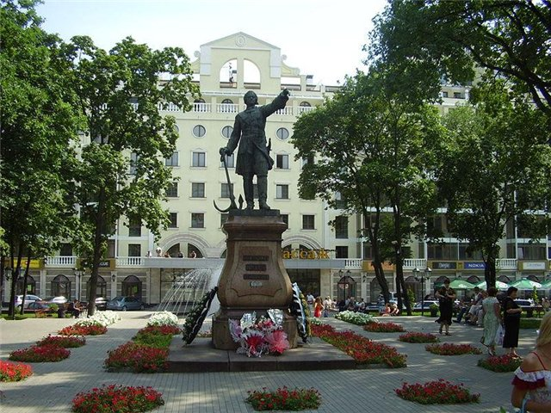
Welcome to voronezh

Slide 3
Доля опрошенных по странам
Общее число опрошенных
180 человек

Slide 4
Цель урока: взаимосвязанное коммуникативное и социокультурное развитие школьников средствами английского языка и ИКТ для подготовки к межкультурному общению.

Slide 5
Формирование различных видов чтения, умения анализировать, обобщать полученные знания, выделять главное;
Обогащение и активизация языкового запаса, развитие умений монологической и диалогической речи;
Формирование эмоционально-чувственного восприятия учащимися культуры и истории родного города;
Формирование навыков самоконтроля;
Повышение ИКТ - компетентности учащихся.

Slide 6
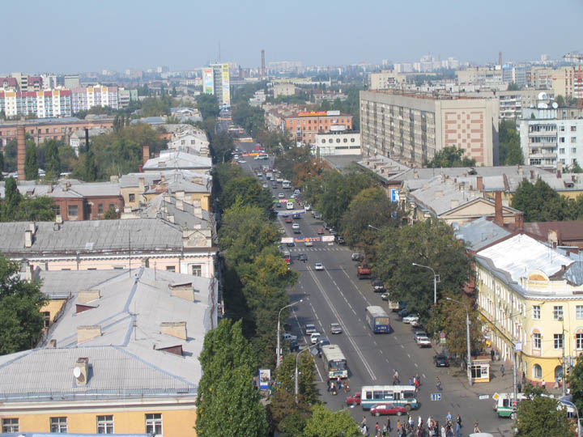
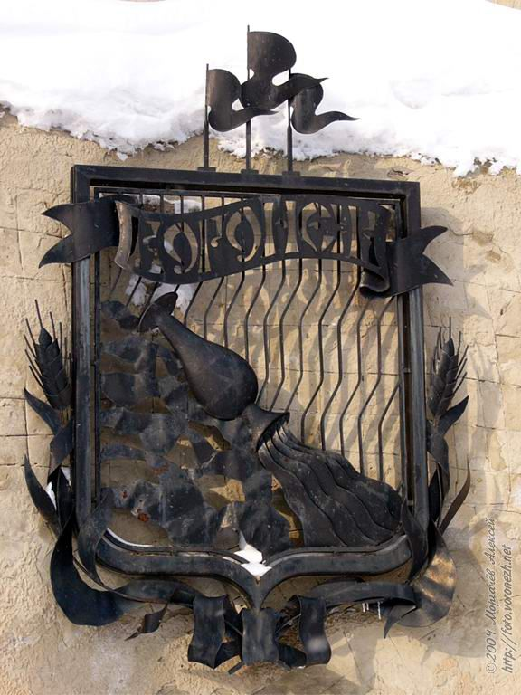
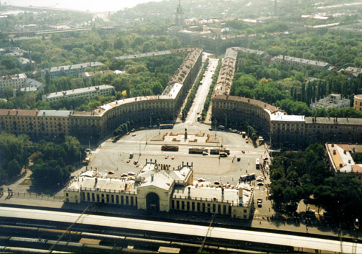
WHAT ABOUT VORONEZH?
POPOVA MARINA
PUZIKOVA YANA

Slide 7
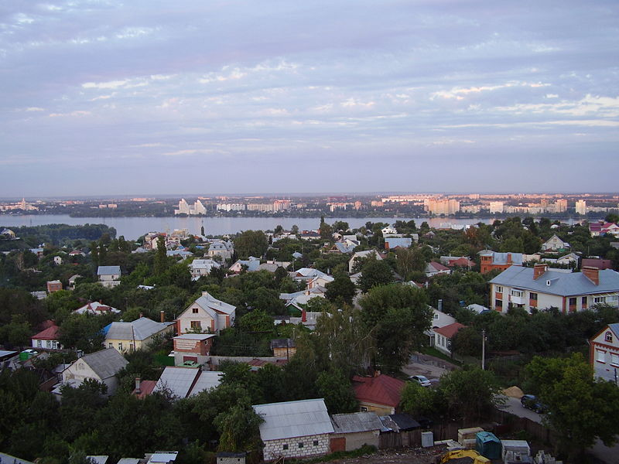
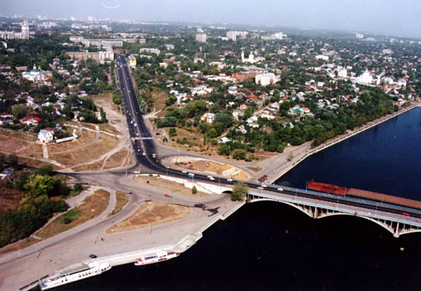
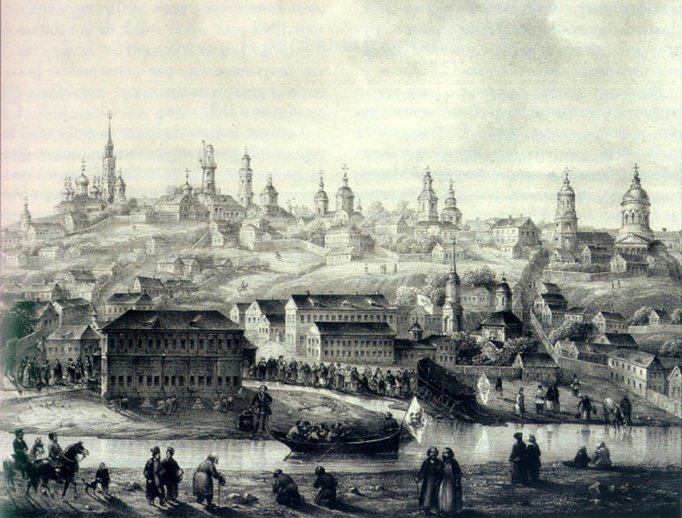
VORONEZH is a city in southwestern Russia. It was founded in 1586 by Feodor I as a fort protecting the Russian state from the raids of Tatars.

Slide 8
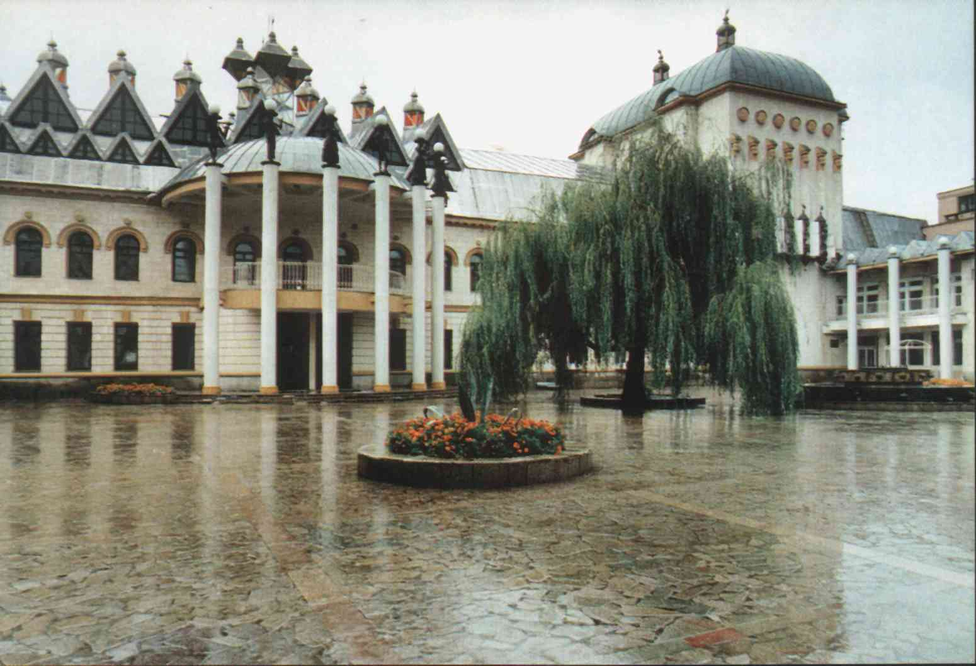
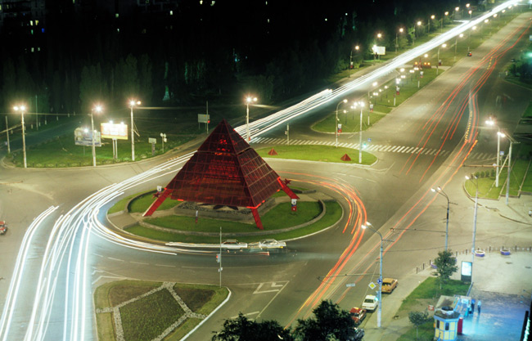
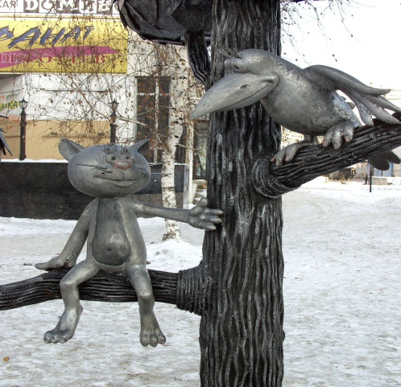
Voronezh today is one of the largest industrial, transport, distribution and cultural centers of Russia. There are few historical sights in the city. If you are a guest of Voronezh, go for a walk about the city.

Slide 9
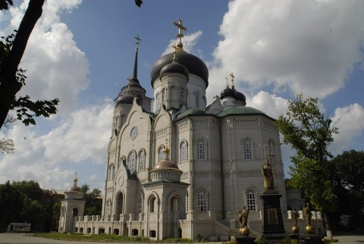
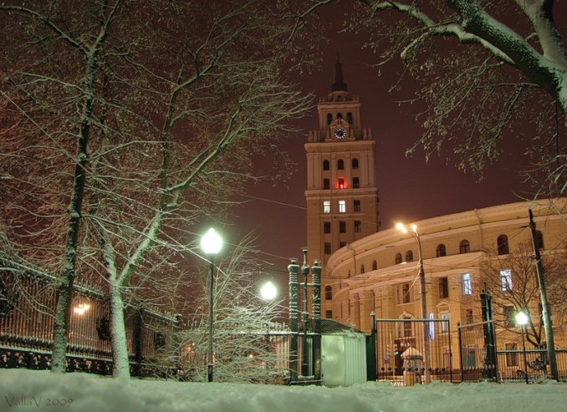
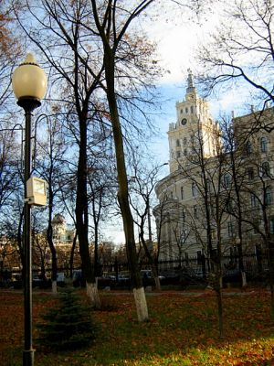
City (Pervomaisky) park It was laid out in 1840 between present P.Engels and Pheoktistov streets. the city garden keeps its former rectangular configuration. Diagonally it is crossed by alleys. Maples of the beginning of XX century have been preserved in the main alley. Blagoveschensky cathedral has been building along the axis of the garden since 1999.

Slide 10
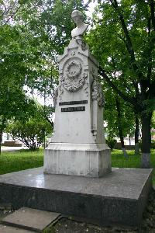
Monument to A.V.Koltsov It stands in the park, naming after the great Russian poet, a native of Voronezh, A.V.Koltsov. It was opened in 1868. It was made of white marble by Petersburg sculpture A.Triskorni. The monument represents a small bust, erected on the complex high pedestal. According to classicism traditions the poet’s appearance corresponds to antique patterns.

Slide 11
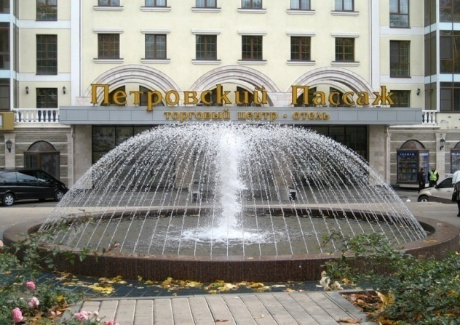
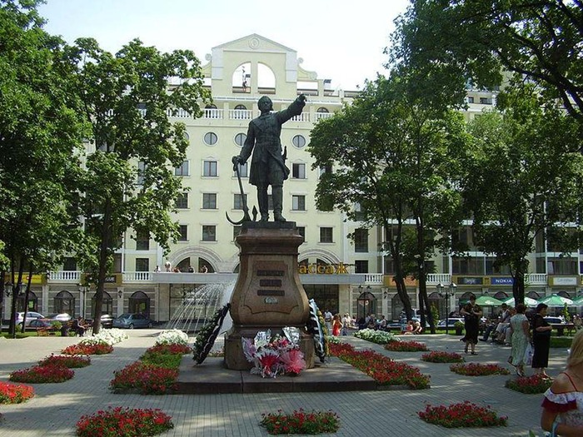
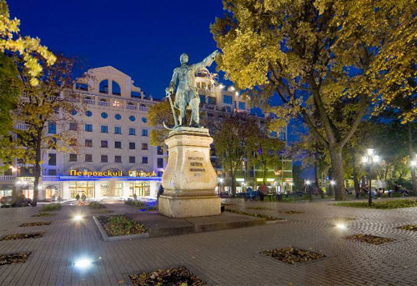
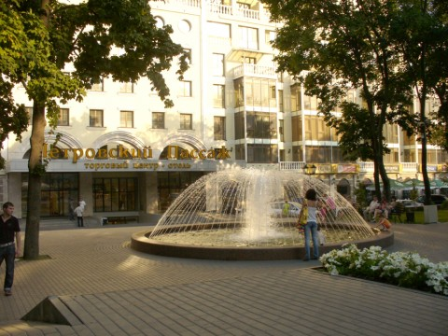
Petrovsky park.
The monument to Peter I
It is located in the middle of Petrovsky park, face to the avenue. The bronze monument was founded in Petersburg in 1880. The pedestal is made of red granite.

Slide 12
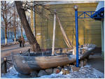
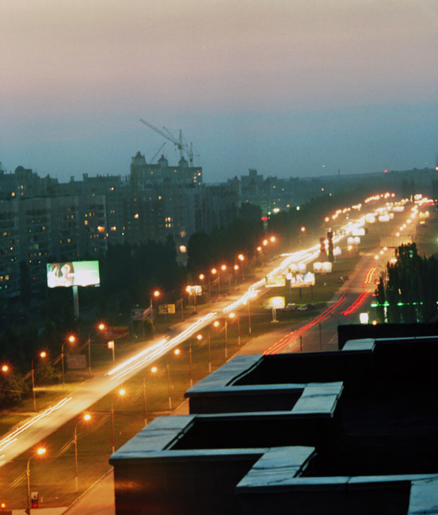
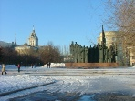
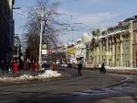
In Voronezh you can see аlso: - Prospekt Revolyutsii. Is the epicenter of Voronezh's life. It has many beautiful and historical buildings.

Slide 13
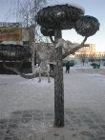
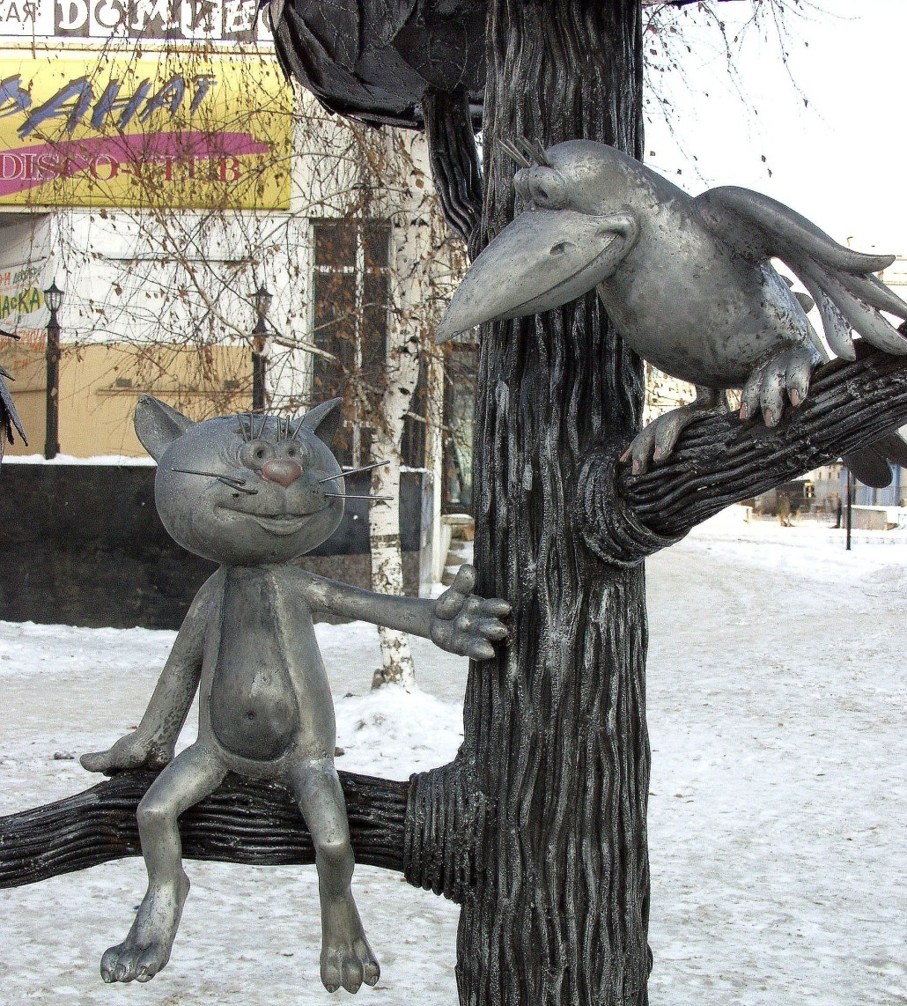
- The monument Kitten from Lizyukova street

Slide 14
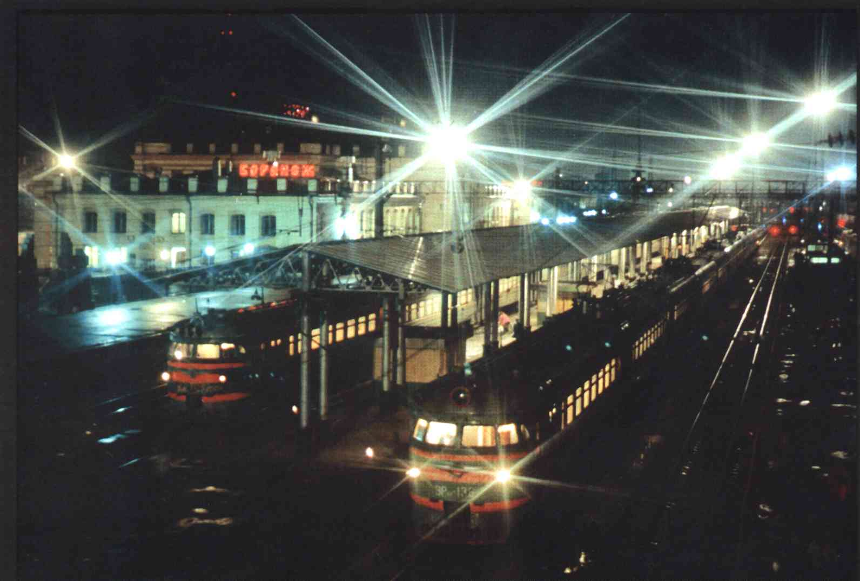
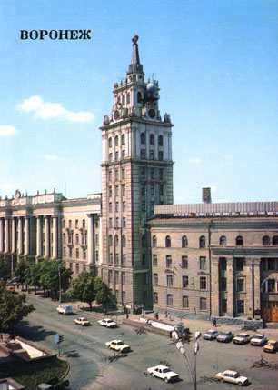
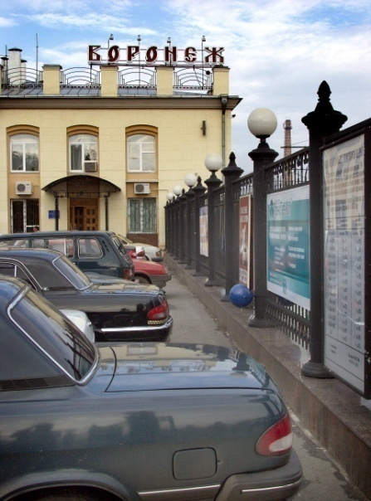
-The office of South-Eastern Railways (SERW), in Russian: YU-VE-ZHE-DE.

Slide 15
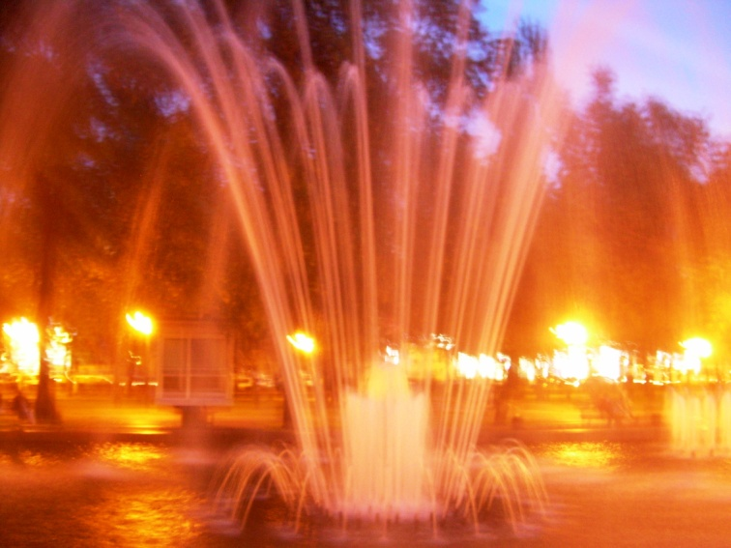
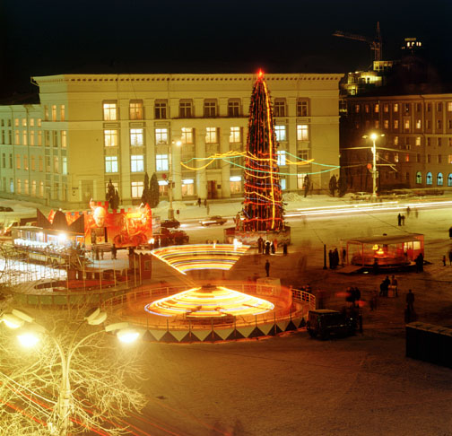
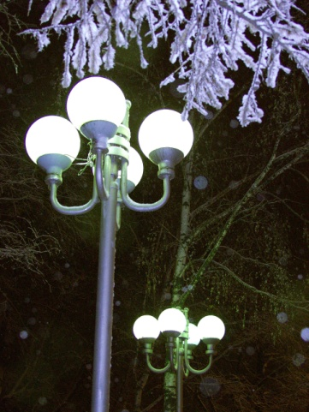
- The Lenin Square. - The park Koltsovskiy skver

Slide 16
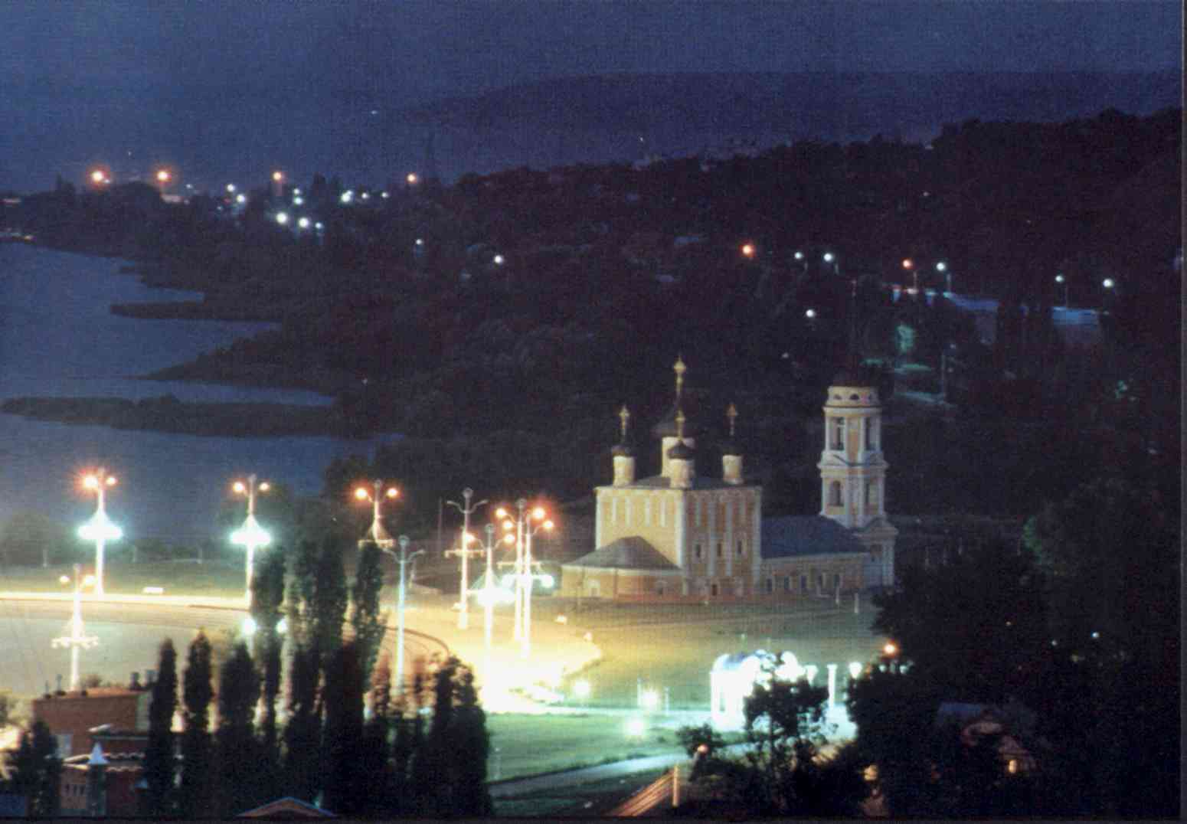
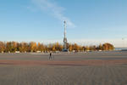
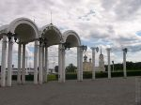
- The Admiralteyskaya square with the old church where Peter the Great baptized his ships.

Slide 17
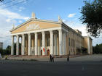
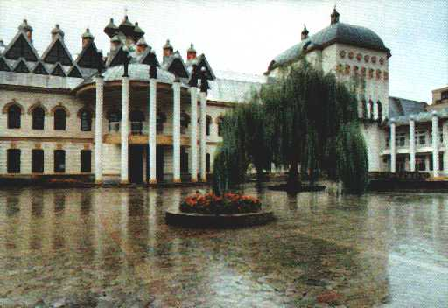
In Voronezh you can visit the Opera and the Ballet Theatre, the Puppet Theatre, the Philharmonic Society, the Russian Folk Choir, the Kramskoy's Fine Arts Museum, the Nikitin's Literary Museum and the Museum of Local Lore.

Slide 18
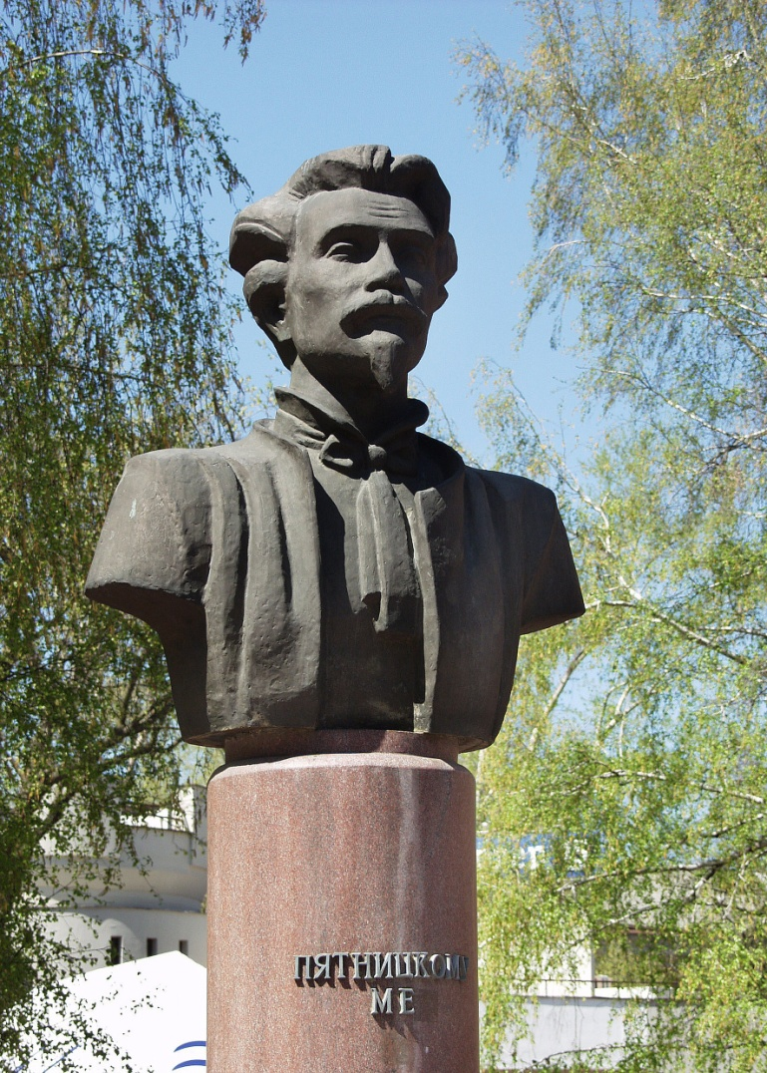
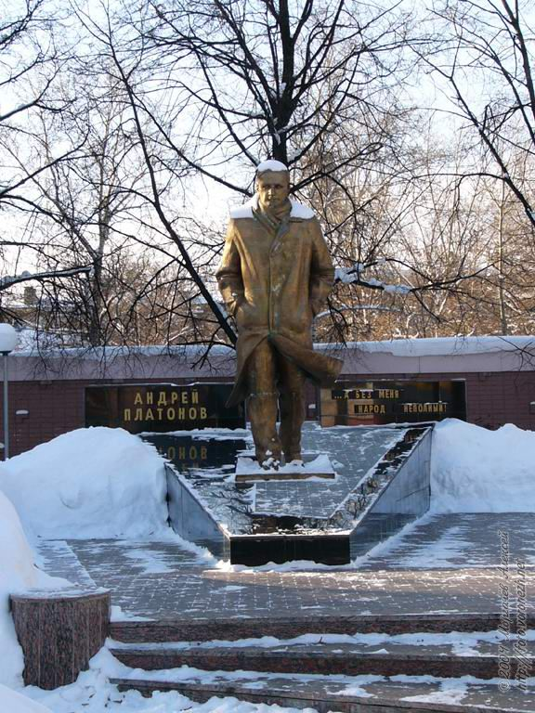
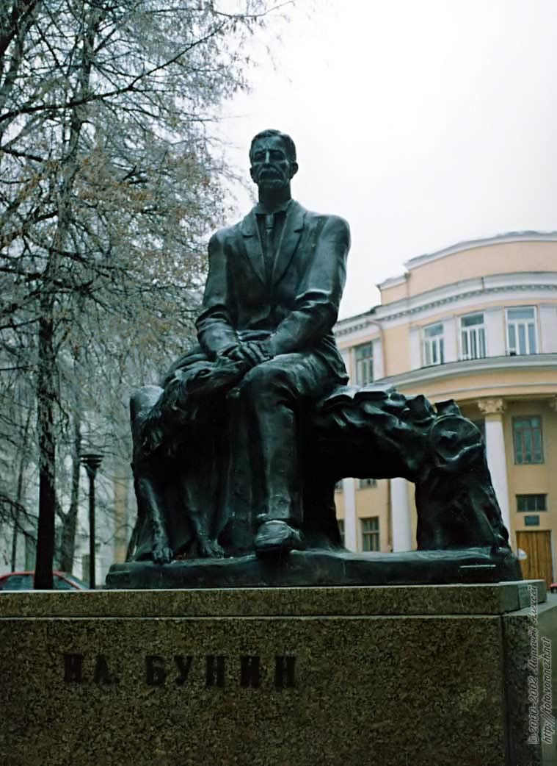
- Monuments to such writers and poets as Nikitin, Mandelshtam, Esenin, Pyatnickii, Platonov, Bunin.

Slide 19
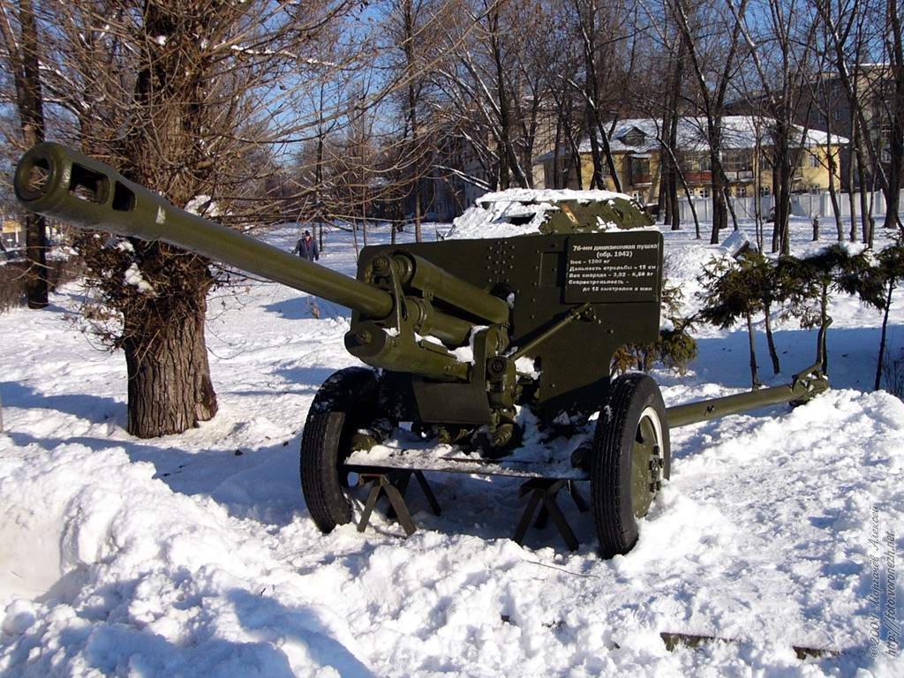
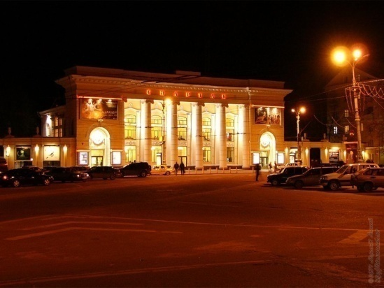
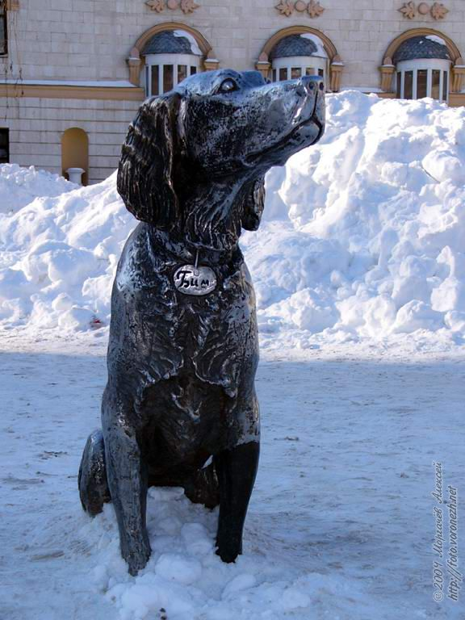
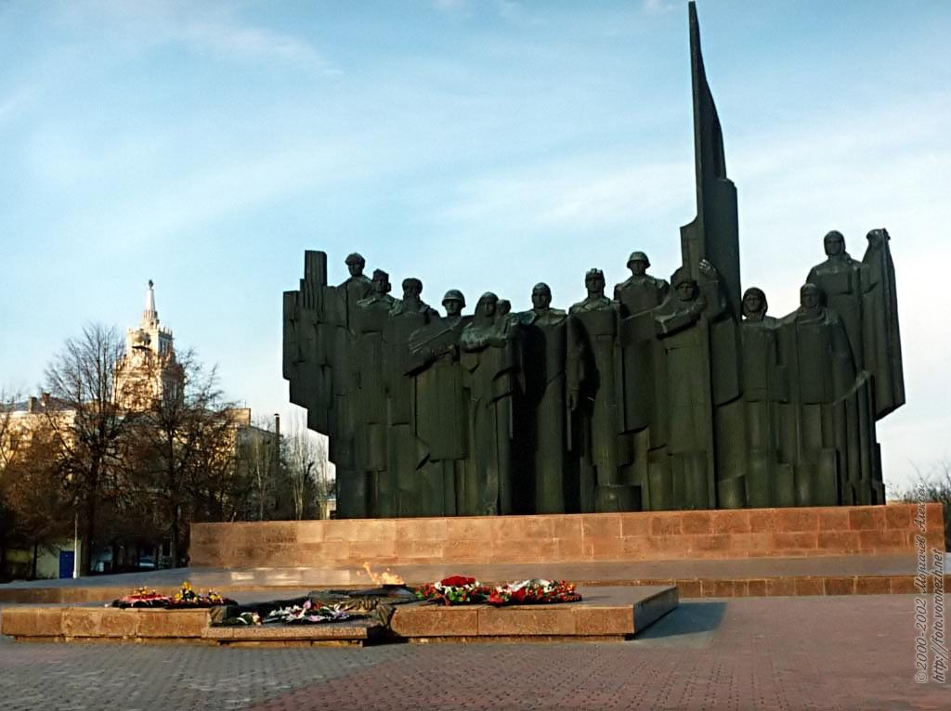
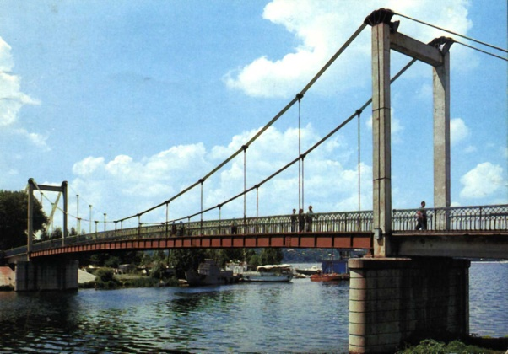
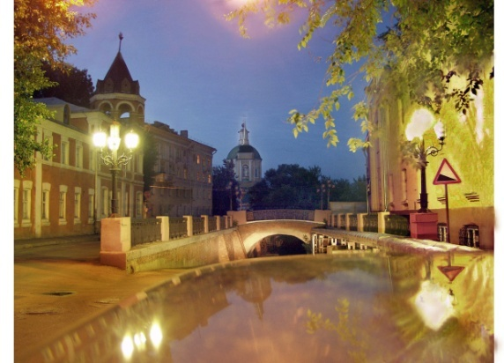
-and many others beautiful places.

Slide 20
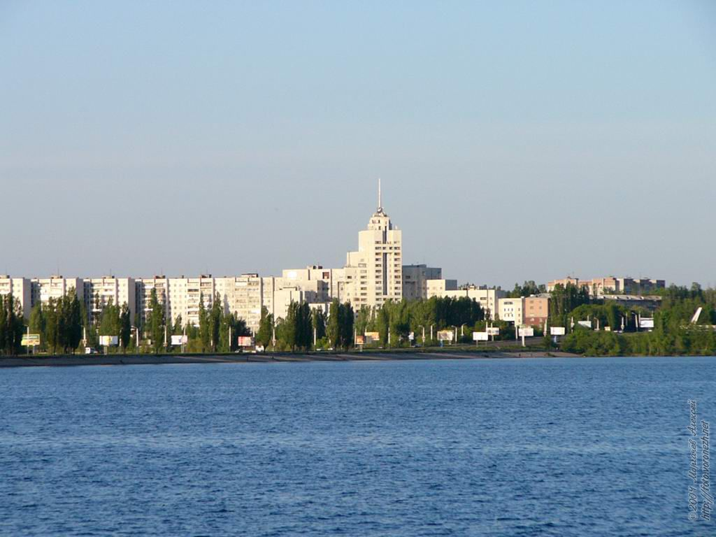
Voronezh honors its past and is full of creative effort and vitality.

Slide 21
THE END

Slide 22
Final Thoughts
«Success is not final, failure is not fatal: it is the courage to continue that counts»
Winston Churchill

