Slide 1
Shopping and Money

Slide 2
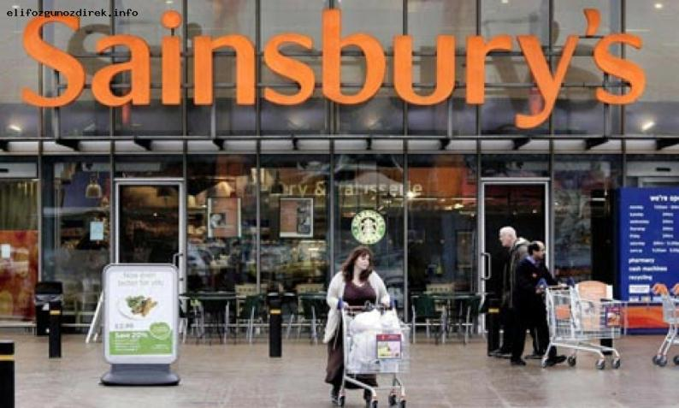
http://www.sainsburys.co.uk/sol/index.jsp

Slide 3
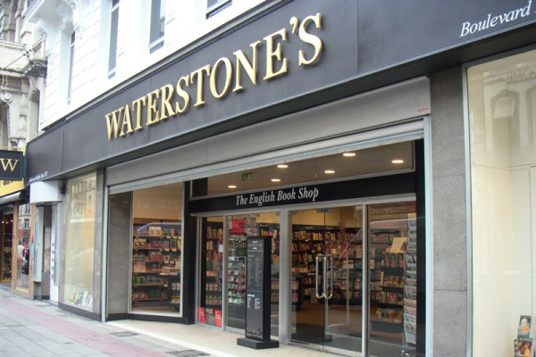
http://www.waterstones.com

Slide 4
http://www.johnlewis.com/

Slide 5
http://www.marksandspencer.com/

Slide 6
1. Written orders to a bank to pay a certain sum of money from one’s bank account
1.
2. Paper money and coins
2.
3. Plastic cards issued by banks, they can be used instead of money to pay for goods and services
3.
4. Cheques that can be bought at a bank and taken abroad where they are exchanged for money
4.

Slide 7
Possibility of exchange and trade
Storehouse of value
Money
Yardstick of value
standard for future payments

Slide 8
Money

