Slide 1
The Pomor Character

Slide 2
Pomorye, or the land of the Pomors, is the Polar region in the European part of the Russian North.

Slide 3
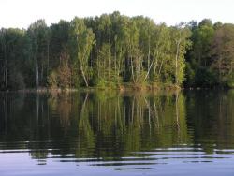
The Pomors were brave hunters and fishermen. The Pomor family could consist of thirty people, the father was the head of the big family. Boys went fishing and hunting with their fathers.

Slide 4
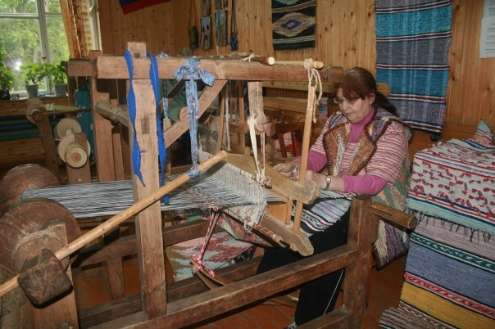
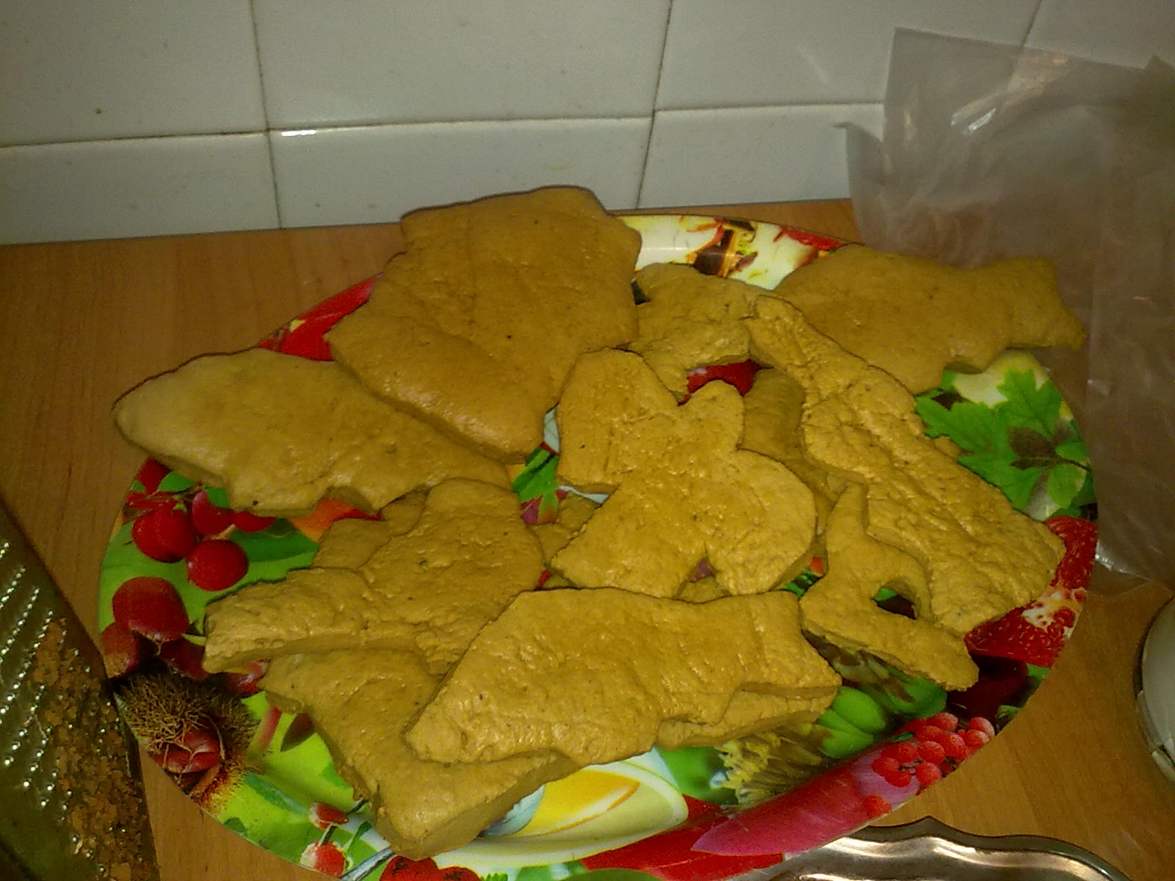
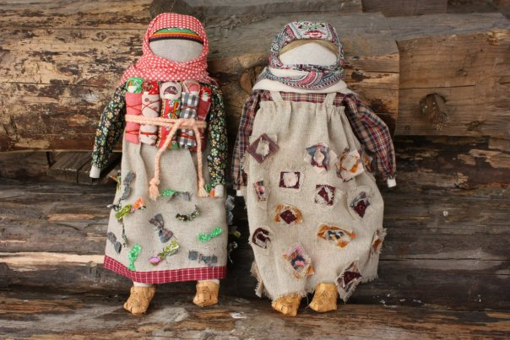
Girls learnt embroidery, cooking and breadmaking.

Slide 5
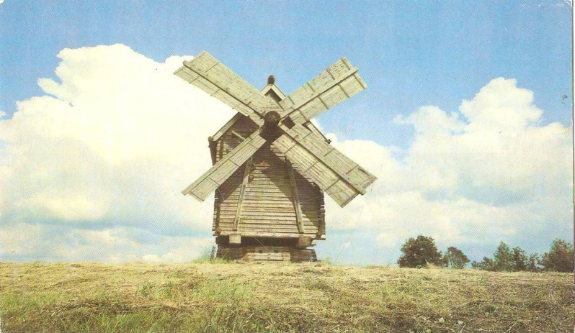
The Pomor houses were made of wood, with one room, the windows and the doors were small.

Slide 6
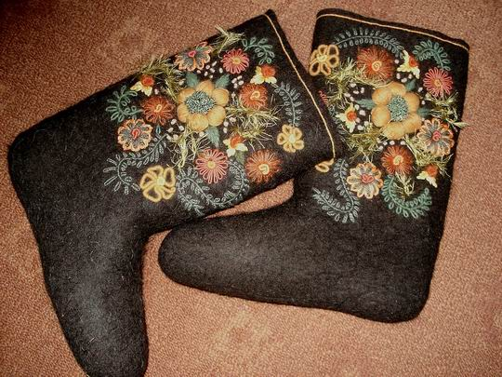
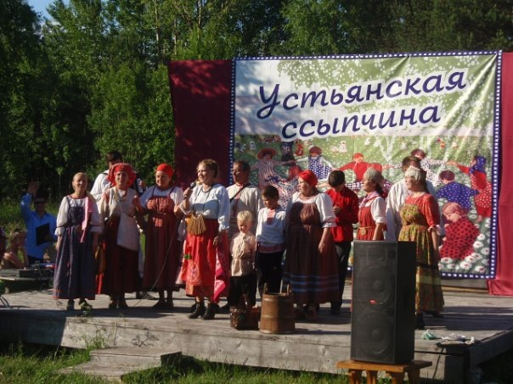
The main women`s costume was sarafan, decorated with embroidery, buttons and lace. The most popular women`s headgear was kokoshnik. Girls liked to wear venets. The main type of footwear were lapti and valenki

Slide 7
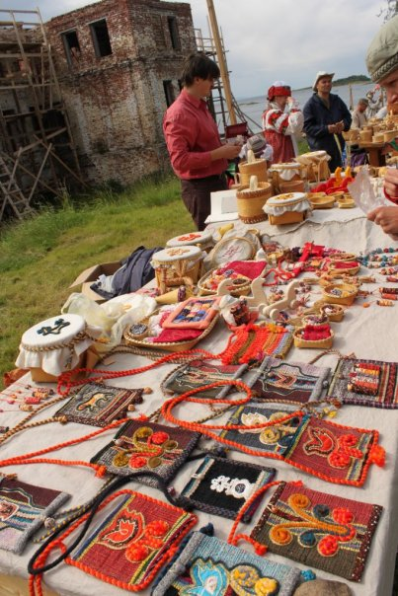
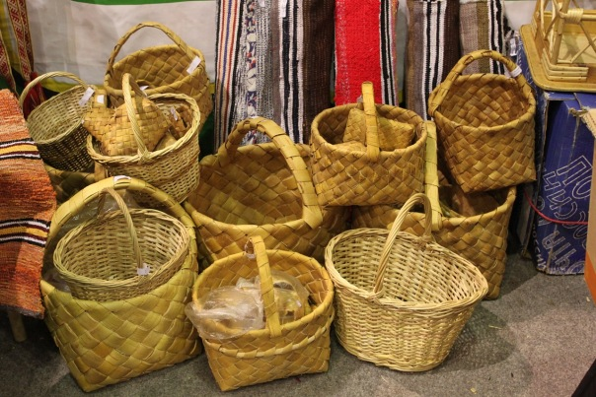
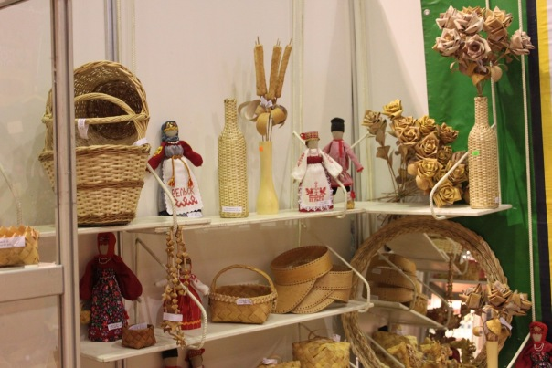
The Pomors were skillful craftsmen. And nowadays in our town Velsk there is a club “Berendei” where people learn old crafts.

