Slide 1
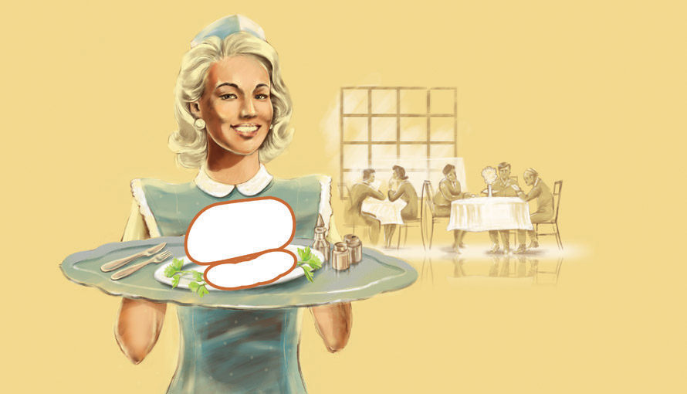
A girl with golden curls serves burgers on Thursday.

Slide 2
Monday Tuesday Wednesday
Thursday Friday Saturday Sunday

Slide 3
Read a book Watch TV Wake up late
Play sports
Wash the dishes
Go shopping Clean my room

Slide 4
On Sunday I like to go shopping.
Monday Tuesday Wednesday
Thursday Friday
Saturday Sunday

Slide 5
They play volleyball twice a week.
Once a week
Twice a week
Three times a week

