Slide 1
Let’ s travel to Australia!
Unit 5, Lesson 2
New Millennium English 9
Groza O. L. and others

Slide 2
He that travels far knows much
John Clarke

Slide 3
Travelling
To learn foreign languages
To exchange experience
To see new places
To improve foreign languages
To make new friends
To get to know new traditions
To have a rest, for pleasure

Slide 4
CROSSWORD
1. The capital of this country is Delhi. This is a country of elephants and tigers, of tea and coffee, of films and bright colors.
What country is this?
2 It is not a large country. It is situated in Europe. It is much smaller than France or Norway. It consists of four parts, but English is the national language in all parts of the country. What country is this?

Slide 5
3 This country lies in the middle of the North American continent. Its area is over 9 million square kilometers. The country consists of 50 states. Its national emblem is the bald eagle. The flag is called "The Stars and Stripes''. What country is this?
4 . This country is called the "Upside down country". The hottest summer month is January and the coldest winter month is June. It lies in the southern hemisphere.

Slide 6
5. It is a very large country. Its territory is about 10 million square kilometers, people speak English and French there.
DOWN:
6 This country is situated in the southern hemisphere. When it is midnight in Great Britain, it is the noon of the next day in this country . Many people came to live here at the end of the 18th century. What country is this?

Slide 7
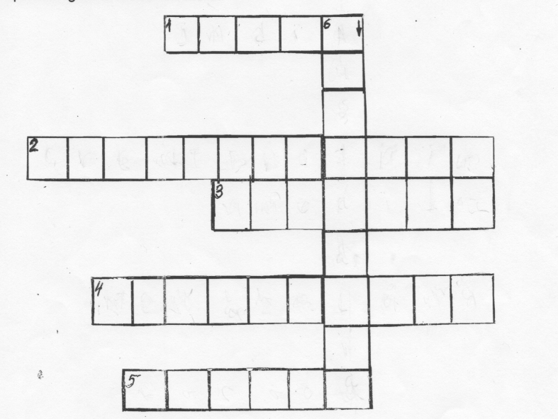
I N D I A
I N D I A
U
S
G R E A T B R I T A I N
A M E R I C A
A
N EW Z E A L A N D
I
C A N A D A

Slide 8
The Commonwealth of Australia
— Австралийский союз, официальное название государства.
Down Under —разговорное название Австралии и Новой Зеландии, указывающее на географическое положение этих стран по южную сторону экватора.
Outback —самая засушливая часть материка .
Aussie — сокращенное от Old Australian – «старый австралиец», потомок переселенцев из Великобритании, родившийся в Австралии.

Slide 9
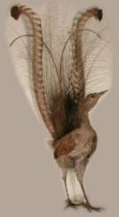
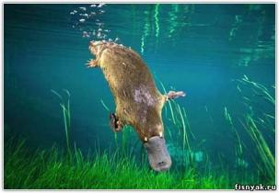
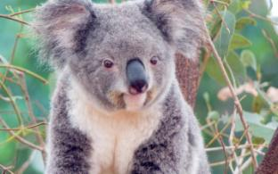
Aussieland — разговорное название Австралии, так же Kangarooland — страна кенгуру.
Platypus — утконос
Koala — коала
Lyrebird — птица-лира, один из символов Австралии
Kookaburra — кукабурра, зимородок-хохотун

Slide 10
Fact file:
Name: The Commonwealth of Australia
Area: 7,686,850 square km
Population: 21 600 000 (approximately 25% born overseas)
Native people: Aborigines
Capital: Canberra
Government: Australian Federal Government, State and Territory Governments, Regional Councils
Language: English, Maiori

Slide 11
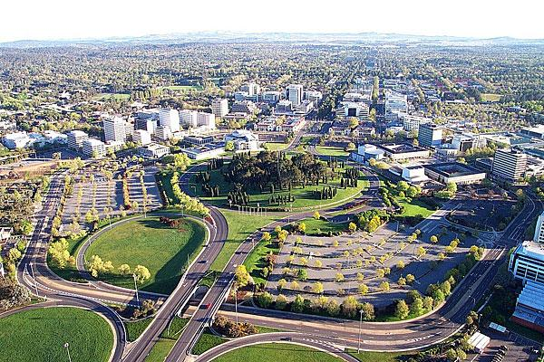
Canberra

Slide 12
Dear __________ ,
I am in Australia now. I am full of impressions….
Sincerely yours,
…….

