Slide 1
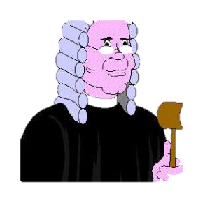
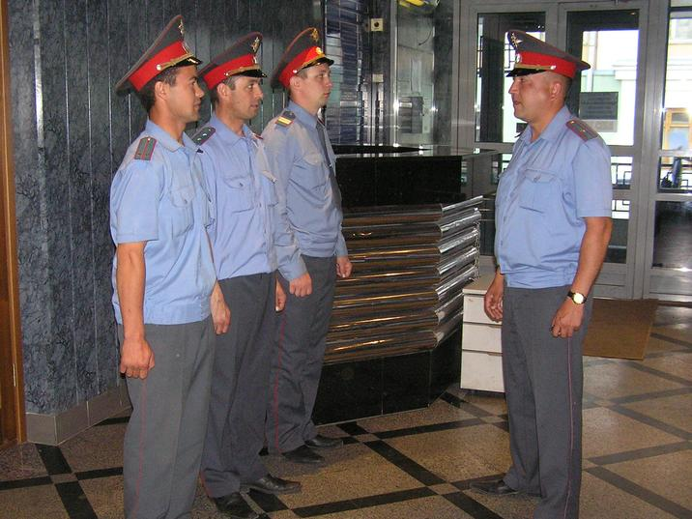
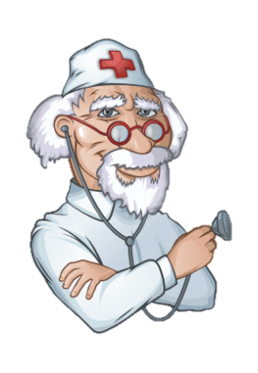
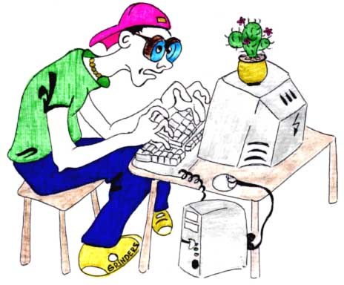

Slide 2
What does the word “job” mean?
A Job is the work that a person does regularly in order to earn money.
What does the word “profession” mean?
A Profession is a job that requires special training, often a university education,
and brings a rather high social status.
What does the word “occupation” mean?
An Occupation is a job or profession.
What does the word “career” mean?
A Career is series of jobs that a person does in his/her life, usually in one and
the same field.

Slide 4
Which of the tips mentioned in the text
you find most helpful?

Slide 5
Take a seat
Thank you
Enjoy
Work experience
Qualities
Certainly
Important thing
Just one thing
Getting in touch

Slide 7
CURRICULUM VITAE
PERSONAL INFORMATION
Name: Maureen Taylor
Date of birth: 21.03.81
Nationality: British
Address: 87 Orchard Rise. Bishops Castle SY9 7H
EDUCATION AND QUALIFICATIONS
Secondary school: Newcastle, 1992-99
EXPERIENCE
Voluntary work for Community Links 1996 - Teaching English - St Paul's Church, Bishops
Castle
OTHER SKILLS AND ACHIEVEMENTS
Driving licence; First Aid Certificate (First Class)
INTERESTS
Reading; cinema; cooking; swimming.

Slide 8
1. Ambitious
d) Determined to be successful, reach, powerful.
2. Motivated
j) Very keen to do something or achieve something, especially because
you find it interesting or exciting.
3. Organised
b) Achieving aims in an effective, ordered and sensible way.
4. Creative
e) Very imaginative and good at making things, producing or using new ideas.
5. Confident
h) Sure that you can do something or deal with or situation successfully.
c) Able to wait calmly for a long time or to accept difficulties without becoming
angry.
6. Patient
7. Responsible
i) Having a duty to be in charge of or to look after someone or something
8. Outgoing
a) Liking to meet and talk to new people.
9. Hard-working
g) Working with a lot of effort.
10. Persuasive
f) Good at influencing other people to believe or do what you want

