Slide 1
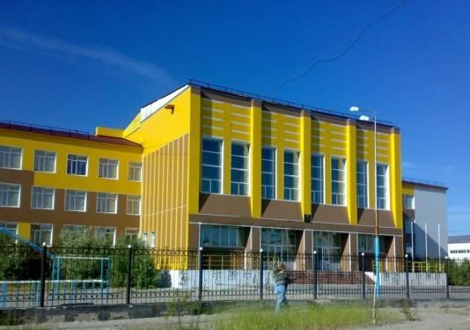
SCHOOL OF REAL DREAM

Slide 2
Questions (survey)
Вопросы для анкетирования
1) Хотелось бы вам, чтобы наши ученики имели право свободно посещать школу, не более 2 недель (согласно письменному соглашению родителей), при этом выполнять классную и домашнюю работу в домашних условиях, в конце - сдавать зачет или проект?
1. Would you like the students to have the right for free school attending, not more than for 2 weeks (according to their parents` agreement ) doing their class-work and homework at home, passing a credit or presenting a project at the end of their staying at home?
2) Хотелось бы вам, чтобы наши ученики имели право выбирать ученическое самоуправление , учителей, администрацию и директора школы?
Would you like our students to have the right to choose a students` self-governing (every year), the teachers, a school administration, a school director (each 3 years)?
3) Хотелось бы вам, чтобы в столовой появилось такое оборудование, как автоматы с едой и напитками? Хотели бы вы один раз в неделю питаться разнообразной едой («Шведский стол»)?
3. Would you like to have automats with meals and drinks in your school canteen? Would you like to have a «Swedish table» once a week?
4) Хотели бы вы слушать спокойную или любимую музыку на переменах?
4. Would you like to listen to quiet or your favorite music during the school breaks?

Slide 3
5) Хотелось бы вам слышать звонок с урока или на урок с нестандартным звучанием (пение птиц, шум морской волны, мелодию спокойной музыки)?
5. Would you like to hear not standard «bell» from or for the lesson (birds` singing, splash of sea-wave, quiet music)?
6) Каково ваше отношение к школьной форме?
6. What do you think about a school uniform?
7) Хотелось бы вам, чтобы в школе был кинозал (в актовом зале), была возможность смотреть фильмы на английском, немецком, французском и родном языках?
7. Would you like to have a Cinema Hall (in our Assembly Hall) to watch films in English, German, French and Russian?
8) Хотелось бы вам, чтобы тесты и контрольные работы учеников проверял не учитель, а компьютер?
8. Would you like the students` tests to be checked by computers, not teachers?
9) Хотелось бы вам, чтобы уроки физической культуры были вынесены во вторую половину дня в форме секционных занятий 3-4 раза в неделю?
9. Would you like to have sport sections 3-4 times a week in the afternoon, instead of PT lessons in a school-day schedule?

Slide 4
SOME TIPS TO A new school model
Canteen,
automats
with meals and drinks
The right to choose teachers, administration
Breaks
Bells
Free
attending and
Five-day week
New Model of School
Uniform
Cinema Hall
PT
New school day
Computer testing

Slide 5
SCHOOL DAY
Start of school-8.30 a.m.
1st lesson-8.30-9.10 a.m.
1st Break-9.10-9.20 a.m.
2nd lesson-9.20-10.00 a.m.
2nd Break-10.00-10.10 a.m.
3rd Lesson-10.10-10.50 a.m.
3rd Break-10.50-11.00 a.m.
4th Lesson-11.00-11.40 a.m.
4th Break-11.40-11.50 a.m.
5th Lesson-11.50-12.30 p.m.
Dinner, free time-12.30-14.00 p.m.
Self preparation-14.00-16.00,16.10 -17.40p.m. -PT

Slide 6
Canteen RECONSTRUCTION

Slide 7
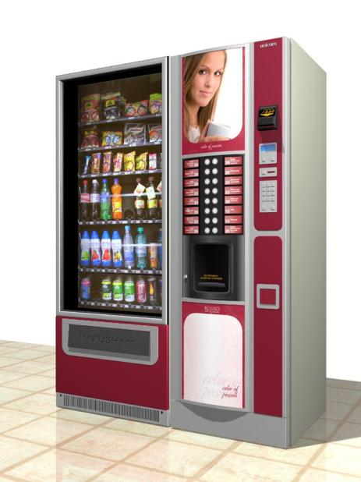
Kinds of automats

Slide 8
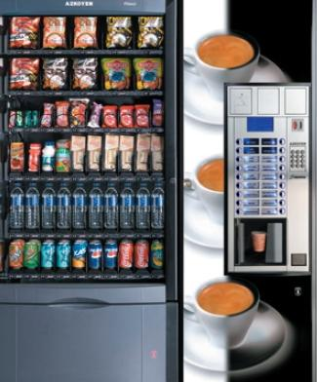

Slide 9
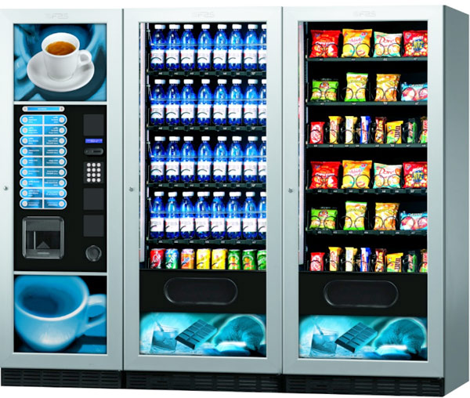

Slide 11
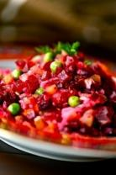
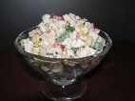
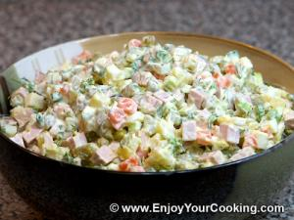
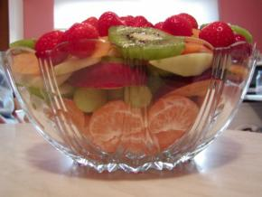
Variety of mealS at school
SALADS
Crab Salad
Vegetable Salad
Olivier Salad
Fruit Salad

Slide 12
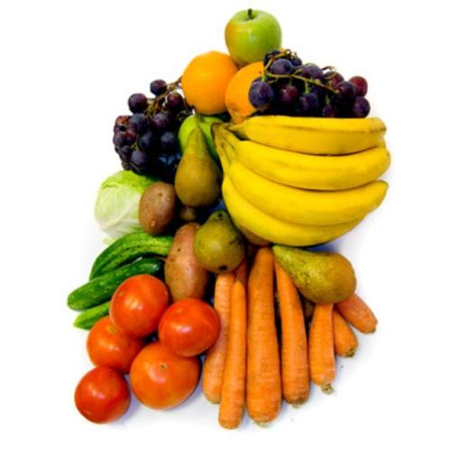
Fruits, vegetables
- tomatoes
- cucumbers
- bananas
- oranges
- apples
- vine
- pears

Slide 13
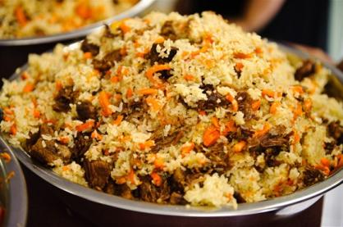
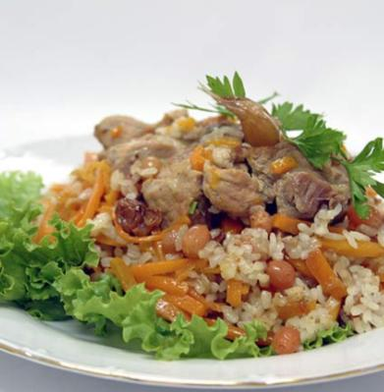
PILAU

Slide 14
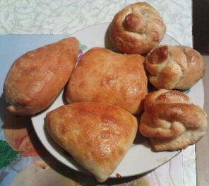
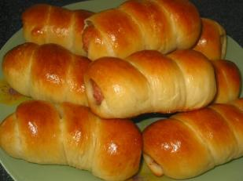
rolls, patties
WITH CABBAGE, POTATOE
WITH JAM, SPRINKILLED WITH SUGAR
FRANFKFURTERS

Slide 15
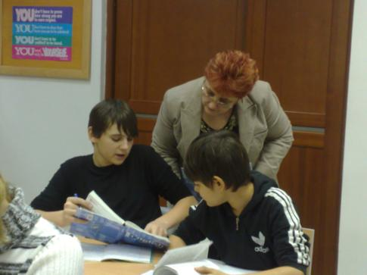
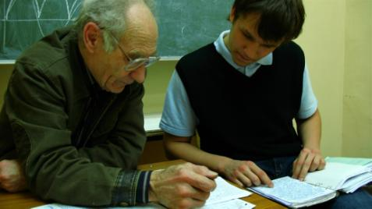
Self - preparation

Slide 16
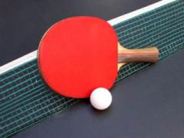
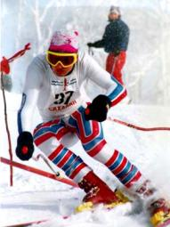
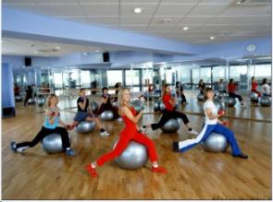
kinds of sport
Table tennis
Basketball
Volley - ball
Skiing
…and other types of sport
Fitness

Slide 17
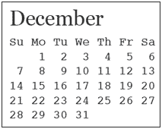
Five – day week
A five –day week - is not a luxury, it is the necessity! We will spend much more time with our parents, friends, go in for hobbies, develop our creativity and just relax enough to feel healthy.
1
2
3
4
5

Slide 18
Free school attending
Every student should have the right for free school attending. It means that every pupil has the right to study at home and not to go to school every early morning. But a student should do his class work and homework on his or her own. Parents should sign an agreement that they allow their kids not to attend school for a certain period of time (a week or two, no more. After that they should pass the credit and report about the work on their own.

Slide 19
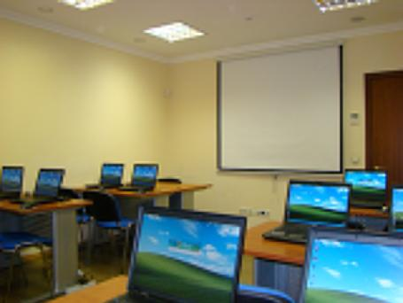
Classrooms of our dream

Slide 20
SCHOOL DEMOCRACY
The right to choose Student Government, teachers, School Administration
Students should have the right to choose teachers, elect a Students` Government, a School Director, a School Administration.
The Day of Elections will be a holiday for both students and teachers – October 1, for example.
Election of Students‘ Self-Governing | Election of teachers, School Director, School Administration
Every year | Every 3 year

Slide 21
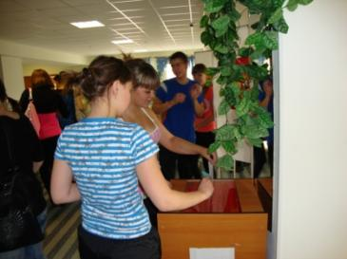
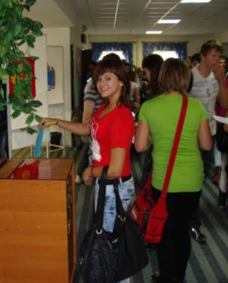
SCHOOL DEMOCRACY

Slide 22
Breaks and bells
The sound of the bell at the end and at the beginning of the lesson shouldn`t be so harsh and cause a feeling of alarm. Therefore:1) I`d like to listen to the tunes of pleasant music, 2) also there shouldn`t be bright lights in the corridors and classrooms during the breaks.3) Students` favorite music should be played during the whole break long. The students of upper forms should be responsible for it.

Slide 23
Cinema hall
It would be great to have a cinema hall at our school. Why not to use our school assembly hall for watching new films in English, German, Russian in our free time?
Some students of High School may be responsible for it.
Pop-corn and sweet bars, juice could be proposed at low price there. It`s much better than hanging out in the streets, smoking and drinking alcohol, listening to stories about drug-addicts and what not…

Slide 24
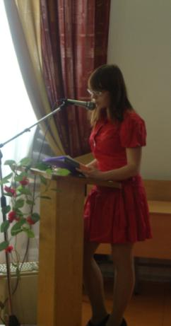
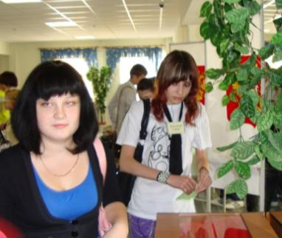
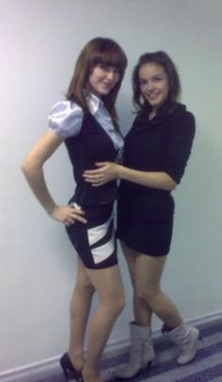
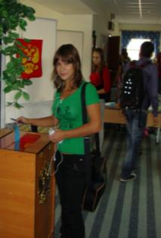
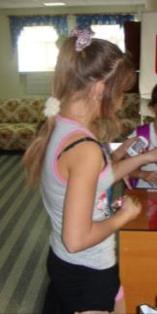
SCHOOL UNIFORM
WE LOOK LIKE THIS NOW

Slide 25
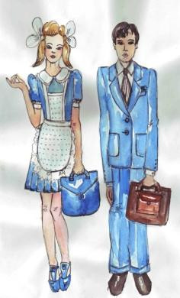
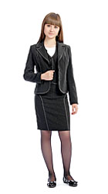
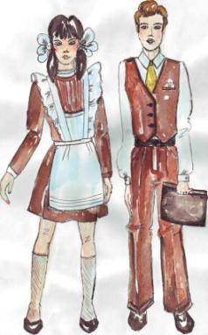
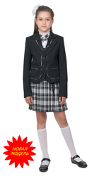
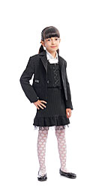
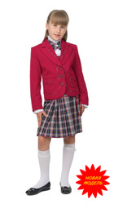
SCHOOL UNIFORM
WHY NOT TO LOOK LIKE THIS?

Slide 26
questionnaire + «for» , - «against» ( Students)
Question Person | Free at- tending | Choice of teachers | Canteen | Breaks | Bells | Uniform | Cinema Hall | Compu-ter Testing | PT
1 | - | + | + | + | + | - | - | + | +
2 | + | + | + | + | + | It depends | - | - | +
3 | + | + | + | + | + | + | + | + | +
4 | + | + | + | + | - | + | + | + | +
5 | - | + | + | + | - | - | - | - | +
6 | + | + | + | + | + | - | + | + | +
7 | + | + | + | + | + | It depends | + | - | +
8 | - | + | + | + | + | - | + | + | +
9 | + | + | + | + | + | - | + | + | +
10 | + | + | + | + | - | + | - | - | -
11 | + | + | + | + | + | + | - | + | +
12 | - | + | + | - | - | + | - | - | -
13 | + | + | + | + | - | - | + | - | +
14 | + | + | + | + | + | - | + | + | +

Slide 27
Question Person | Free at- Tending | Choice of teacher | Canteen | Breaks | Bells | Uniform | Cinema Hall | Compu-ter Testing | PT
15 | + | + | + | - | - | - | - | - | +
16 | - | + | + | + | + | + | - | + | -
17 | - | + | + | + | + | + | + | - | +
18 | - | + | + | - | + | It depends | - | + | +
19 | - | + | + | + | - | - | + | - | -
20 | + | + | + | + | + | - | + | + | +
21 | + | - | + | - | - | It depends | + | - | +
22 | - | + | + | + | - | - | - | + | +
23 | - | + | + | + | + | + | + | - | +
24 | - | + | + | - | - | - | + | + | -
25 | + | - | + | + | + | It depends | + | + | -

Slide 28
teachers
Question Person | Free at- tending | Choice of teachers, administration | Canteen | Breaks | Bells | Uniform | Cinema Hall | Compu-ter Testing | PT
1 | + | - | + | + | + | + | + | + | +
2 | + | + | + | - | - | + | + | + | +
3 | - | - | + | + | - | - | + | + | +
4 | + | + | + | + | + | + | + | + | +
5 | + | - | + | - | + | - | - | + | +
6 | - | - | + | + | + | - | + | - | +
7 | + | - | + | + | + | + | + | + | -
8 | - | + | + | + | + | - | + | + | +
9 | + | - | + | - | - | + | - | + | +
10 | + | - | + | + | + | + | + | + | +
11 | + | - | + | - | + | - | + | - | +
12 | - | + | + | + | + | - | + | + | +
13 | + | + | + | + | + | + | + | + | +
14 | + | + | - | + | + | + | - | + | +

Slide 29
Question Person | Free at- Tending | Choice of teacher | Canteen | Breaks | Bells | Uniform | Cinema Hall | Compu-ter Testing | PT
15 | + | + | + | + | + | + | + | + | +
16 | - | + | + | - | + | + | + | + | +
17 | + | - | + | + | + | + | + | + | +
18 | + | - | + | + | + | + | + | + | +
19 | - | - | + | + | + | + | + | + | -
20 | - | + | - | + | + | + | + | - | -
21 | - | - | - | + | + | + | + | + | -
22 | - | - | + | + | + | - | - | + | +
23 | - | - | - | + | - | - | + | - | +
24 | - | + | + | + | + | + | + | + | +
25 | + | + | + | - | + | + | + | - | -

Slide 30
Results of the questionnaire for students
Questions | «for» | «against» | other
Free attending | 14(56%) | 11(44%) | -
Choice of teachers | 24(96%) | 1(4%) | -
Canteen | 25(100%) | - | -
Breaks | 20(80%) | 5(20%) | -
Bells | 15(60%) | 10(40%) | -
Uniform | 8(32%) | 12(48%) | 5(20%)(it depends what kind of uniform)
Cinema Hall | 15(60%) | 10(40%) | -
Computer Testing | 12(48%) | 13(52%) | -
PT | 20(80%) | 5(20%) | -

Slide 31
Results of the questionnaire for teachers
Questions | «for» | «against» | other
Free attending | 14(56%) | 11(44%) | -
Choice of teacher | 11(44%) | 14(56%) | -
Canteen | 21(84%) | 3(12%) | 1(4%)(it depend upon meals)
Breaks | 19(76%) | 6(24%) | catchy, classic
Bells | 21(84%) | 4(16%) | -
Uniform | 17(68%) | 8(32%) | -
Cinema Hall | 21(84%) | 4(16%) | -
Computer Testing | 20(80%) | 4(16%) | 1(4%)human factor
PT | 20(80%) | 5(20%) | -

Slide 32
conclusion
In conclusion, I'd like to say that I've offered these changes because not only I want our school to be changed for some extant, but many other students and even teachers, as well as I, do.
But my dreams may come true only under the support of three groups: teachers, parents, students. To achieve the goals, it is necessary to organize a joint discussion of three groups, to discuss all proposals at the teachers` stuff meeting, parents` meetings, Parents` and Teachers` School Council, Student`s School Council, District Educational Department.
THANKS FOR YOUR ATTENTION.

