Slide 1
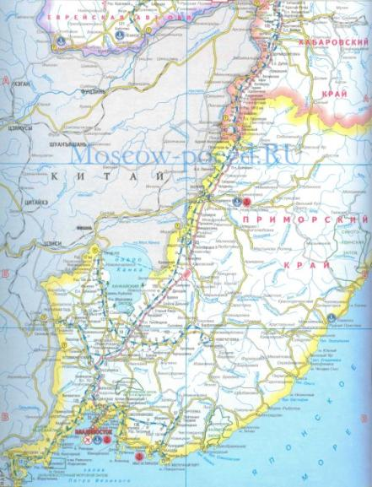
My Homeland is Primorye
Обобщающий урок 8 класс

Slide 2
Oil-pipeline “Vostochnaya Sibir-Pacific Ocean
For-Estern Federal University
Sea of Japan
Ussuri tiger
Primorye
Vladivostok
Cinemafestwal Pacific Meridian
ATES-2012
Korean Cedar

Slide 3
Questions
1. What is Primorye?
2. What is Primorye famous for?
3. Water biological resources are very rich in this part of our country, aren’t they?
4. Why is it an industrial and agricultural area?
Answers
1. Primorye is a Russian territory situated in the Russian Far East . It is equal to Belgium ,Netherlands Switzerland combined .
2. Primorye is famous for its harbours , for Ussuri Taiga and for its people .
3. Yes , they are. Primorye is rich in wood , land and water resources .
4. Primorye is a miraculous place for it’s agriculture and it has important sea-ports and shipbuilding yards .

Slide 4
5. What universities and institutes is Primorye proud of?
6. What are the main export products? Why?
7. What is the climate like in Primorye ? Why is neither rainy summer nor cold winter winds come as surprise to the people of Primorye?
8. What are the traditional Primorskiy holidays in Primorye ?
5. Primorye is proud of its universities and institutes : Far Eastern Federal University , Agricultural Academy Institute of Economy and Technology.
6. The main export products are timber and fish because two-thirds of Primorye is covered with forests and it is washed by the Sea of Japan.
7. The climate is very particular .It is rather mild but in the north in winter the temperature is 40-45 c . Typhoons are common in the second half of summer and cold winds come in winter.
8. The Day of Tiger , Day of Seamen , Day of Fishermen.

Slide 5
Fill in the articles where necessary
1. The
2. The
3. The
4. The
5. ---
6. The
7. The
8. ---
9. The
11. The
12. The
1. The
2. The , the
3. The
4. --- , the , ---
5. --- , ---
6. --- , ---

Slide 6
Listen to the text and answer the questions ?
1. When was Nakhodka disсovered ?
2. Who discovered Nakhodka ?
3. How can cargo arrive at Nakhodka ?
4. What cities are sister-cities of Nakhodka ?

Slide 8
Combine text parts in a correct order.
1. b
2. d
3. e
4. c
5. a

Slide 9
Test Nakhodka
1. Nakhodka is a large …. Port.
( Pacific )
2. There are …. ports in Nakhodka.
( 4 )
3. Nakhodka obtained the status of city in ….
( 1950 )
4. Nakhodka’s climate is ….
( monsoon , mild and damp )
5. The main street in Nakhodka is ….
( Nakhodkinskiy Prospekt )
6. Nakhodka’s popular sports are ….
( boxing , karate , judo )

Slide 10
7. Famous people of Nakhodka are …..
( Yavorskaya Maria , Grukhel Oleg )
8. Who is the honorable person of Nakhodka
( Hideo Kabayasi )

Slide 11
Homework
Write a composition “My Homeland is Primorye “.

