Slide 1
Учитель Баряева Н.А. идентификатор 240-700-969
Урок на тему
« Питание как элемент здорового
образа жизни» в 3 классе

Slide 2
Is it hungry?

Slide 3
WOULD
SOME
LIKE
TO HAVE
GRAPES
I
I would like to have some grapes.
I would like to have some grapes and some melon.
I would like to have some grapes, some melon and …

Slide 4
Could I have some
coffee,please.
coffee,please.
coffee,please.
I’m very sorry, but
I’ve only got cheese.
Could I have some
tea,please.
tea,please.
tea,please.
Yes, of course and
Here it is!

Slide 5
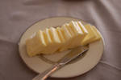
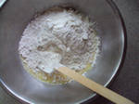
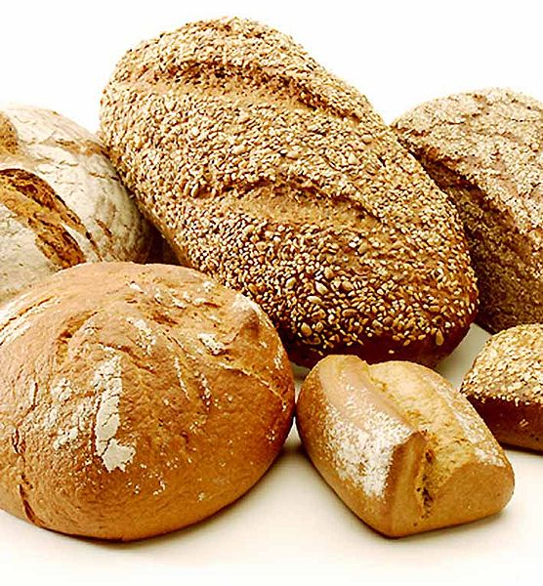
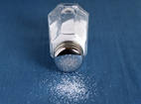
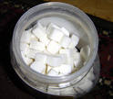
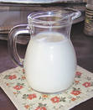
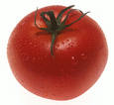
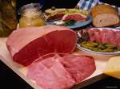
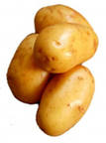
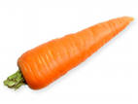
THERE IS… - IS IT…?

Slide 6
Учитель Баряева Н.А. идентификатор
240-700-969

Slide 7
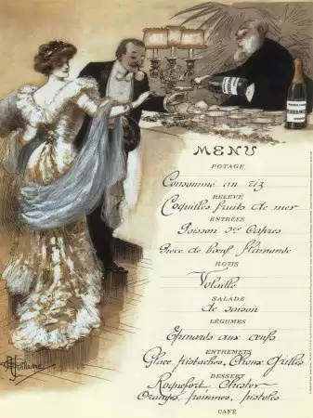
In a reataurant you can choose your food.
You read a menu. A menu is a list of food.
This is a breakfast menu.
Breakfast
Fruit: oranges,bananas and graps
Bread
Eggs
Drinks: orange juice,milk,tea
and coffee.

Slide 8
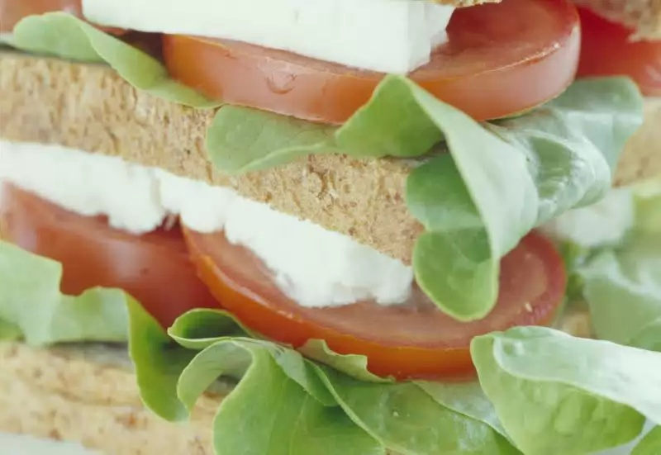
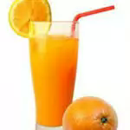
This is a lunch menu. Today the food on this menu is cold.
Lunch
Melon
Sandwiches: egg and tomato, chicken
and tomato
Salad: lettuce,tomatoes and peppers
Ice cream: chocolate or lemon
Fruit salad
Drinks: orange juice and lemonade

Slide 9
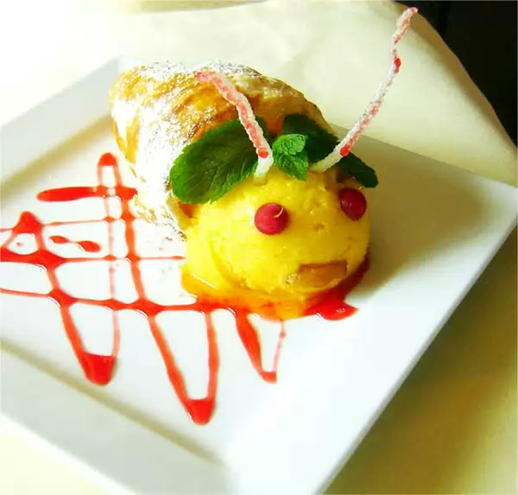
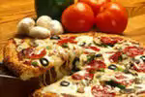
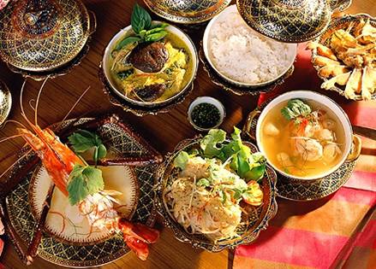
This is dinner menu. Today the food on this menu is hot.
Dinner
Soup
Pizzas: cheese, cheese and
tomato
Fish
Chicken
Vegetables: carrots,peas and beans,potatoes or chips
Apple cake
Chocolate pudding
Drinks: orange juice, tea and coffee

Slide 10
Fredo’s Restaurant. Say True or False
1.You can have eggs for breakfast
2. You can drink lemonade for breakfast.-
3. Pizza is for lunch.-
4. There are chicken and cheese
sandwiches for lunch.-
5. You can have chocolate or lemon ice
cream for lunch.-
6. Fruit salad is for lunch.-
True
False
False
False
True
True

Slide 11
7.The food for dinner is cold.-
8. You cannot have chips for dinner.-
9. You can drink coffee for dinner.-
FALSE
FALSE
TRUE

Slide 12
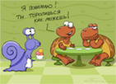
NOW I CAN:
I can name food.
I can read a menu.
I can ask for food./
I can order some food.

