Slide 1
GETTING A JOB The lesson in the 8th form
The teacher Romanchikova G.N.
School № 1285
Moscow

Slide 2
Advice for a job interview
Dress up for the interview to get across a responsible attitude.
Calm down before the interview by having a coffee.
Think about the job and write down your strengths and weaknesses.
Look things up about the company on the Internet.
Turn up at the interview a couple of minutes early.
Settle down in your chair and look around the room.
Take down notes during the interview.
Make up information about yourself.
Make out you understand something when you don't.
Go on about your personal life.
Speak up and express yourself clearly.
Come up with a couple of questions about the job.

Slide 3
Advice for a job interview
Verbs for paraphrasing
put on good clothes, communicate
relax
make a list
find information
arrive
make yourself comfortable
observe everything in a place
write
invent
pretend
talk a lot about

Slide 4
What to do or not to do during
the interview?
Model:
Do………………………… speak
up and express yourself clearly
Don’ t …………go into a lot of
detail about your personal life

Slide 5
Getting a job
Think of, talk clearly, invent, relax,
arrive, make yourself comfortable,
make a list, pretend, communicate,
observe everything in a place,
talk a lot about,
put on good clothes,
find information,
write.

Slide 6
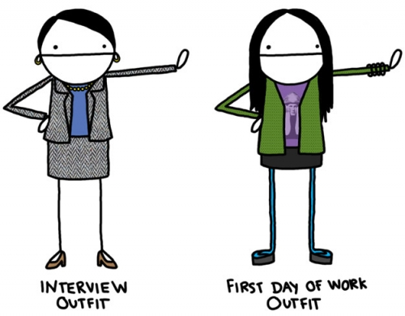
Role game
Interviewer:
Decide on the pay and hours and what kind of person you want to employ. Think of questions to ask about these things:
education, languages spoken
work experience
personal qualities
hobbies and interests

Slide 7
Role game
Interviewee:
Think of information about yourself or invent information about these things;
- education, your school, your best subjects, languages you speak
- work experience
- personal qualities and skills
- hobbies and interests

Slide 8
Answer the questions:
Do many Russian students get Holiday jobs? What sort of jobs?
Do they prepare you for interview in your school? Is this a good idea?
Why or why not?

Slide 9
Revision
Was it difficult for you to act the interview?
Could you say what you wanted to express?
What did you find most difficult?
What was the most useful thing for you to learn?
Was the way of learning interesting?

Slide 10
Used literature
Text – book “English – 8“ by Afanasyeva O.V., Mikheeva I.V., 2008.
“New Opportunities” by Michael Harris, 2010.

