Slide 1
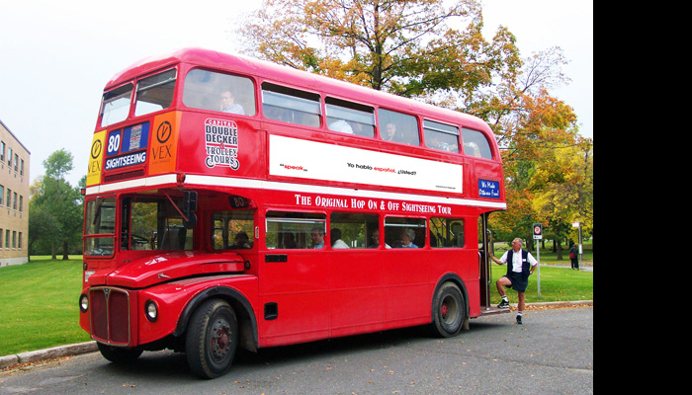
We are going to Great Britain
“
“
“
”.
“Double-Decker Bus

Slide 2
British customs and traditions

Slide 3
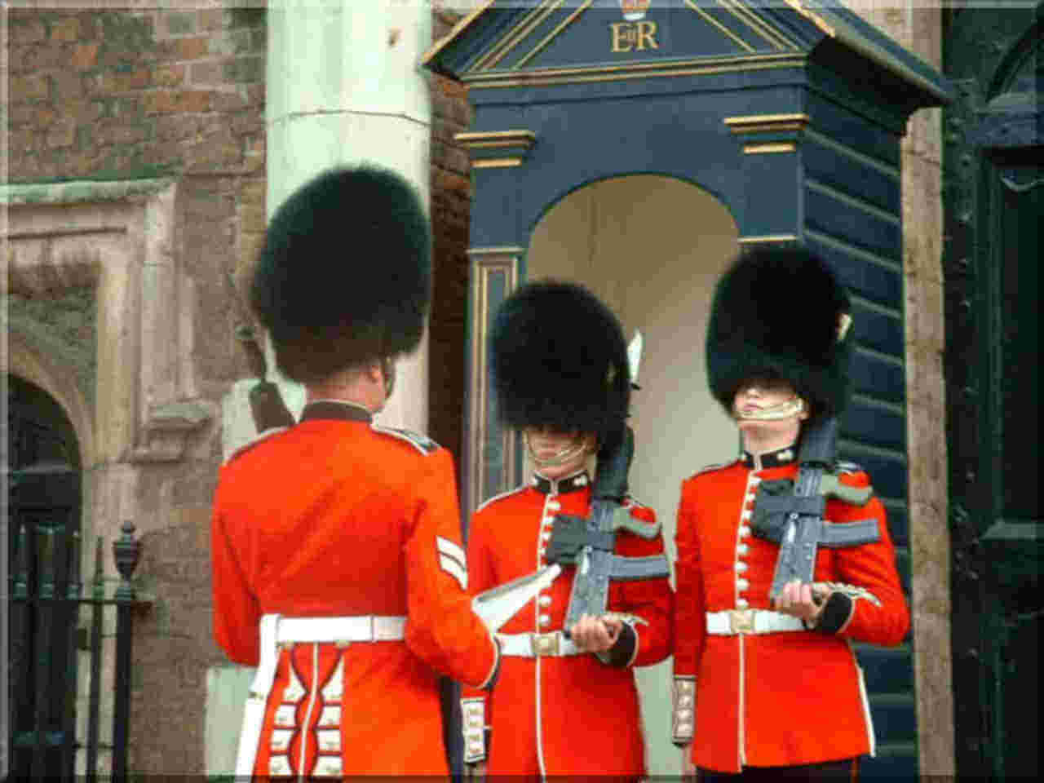
The Changing of the Guard

Slide 4
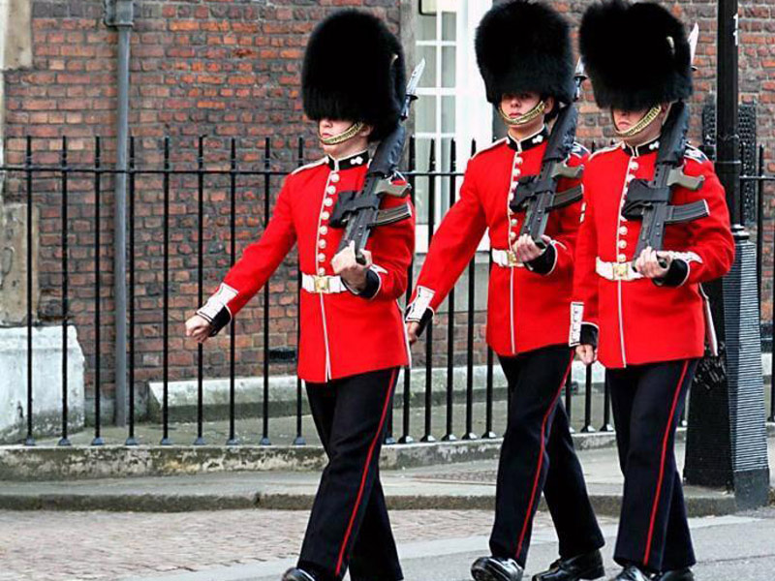

Slide 5
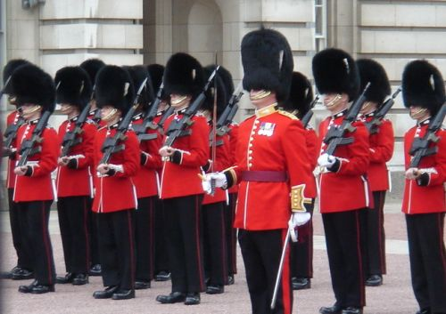

Slide 6
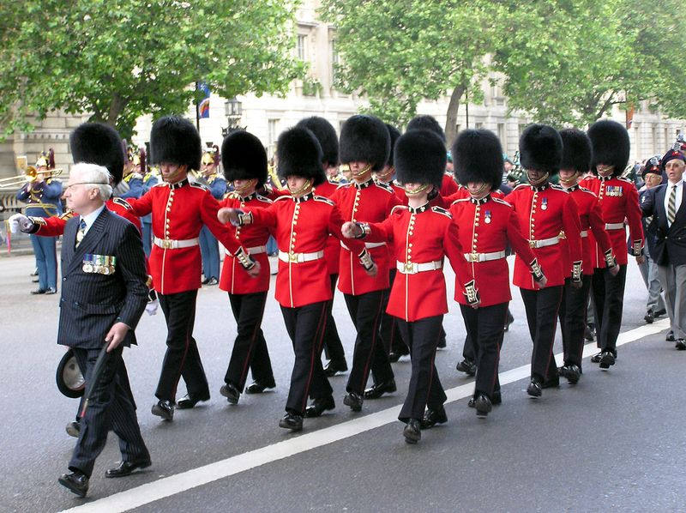

Slide 7
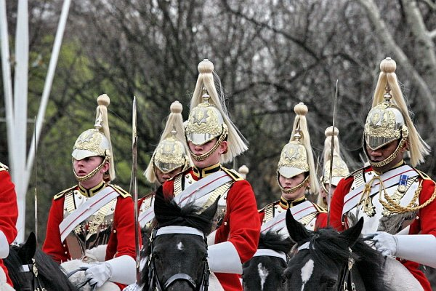

Slide 8
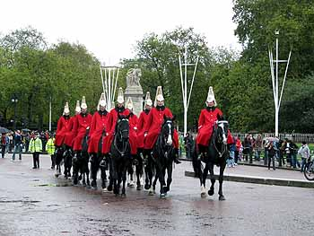

Slide 9
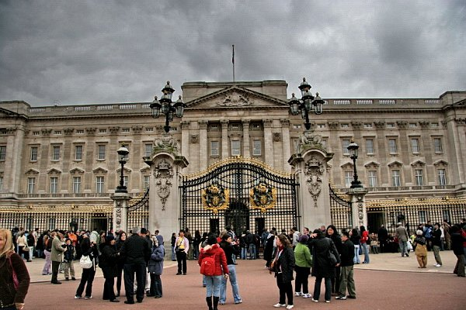
Ceremony of the Keys

Slide 10
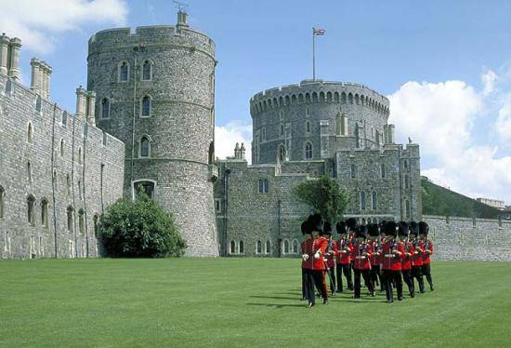

Slide 11
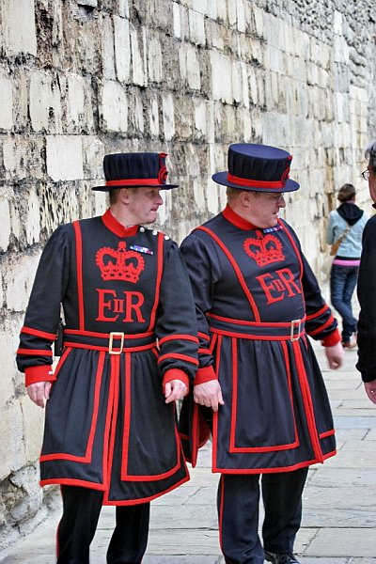

Slide 12
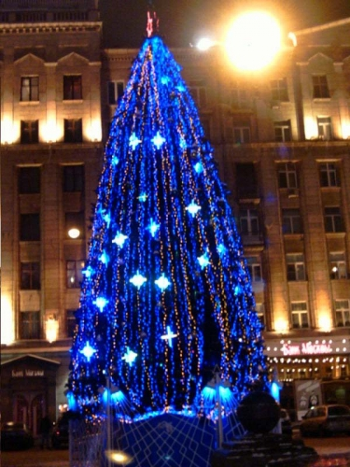
New Year

Slide 13
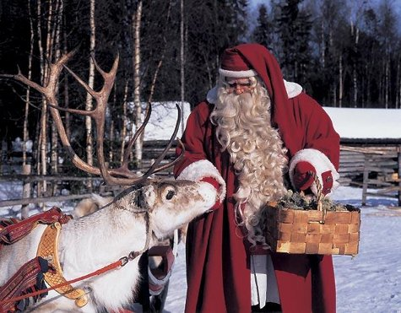

Slide 14
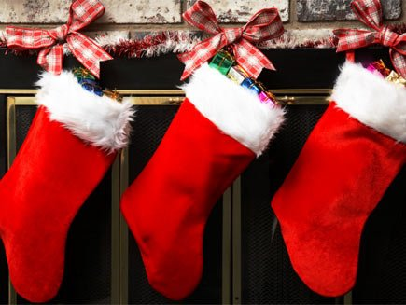

Slide 16
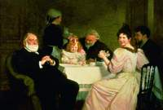
Five- o’clock tea

Slide 17
British sports
football
basketball

Slide 18
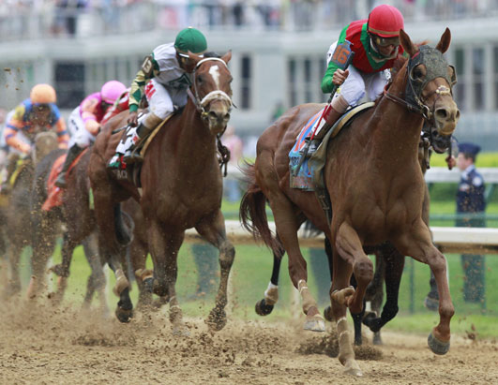
golf
derby

Slide 19
British and Russian customs

Slide 20
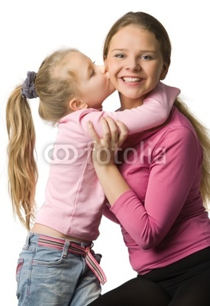
- kiss my Mum on one cheek -invite her to the party

Slide 21
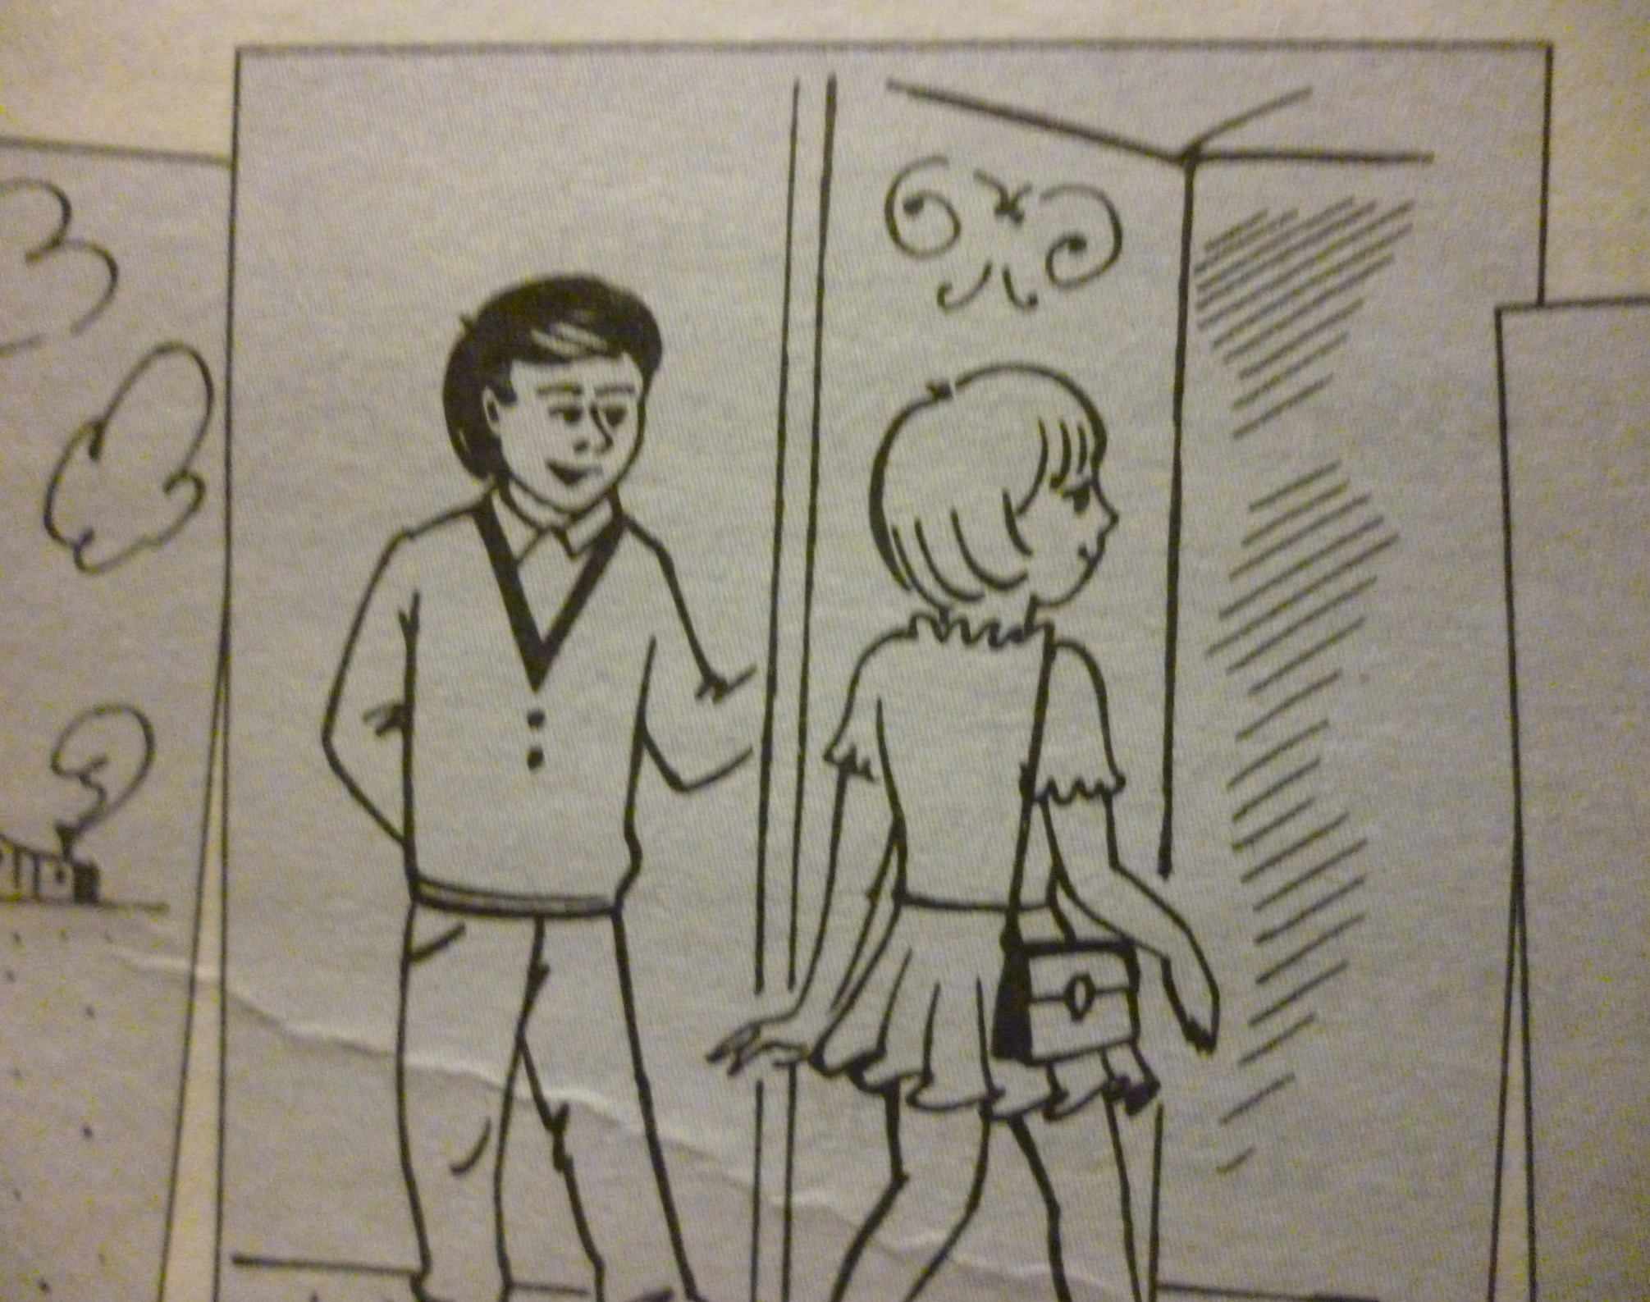
-hold the door open for her -shake hands with her

Slide 22
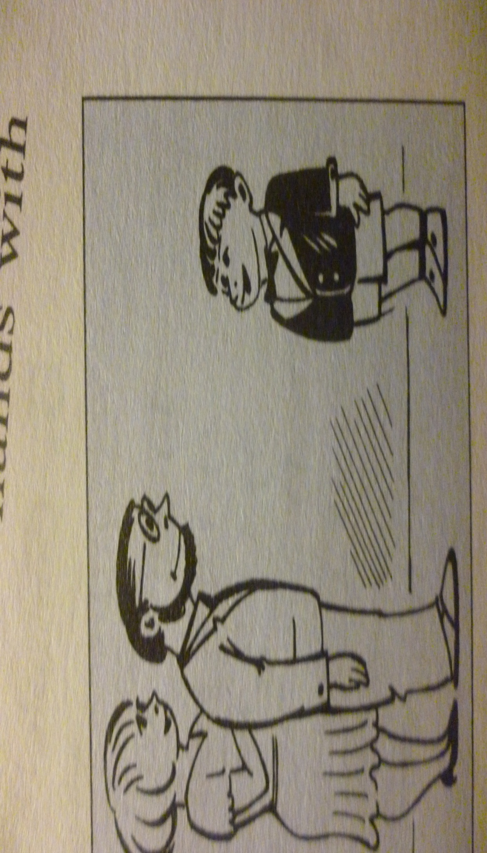
- take off shoes - say”thank you” ‘
Thank you
Thank you

Slide 23
- shake hands with him - come at the time

Slide 24
Не доволен. Сделал не всё,что мог
Мог бы лучше
Сделал всё,что в моих силах

Slide 25
Thank you very much

