Slide 1
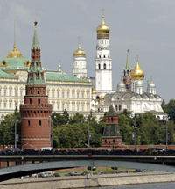
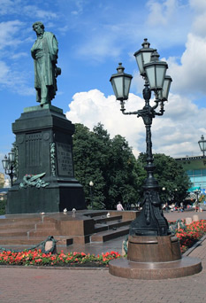
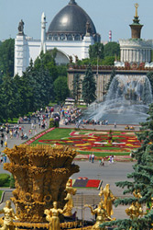
Moscow is rightfully called one of the most remarkable cities in the sphere of arts, entertainment and leisure activities. Here you will find bright and memorable events and famous names in all genres of classical and modern theater, music, cinema, fine arts and sports.
Moscow is where Russia begins!
All-Russia Exhibition Centre (VVC)
The Light of Lovers at the Pushkin Monument

Slide 2
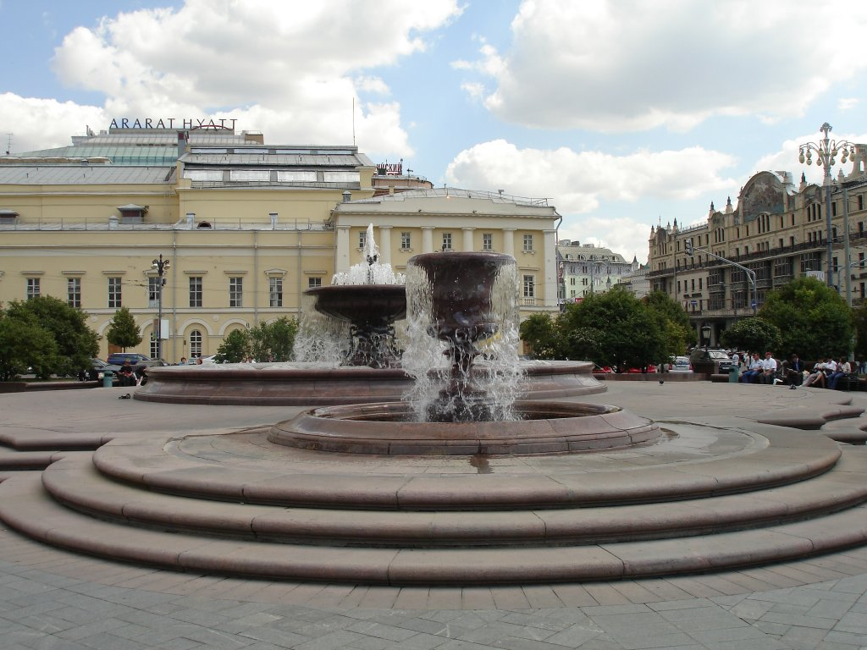
The Theatralnaya Square

Slide 3
The Theatre Square
The Theatre Square known as Sverdlov Square between 1919 and 1991, is a city square in Tverskoy District of Moscow. It's located at the junction of Kuznetsky Bridge Street, Petrovka Street and Theatre Drive.
The square is named after the three theatres situated there — Bolshoi Theatre, Maly Theatre and Russian Youth Theatre. The square is served by the Teatralnaya Moscow metro station on the Zamoskvoretskaya Line, Okhotniy Ryad on the Sokolnicheskaya Line and Ploshchad Revolyutsii on the Arbatsko-Pokrovskaya Line. The square emerged after the Fire of 1812 and conversion of the Neglinnaya River into an underground channel; the river still flows diagonally around the square green. It was designed in a symmetrical neoclassical style by Joseph Bove (1820s) however, in the second half of the 19th century the ensemble was ruined by new additions in eclectic style, considerably taller than the original side buildings. The square also contains the neo-gothic TsUM (ЦУМ), a luxury department store.

Slide 4
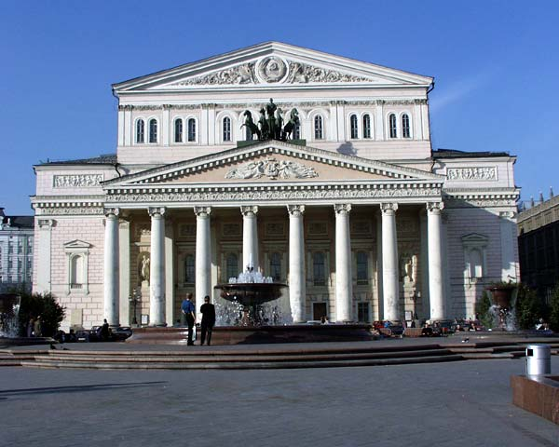
The Bolshoi Theatre

Slide 5
The Bolshoi Theatre
The Bolshoi Theatre is known as Bol'shoy Teatr, meaning Large, Great or Grand Theatre, is a historic theatre in Moscow. Was designed by architect Joseph Bové, which holds performances of ballet and opera. The Bolshoi Ballet and Bolshoi Opera are among the oldest and most renowned ballet and opera companies in the world. The theatre is the parent company of The Bolshoi Ballet Academy, a world-leading school of ballet.
The main building of the theatre, rebuilt and renovated several times during its history, is a landmark of Moscow and Russia (its iconic neoclassical facade is depicted on the Russian 100-ruble banknote). On 28 October 2011, the Bolshoi was re-opened after an extensive six year renovation costing about 21 billion rubles (about $680 million). The renovation included restoring acoustics to the original quality (which had been lost during the Soviet Era), as well as restoring the original Imperial decor of the Bolshoi.

Slide 6
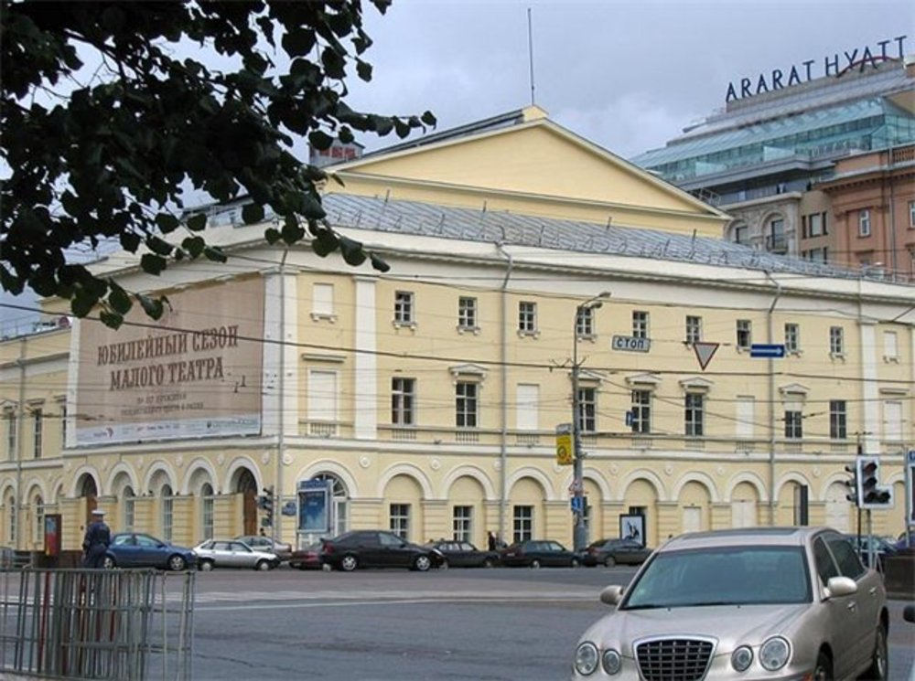
The Maly Theatre

Slide 7
The Maly Theatre
The Maly Theatre - literally Small Theatre is a drama theater in Moscow. Building of The Maly Theatre has begun in 1821 by V. V.Varginym's merchant. In 1824, forming ensemble of the Petrovsky area, O.Bove has reconstructed a building for theatre. In October, 1824 the Moscow drama troupe has given here the first performance. In the 19th century, Maly was "universally recognized in Russia as the leading dramatic theatre of the century". Maly Theatre employs a staff of over seven hundred, including over one hundred drama actors. It is the only drama theatre in Russia that has retained a symphony orchestra and a professional choir.

Slide 8
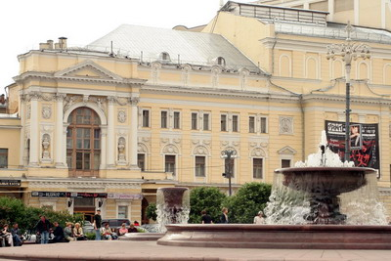
Russian Youth Theatre

Slide 9
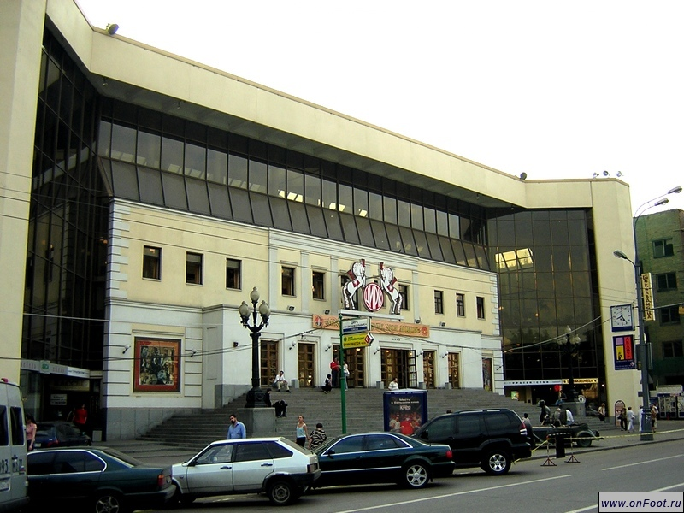
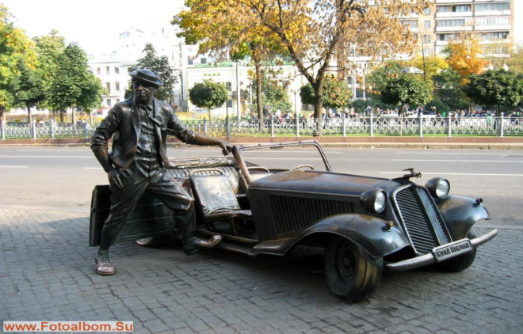
The Yury Nikulin's Circus

Slide 10
The Yury Nikulin's Circus
Moscow Circus on Tsvetnoi Boulevard was the only circus in Moscow between 1926 and 1971 and still remains the most popular one. This is one of the oldest and the most famous circuses in Russia. The circus building was opened on 20 October 1880 as the Solomonsky Circus.
There have always performed the most famous artists — the names of many of them have become a legend — and the whole circus dynasties. In 1949 on the Moscow arena Izyaslav Nemchinsky, Artistic Director of the Circus Studio, created a true eyeopener of the century — Valentin Filatov’s Bear Circus. Oleg Popov, the «Sunny» Clown, gathered full halls. On the Moscow arena the star of the clown with autumn in his heart, Leonid Enguibarov, shone who called himself Charlie Chaplin’s disciple by correspondence: with inspiration he showed people his mimic sketches resembling fairy tales. The everlasting fame of the Circus on Tsvetnoy Boulevard was made up by great clowns Yury Nikulin and Mikhail Shuydin. Sometimes people came to the Circus only for their performance. The Moscow Circus on Tsvetnoy Boulevard stages new attractions, performances, pantomimes and children’s shows.

Slide 11
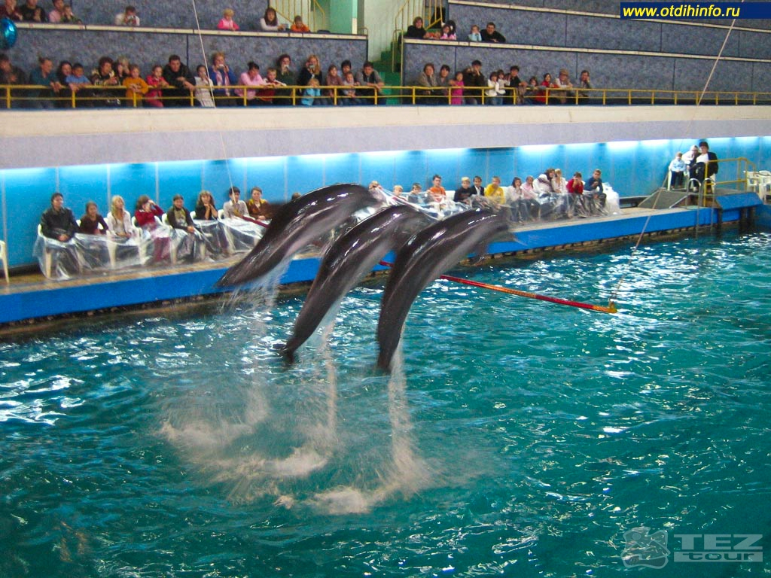
The Moscow Dolphinarium

Slide 12
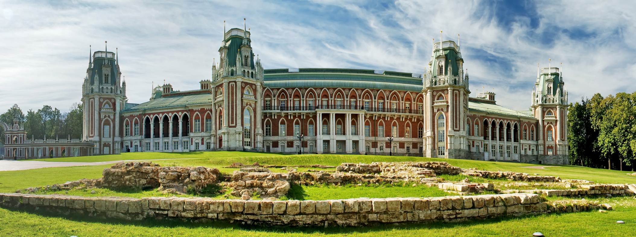
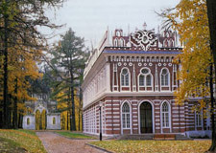
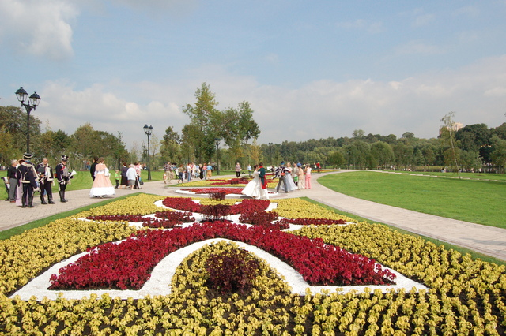
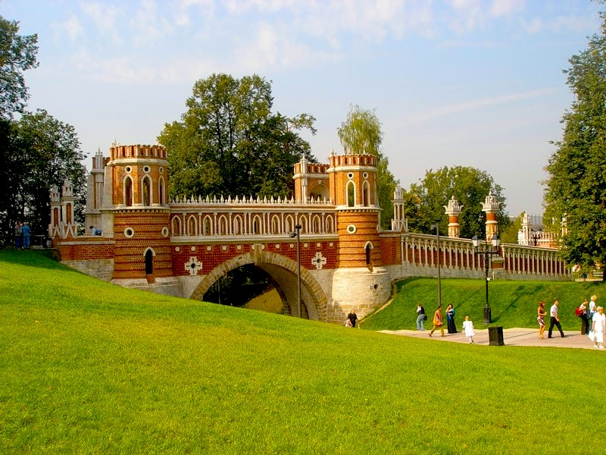
Tsaritsyno Park

Slide 13
The historic estate of Tsaritsyno is located in the Southern Administrative part of Moscow stretching along the shores of the Tsaritsyno ponds. This is Moscow’s largest museum-reserve, and also a national historic and cultural monument. The estate was built in the pseudo-Gothic style and was designed by architects VBazhenovasily and Matvei Kazakov. The first references to the Chernaya Gryaz village (the original name of Tsaritsyno) date all the way back to the 16 century. A cascade of ponds 8 kilometers long enveloping the area was made in the time of Boris Godunov. According to the available sources, the village belonged to the noble family of the Streshnevs, princes Golitsyn. In 1713, Peter I gave the village to the "Moldavian lord" Prince Dmitry Kantemir. In 1775, Catherine II bought the estate from Kantemir’s .with the intention of building a new retreat near Moscow, and the name of Tsaritsyno comes from (literally, Tsarina’s). The estate’s landscape parks were laid out with the help of two garden designers, I. Murno and F. Reed, both sent from Great Britain. The palace was under construction for 10 years, until the demise of Catherine II in 1796, when the work was suspended for what turned out to be two long centuries. Long time it a country area, an urban settlement and a Moscow district. In 1984, it was resolved to launch the restoration of the architectural ensemble and landscape parks of Tsaritsyno. The great palace was not completed until 2005, and the Tsaritsyno ensemble welcomed its first guests at the September 2007 opening ceremony. The architectural ensemble, with its bright combination of red brick walls and white stone decorations, fits in harmoniously with the natural landscape. The center of the composition is made up of two palaces linked by a gallery to which a patterned gate leads, and the Third Cavalier Building (servants’ quarters), with the Bread House (the Kitchens, or the Kitchen Building) behind them. On the island of the Sredne-Tsaritsynsky pond, a musical fountain has been installed that spouts water in sync with the music. The museum now regularly houses various expositions built up mainly from the museum’s collection of decorative and applied arts, and shows and performances are staged in the Bread House. Abundant Water — The Fascination of the Park, as well as the permanent expositions Tsaritsyno Antiquities, Tsaritsyno through the Ages and Catherine the Great.

Slide 14
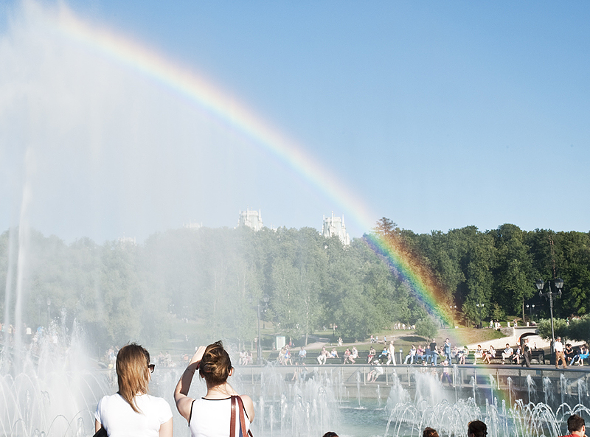
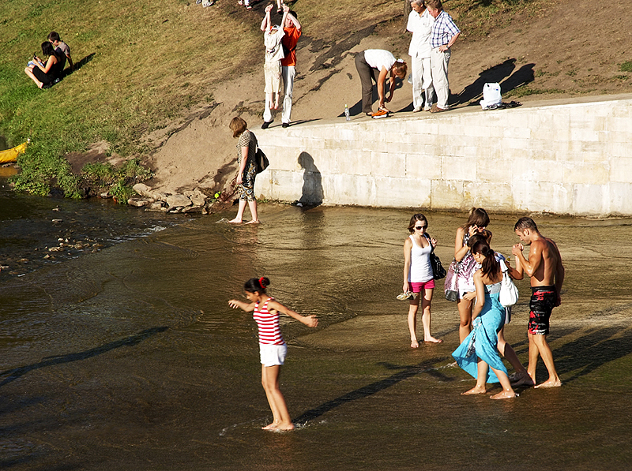
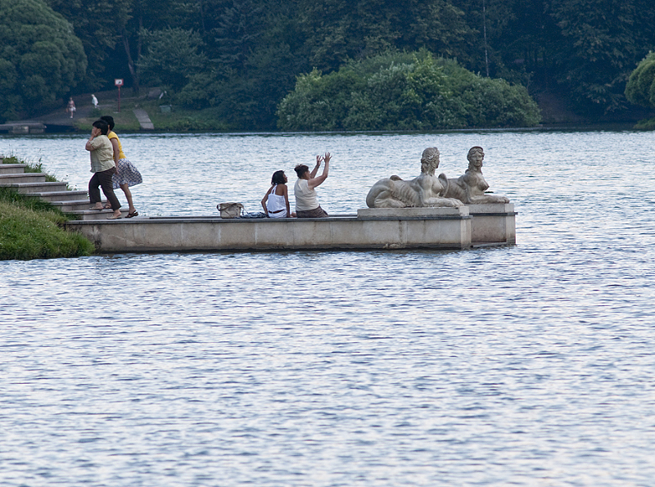
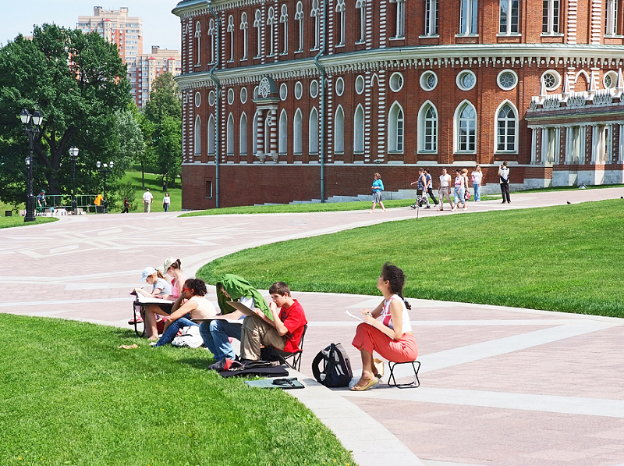
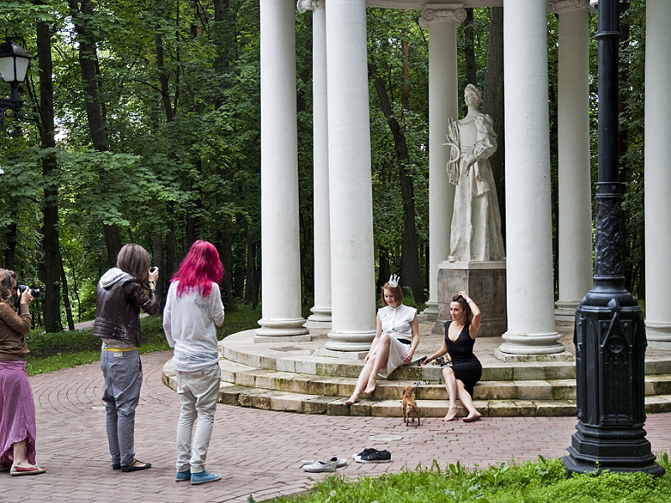
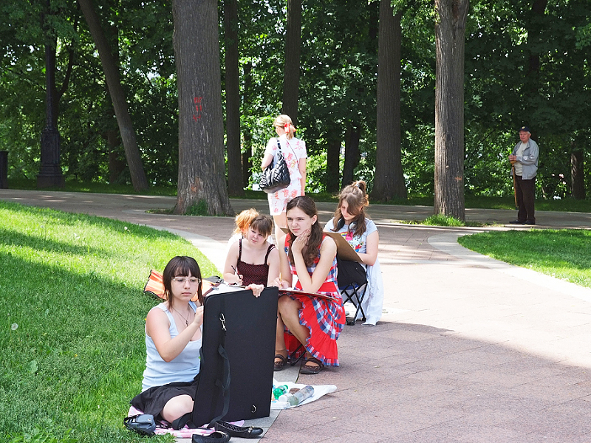

Slide 15
