Slide 1
c | d | g | i | g
o | e | n | t | r
m | n | e | s | e
p | u | p | p | y
u | b | u | l | p
t | o | y | a | o
e | y | s | y | n
r | u | n | h | y

Slide 2
Кроссворд
c | d | g | i | g
o | e | n | t | r
m | n | e | s | e
p | u | p | p | y
u | b | u | l | p
t | o | y | a | o
e | y | s | y | n
r | u | n | h | y

Slide 3
Кроссворд
c | d | g | i | g
o | e | n | t | r
m | n | e | s | e
p | u | p | p | Y
u | b | u | l | p
t | o | y | a | o
e | y | s | y | n
r | u | n | h | y

Slide 4
Кроссворд
c | d | g | i | g
o | e | n | t | r
m | n | e | s | e
p | u | p | p | Y
u | b | u | l | p
t | o | y | a | o
e | y | s | y | n
r | u | n | h | y

Slide 5
Кроссворд
c | d | g | i | g
o | e | n | t | r
m | n | e | s | e
p | u | p | p | Y
u | b | u | l | p
t | o | y | a | o
e | y | s | y | n
r | u | n | h | y

Slide 6
Кроссворд
c | d | g | i | g
o | e | n | t | r
m | n | e | s | e
p | u | p | p | Y
u | b | u | l | p
t | o | y | a | o
e | y | s | y | n
r | u | n | h | y

Slide 7
Кроссворд
c | d | g | i | g
o | e | n | t | r
m | n | e | s | e
p | u | p | p | Y
u | b | u | l | p
t | o | y | a | o
e | y | s | y | n
r | u | n | h | y

Slide 8
Кроссворд
c | d | g | i | g
o | e | n | t | r
m | n | e | s | e
p | u | p | p | Y
u | b | u | l | p
t | o | y | a | o
e | y | s | y | n
r | u | n | h | y

Slide 9
Кроссворд
c | d | g | i | g
o | e | n | t | r
m | n | e | s | e
p | u | p | p | Y
u | b | u | l | p
t | o | y | a | o
e | y | s | y | n
r | u | n | h | y

Slide 10
my, funny, is, kitten, little

Slide 11
My little kitten is funny.

Slide 12
a dog, has, Bob, got

Slide 13
Bob has got a dog.

Slide 14
a bicycle, to, I, ride, like

Slide 15
I like to ride a bicycle.

Slide 16
play, computer, let`s, games

Slide 17
Let`s play computer games.

Slide 18
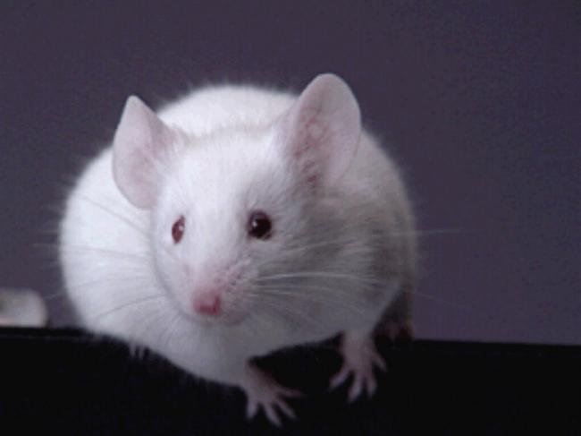

Slide 19
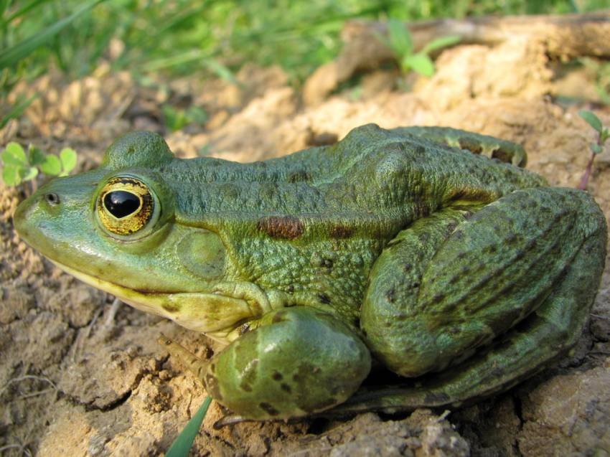

Slide 20
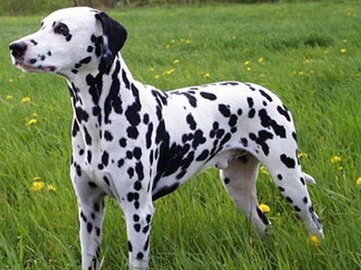

Slide 21
