Slide 1
Information about city
What is London ?
How old is it ?
How many people live their ?
What are the most famous
places in London ?

Slide 2
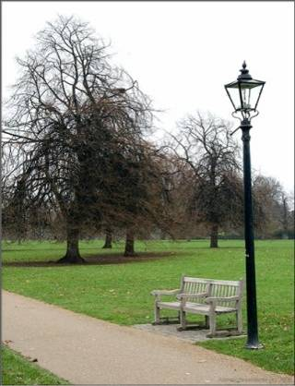
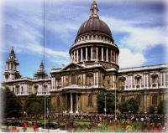
London is the capital of the United Kingdom of Great Britain and Northern Ireland
It was founded more than one thousand years ago
More than eight million people live their
There are many interesting places to visit: Trafalgar square, the Tower of London, Westminster Abbey, Tower Bridge Big Ben, Buckingham Palace
London is famous for its museums, galleries and parks

Slide 3
The River Thames

Slide 4
London Bridge
London Bridge – the first bridge of London, it was builded 1209.
Now there is new London Bridge, it was made from beton.

Slide 5
Westminster Abbey
Westminster Abbey is the most famous church in England. It was built by King Edward in 1065.The coronation of all British Kings and Queens takes place in it. Some famous English people are also buried here.

Slide 6
Big Ben is a great attraction of tourists. They want to see the clock in its tower and to hear the bells. Big Ben is really a bell. You can hear it every hour

Slide 7
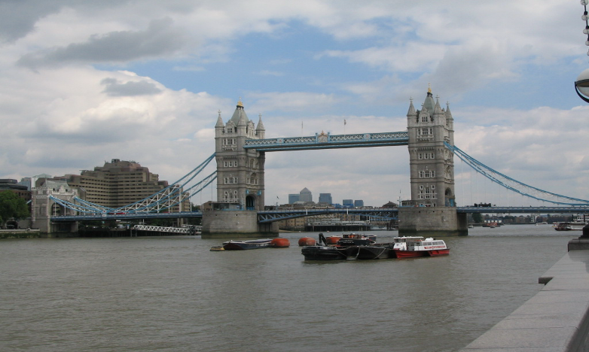
Tower Bridge

Slide 8
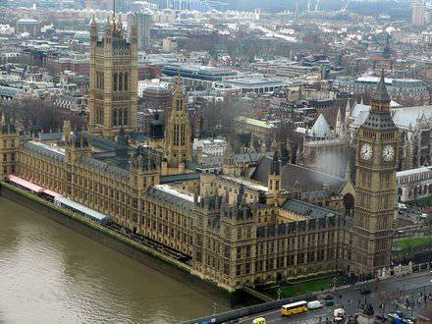
Houses
Parliament
of

Slide 9
The Tower of London
You can see the Tower of London from the river Thames. The tower is very old. It has a long and cruel history. The Tower was King’s palace, prison, zoo. Now it is a museum. Where one can see treasure of British monarchy.

Slide 10
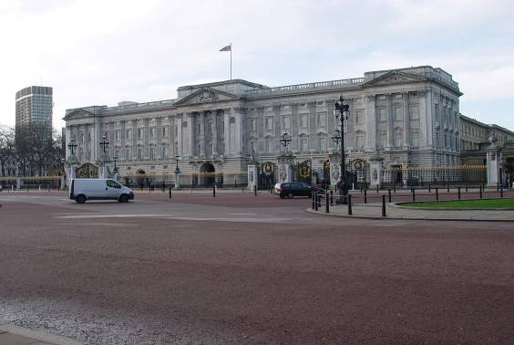
Buckingham Palace
Buckingham Palace is the place where British Queen Elizabeth II lives. When the Queen is at home we can see the flag above the palace.

Slide 11
Trafalgar Square
Trafalgar square is
the center of London.
In the center of square
we can see Nelson Column
in honor of admiral Nelson
who defeated Napoleon
fleet in 1805.There are four bronze lions around the column.

