Slide 1
Business in the USA
Almaeva Diana, 8L1

Slide 2
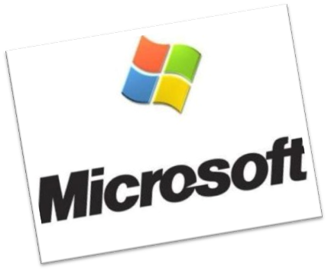
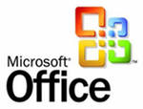
Microsoft
Microsoft Corporation is a very big company which makes computer software and video games all over the world. Bill Gates and Paul Allen started the company in 1975.
Microsoft makes Windows, Microsoft Office, Internet Explorer, MSN, and the Xbox 360. These are just the most popular products - they make a lot of other ones too.
Most of Microsoft programs can’t be downloaded for free - people have to buy them in a shop or online. Some products are already installed when people buy a new computer.

Slide 3
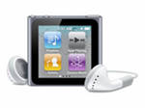
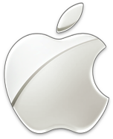
Apple
Apple is an American multinational corporation that makes computer software and personal computers. The company's most famous products are the iPod, the iPhone and the iPad. People all over the world use these products.
As of July 2011, the company operates 357 retail stores in ten countries, and an online store where hardware and software products are sold.

Slide 4
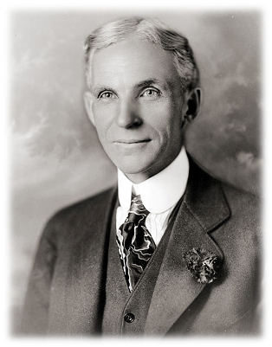
Ford Motor Company
Ford Motor Company is an American multinational automaker based in Dearborn, Michigan, a suburb of Detroit. The automaker was founded by Henry Ford and incorporated on June 16, 1903.
Henry Ford's methods came to be known around the world as Fordism by 1914.
Ford is the second largest automaker in the U.S. and the fifth-largest in the world.

Slide 5
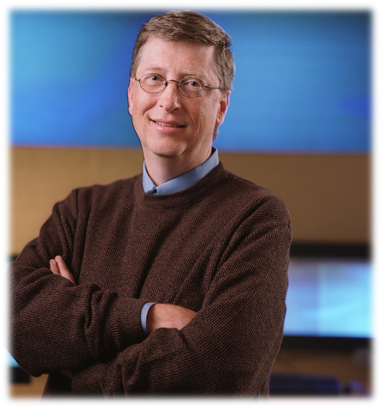
Bill Gates
Bill Gates was born October 28, 1955. In 1975 at the age of 20 he left university and formed his own company. He called it
Microsoft. That was the beginning of the
'personal computer'. Before that, most
people didn't have computers in their homes. The company is incredibly
Successful and its products are known all over the world.

Slide 6
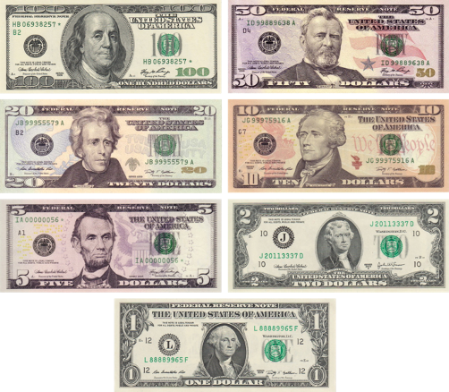
United States dollar
The U.S. dollar was created by the Constitution and defined by the Coinage Act of 1792.Since than it became the official currency of the USA. It Divided into 100 smaller units called cent or pennies. Several countries use it as of official currency. On the dollar banknotes you can see the portraits of the most famous American people, such as George Washington the first president of the country.

