Slide 1
Lanskaya Polina, 8 L1

Slide 2
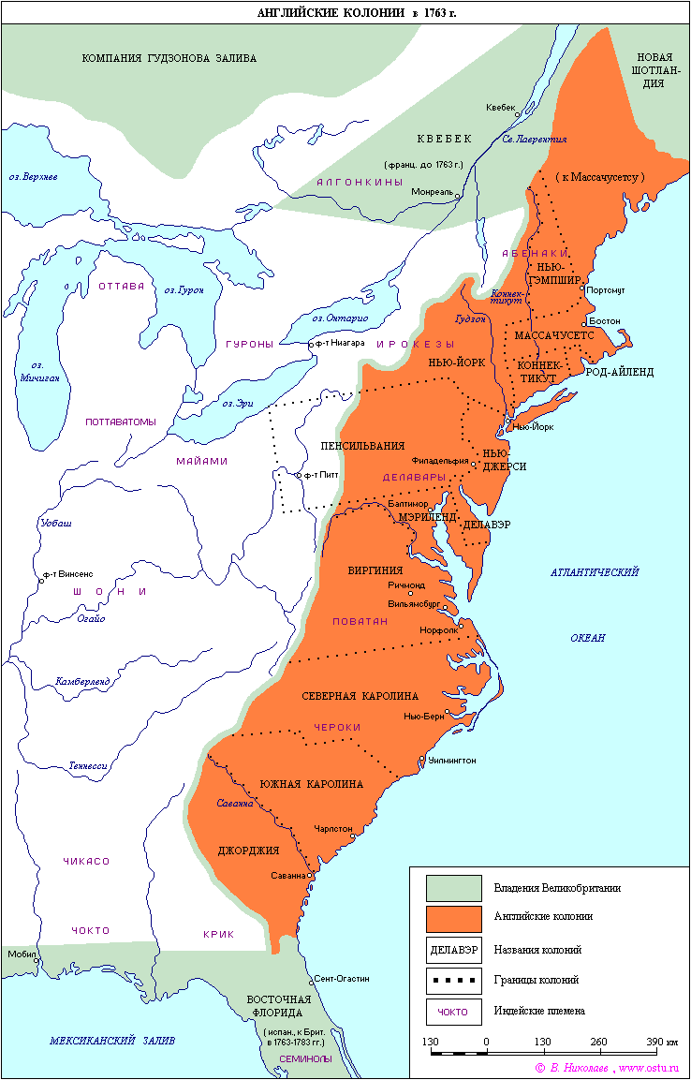
The British conquest began in the 13th century with the invasion into Ireland.
The path to the British colonization of America was opened with the defeat of the Spanish Armada in 1588.
In 1607 the first English colony was founded in North America.

Slide 3
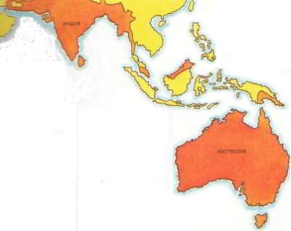
Almost at the same time the penetration began in India.
In 1600, a group of London merchants founded the East India Company.
By 1640 there had been established a network of factories not only in India but also in Southeast Asia and the Far East.
In 1690 the company began to build the city of Calcutta and in the next decade it actually dominated the entire Indian subcontinent.

Slide 4
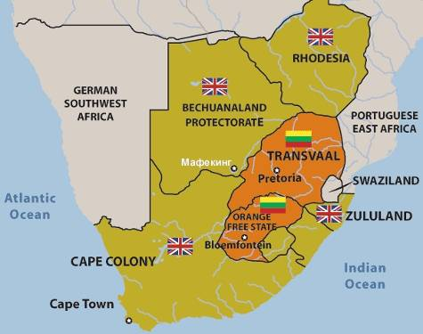
During the "colonial division of the world" (the last quarter of the 19th century) Britain invaded Cyprus, established control over Egypt and the Suez Canal, completed the conquest of Burma, established a de facto protectorate over Afghanistan, conquered vast territories in Tropical and Southern Africa.
After a bloody Anglo-Boer War (1899-1902), Britain also seized the Boer republics of Transvaal (South Africa)

Slide 5
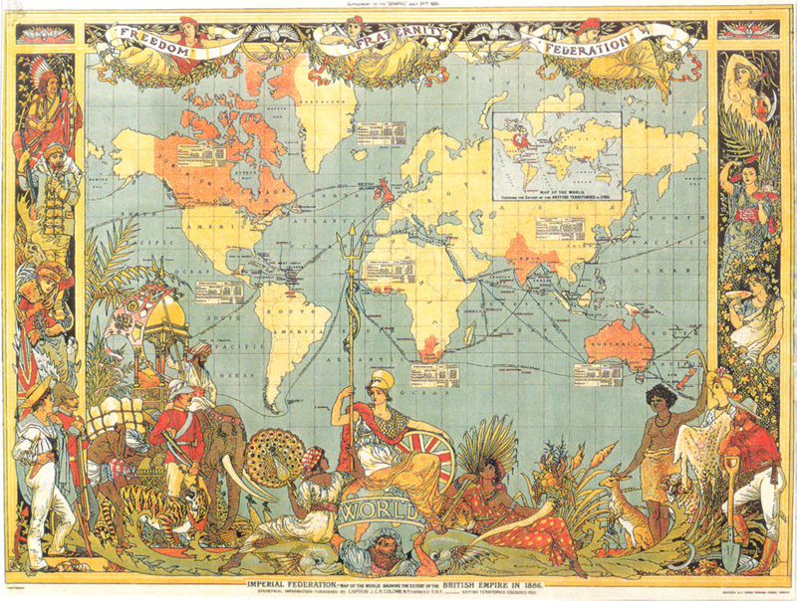
England had large colonies in the world, and all the people in those colonies spoke English.

Slide 6
