Slide 1
(1422 - 1491 )
Kartamyshev D., 8L1

Slide 2
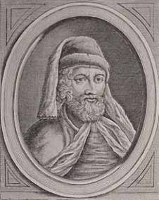
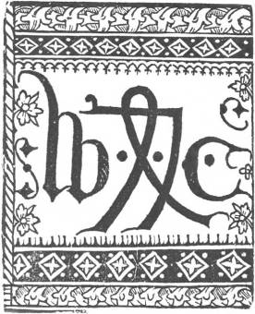
He is the first book English printer. He was born in Kent in1422.His father was a farmer. William did not want to become a farmer like his father. So his father sent him to London.
When William Caxton was thirty, after his master`s death he started his own business in Belgium.

Slide 3
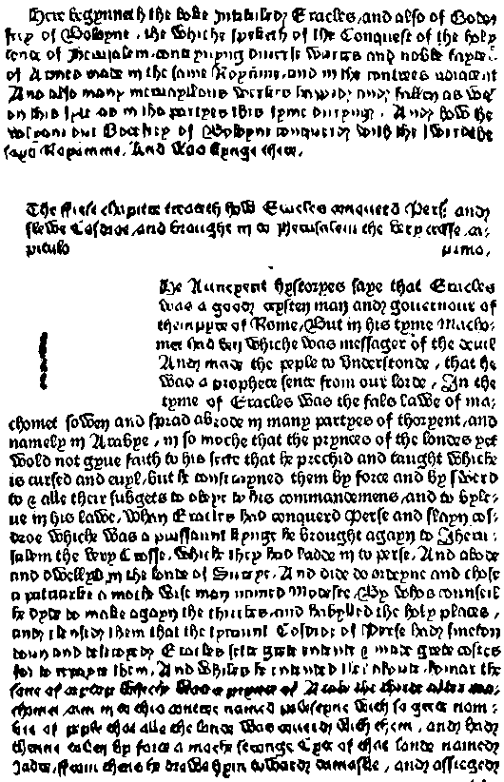
In 1476 he brought his printing-press to London.

Slide 4
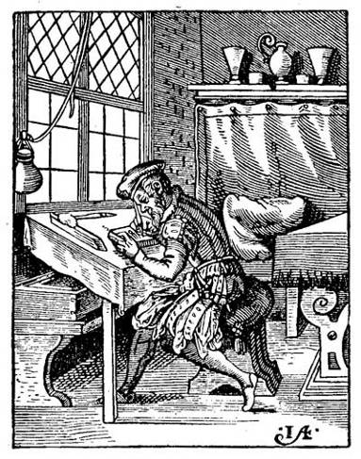
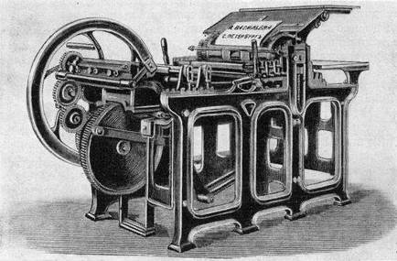
Printing was something new at that time and most people thought that it was the work of the devil. Some of the people wanted to break his press.

Slide 5
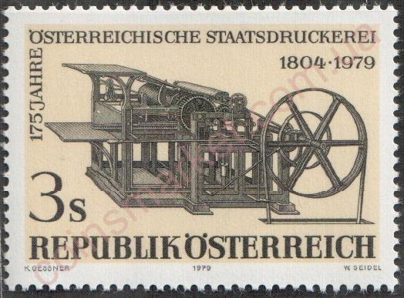
Caxton printed his first book in 1477. It was the first book printed in the English language.

Slide 6
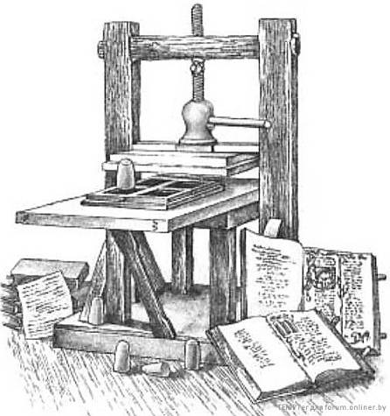
William Caxton printed about eighty books. He translated thirty-one books from French . Caxton died in 1491.

