Slide 1
The History of the English Language
Dalakishvily Sophia, 8L1

Slide 2
The History of the English language can be divided into the following periods:
Old English (450-1066)
Middle English (1066-1500)
New English (from 1500 to the present time).

Slide 3
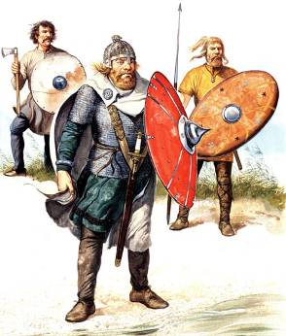
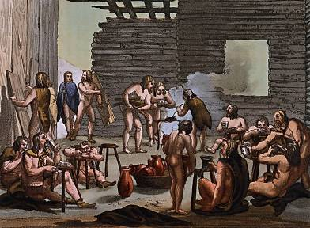
Old English Period
Germanic tribes of the Angles, the Saxons and the Jutes, are considered the ancestors of today's English. They migrated to Britain's island in the middle of V century.
When the Germanic tribes migrated to the British Isles, they entered into a fierce struggle with the indigenous local population - the Celts.

Slide 4
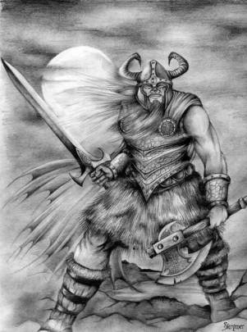
Old English Period
The Vikings conquered Britain a bit later.
The Vikings gave the Old English a significant amount of words of the Scandinavian origin.

Slide 5
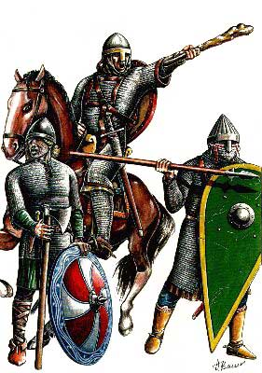
Middle English Period
The Normans invaded Britain after the Vikings. They introduced the powerful Anglo-Saxon lexical layer-Normanism.
Norman remained the language of the church for a long time. But the conquerors were few to impose their language intact.
The Normans language teaching was stopped in 1385.
The laws of Parliament were published in English in 1483.

Slide 6
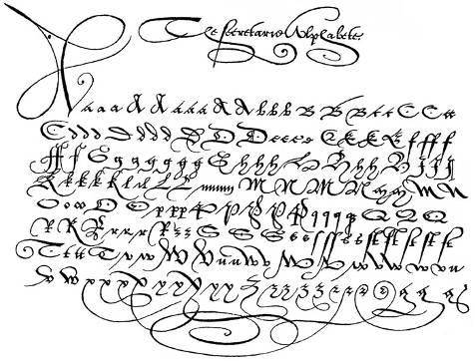
New English Period
Modern English, which is now spoken by the British, begins to develop at the end of the XV century.
Phonetics and spoken language continues to change and move away from the word norms.

