Slide 1
Alexeeva Valeria, 8L1

Slide 2
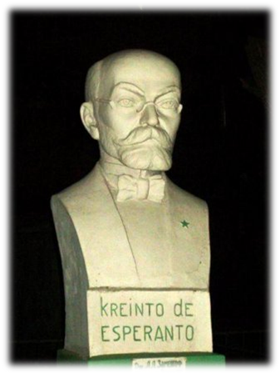
Esperanto is the most widely spoken artificial language created in 1887. It was created by Dr. Ludwig Lazarus Zamenhof, an ophthalmologist from Bialystok, then part of the Russian Empire. According to Zamenhof, he created this language to foster harmony between people from different countries. It took him ten years of work to create Esperanto. The language is extremely easy and it includes words almost from all world languages.

Slide 3
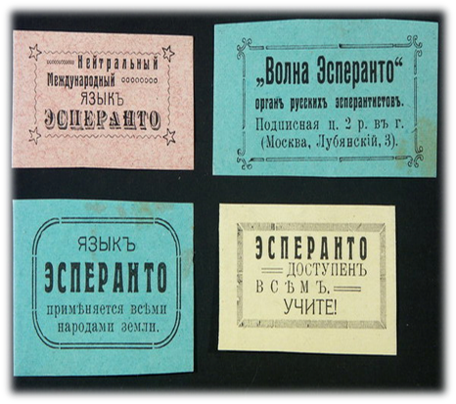
There are 28 letter in the alphabet, 2 cases (nominative and accusative), no gender.
But Esperanto is not very popular in the world. Estimates of Esperanto speakers range from 10,000 to 2,000,000 active or fluent speakers, as well as native speakers, that is, people who learned Esperanto from their parents as one of their native languages.
Esperanto is spoken in about 115 countries.

Slide 4
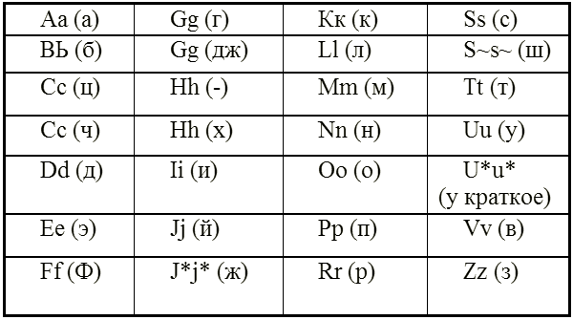
Esperanto’s alphabet

Slide 5
Esperanto’s flag

