Slide 1
The Tower of Babel
Ampleeva Irina, 8L1

Slide 2
From Mount Ararat, where the ark rested, many of the people moved southward into a country between two great rivers, the rivers Tigris and Euphrates: and there they built houses for themselves. They undertook to build a great city, which should rule all the peoples around them.

Slide 3
They found that the soil in that country could be made into bricks, and that the bricks could be heated and made hard; so that it was easy to build houses to live m, and walls around their city to make it strong against enemies.
And the people said to each other, " Let us build a great tower, that shall stand on the earth and shall reach up to the sky; so that we may be kept together, and not scattered abroad on the earth."

Slide 4
So they began to build their great tower out of bricks, which they piled up, one story above another. But God did not wish all the people on the earth to live close together, just as they had lived before the great flood. God knew that if they all kept together, those that were wicked would lead away from God those that were good, and all the world would become evil again, as it had been before the flood.

Slide 5
This was the way that God kept people from staying in one place. While they were building this great city and tower which they intended to rule the world, God caused their speech to change. At that time, all men were speaking one language, so that everybody could understand what every other person said.

Slide 6
God caused men to change their language, perhaps not all at once, but by degrees, little by little. After a time, the people that belonged to one family found that they could not understand what the people of another family were saying, just as now Germans do not understand English, and French people cannot talk to Italians, until they have learned their different languages.

Slide 7
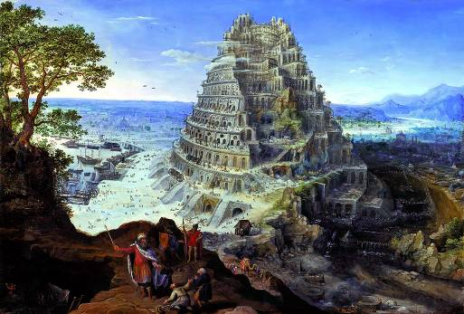
As people began to grow apart in their speech they moved away into other places, where the families speaking one language could understand each other. So the men who were building the city and the great tower could no longer understand each other's speech; they left the building without finishing it, and many of them went away into other lands. So the building stayed forever unfinished.

Slide 8
And the city was named Babel, a word which means "confusion." It was afterward known as Babylon, and for a long time was one of the greatest cities of that part of the world, even after many of its people had left it to live elsewhere. So after the flood, the earth again became covered with people living in many lands and speaking many languages.

