Slide 1
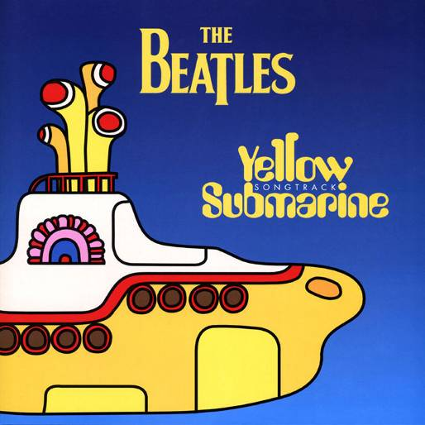
The Beatles Yellow Submarine
In the town where I was born Lived a man who sailed to sea. And he told us of his life In the land of submarines. So we sailed up to the sun Till we found the sea of green And we lived beneath the waves In our Yellow Submarine.
Chorus: We all live in a Yellow Submarine, Yellow Submarine, Yellow Submarine, We all live in a Yellow Submarine, Yellow Submarine, Yellow Submarine.
And our friends are all aboard, Many more of them live next door And the band begins to play…
Chorus:
As we live a life of ease, Everyone of us has all we need Sky of blue and sea of green In our Yellow Submarine
Chorus:

