Slide 1
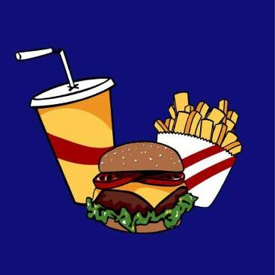
Mikhailova Catherine, 8L1

Slide 2
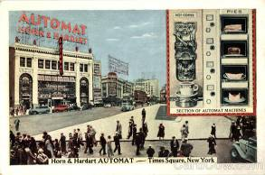
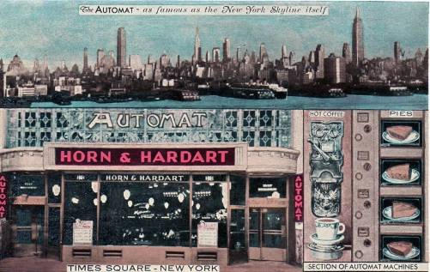
The industry of American fast food started in 1912, when Horn & Hardart company opened the first snack bar called “Automat”. Though the first fast food bar was opened in Philadelphia, this way of eating became very popular exactly in New York! Moreover the same fast food bar in NY became a real landmark!

Slide 3
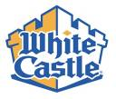
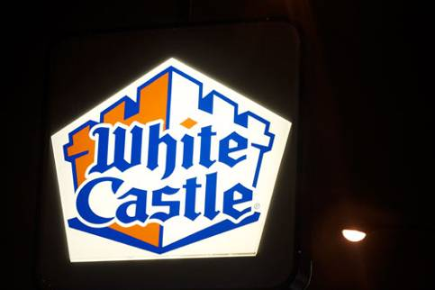
In 1921 White Castle company opened its snack bar in Kansas. The main dish there was a hamburger. Stable price was 5 cents. And doubt about the quality of the product was eliminated by a sly approach of the company owner Billy Ingram.
Special men in white bathrobes created the impression that doctors buy hamburgers!

Slide 4
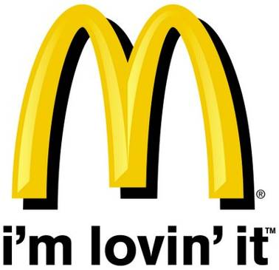
MacDonald’s
In1948 brothers MacDonald opened their first fast service restaurant in San- Bernardino. It became very successful. MacDonald's was a very dangerous competitor for Hord & Hardart! So brothers decided to develop their own business.

Slide 5
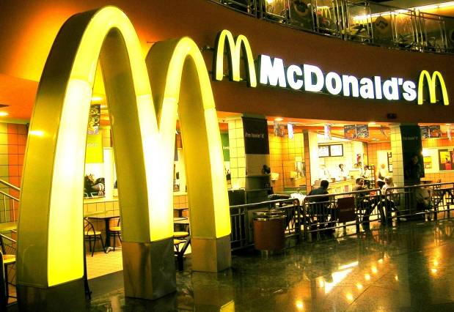
MacDonald’s
This solution has started the development of the world famous net of snack bars - MacDonald’s! Now there are many MacDonald’s fast food bars, more then in 120 countries!

Slide 6
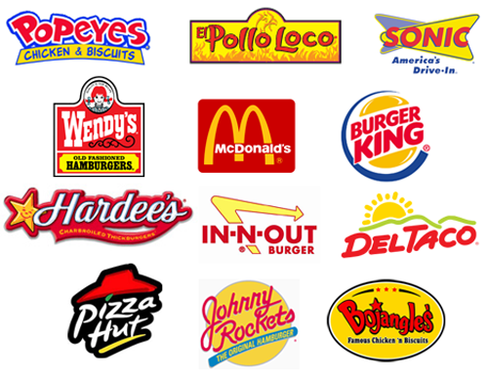
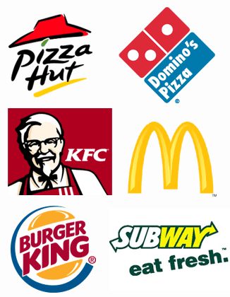
The most famous fast food corporations are MacDonald’s, Burger King and SubWay.

Slide 7
Radistka Kat

