Slide 1
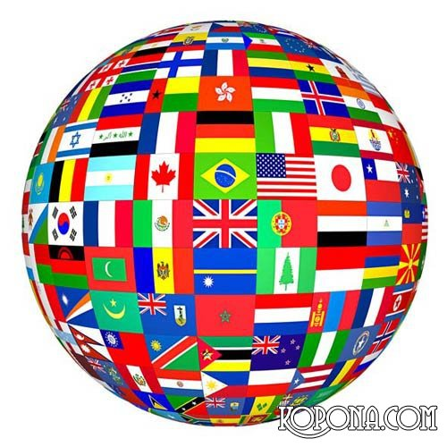
World Languages
Nowadays there are
about 6800 languages
in the world.

