Slide 1
Why do we study?
The more we study, the more we know
The more we know, the more we forget
The more we forget, the less we know
The less we know the less we forget
The less we forget, the more we know
So why study?

Slide 2
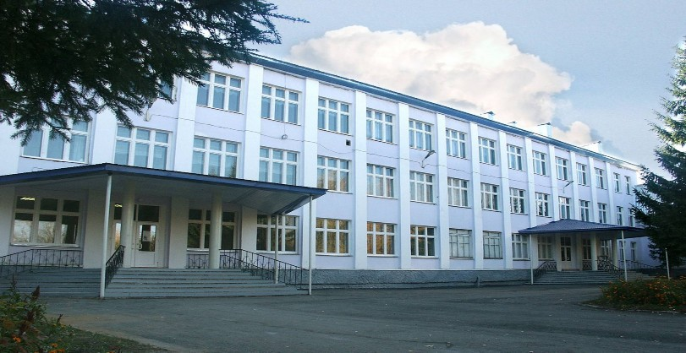
My school.

Slide 3
Speaker’s corner
1 make up а dialogue of introduction
2 make up аdialogue about your flat
make upа dialogue about your hobby
make up а dialogue about your favourite subject

Slide 4
Listening corner
Complete the chart
1 The science lesson is in room ----------
2 His name is --------
3 Markus is ---- years old
4 Markus is in class -----

Slide 5
Listening corner
Check your answers
The science lesson is room D
His name is Markus
Markus is 12 years old .
He is in class 2 E

Slide 6
A letter from Mike
Dear Nikita,
Thanks a lot for your letter. It was very interesting to know about your family.
In my letter I would like to tell you about my school. As you know in England schools have names, not numbers. Well, I study at Hazell Grove school. The school year begins on the first Tuesday of September. We wear school uniform (I hate it). My favorite subject is Maths, we do a lot of tests.
Where do you study? Who is your favourite teacher? You spend time after school with your friends, don’t you ?
Unfortunately, its time for me to do homework (boring)
Best wishes,
Mike.

Slide 7
Reading corner
1. Mike studies at secondary school №4
2. The school year begins on the first Tuesday of September.
3. He doesn’t wear school uniform.
4. His favourite subject is Maths.
5. Mike dislikes his school.

Slide 8
Reading corner
1. Mike studies at secondary school №4-F
2. The school year begins on the first Tuesday of September.-T
3. He doesn’t wear school uniform.-F
4. His favourite subject is Maths.-T
5. Mike dislikes his school.-F

Slide 9
Сorner of Puzzles
h | i | s | t | o | r | y | g | w | t
m | a | c | e | s | u | d | e | f | g
u | h | i | n | k | s | l | o | p | o
s | r | e | g | t | s | y | g | u | i
i | e | n | l | w | i | q | r | a | s
c | d | c | i | f | a | g | a | r | t
c | z | e | s | l | n | k | p | j | h
v | b | n | h | m | q | w | h | e | r
a | s | x | v | f | b | r | y | n | u
l | y | t | r | t | h | b | c | s | y
Find the words ”School subjects’’

