Slide 1
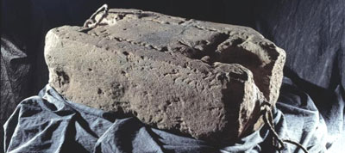
SCONE STONE
The Stone of Scone is arguably the greatest symbol and touchstone of Scottish nationhood and as such, has been a very potent icon for more than a thousand years. It was the seat on which generations of Kings of Scotland, and Kings of Dalriada before them, were crowned.

Slide 2
LEGEND
The legend of the Stone of Destiny goes back to the foundation myth of Scotland.
The legend runs that Scotland is named after an Egyptian princess, Scota who was exiled from Egypt. Her descendents conquered Ireland before migrating to what is now Argyll in Western Scotland and establishing the kingdom of Dalriada.
Among the possessions Scota took from Egypt was a 152kg sandstone block which had been used as a pillow by Jacob when he had the dream reported in Genesis about Jacob's Ladder.
This stone became the seat on which the Kings of Dalriada were enthroned and became known as the Stone of Destiny.

Slide 3
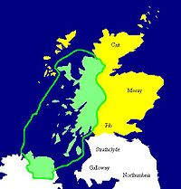
HISTORY
At that time, Scotland was occupied by five different peoples.
The Picts lived in the large area north of the rivers Forth and Clyde.
The Scots, from Ireland, made their home in Argyll in the fifth and sixth centuries.
The Angles held Lothian,
the ancient Britons had retreated to Strathclyde, and, in the ninth century, the invading Norsemen settled in Orkney, Shetland, Caithness, Sutherland and the Western Isles.
The unification of these different peoples began in the mid-ninth century, when Kenneth MacAlpin became king of both Picts and Scots.

Slide 4
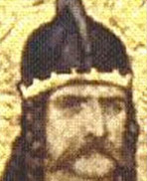
KENNET MACAILPIN (843-859)
After the Picts suffered a severe defeat at the hands of the Vikings in 839, Kenneth pressed his own claim to add the crown of the Picts to the crown of the Scots he already held. Scone had been an important Pictish centre for centuries, and the Picts and the Scots met here to discuss the Pictish succession in 843.
The story goes that after much alcohol had flowed, Kenneth's Scots turned on their Pictish hosts and killed them, and Kenneth was subsequently crowned King of the Picts and the Scots at Scone, using the Stone of Destiny to legitimise the coronation. After that Kenneth I or Kenneth Mac Alpin, the 36th and the last King of the Scots of Dalriada, moved his capital of his expanding empire from Ireland to Scone in what is now Perthshire, Scotland.
The Stone was first located at Dunadd during the time of Dalriada, then it was moved to Scone by King Kenneth I.

Slide 5
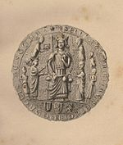
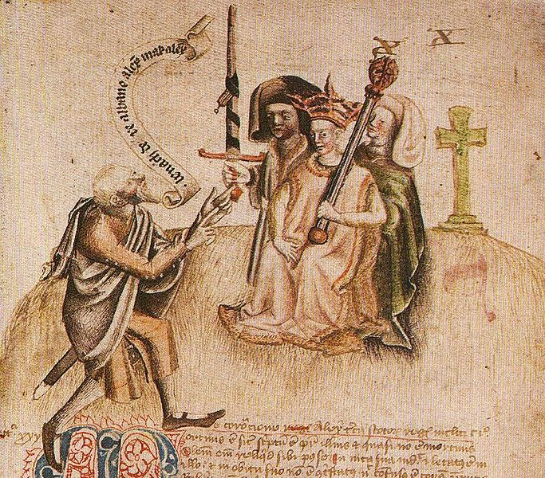
CORONATIONS AT SCONE
It was a tradition to enthrone a Scottish king as they sat upon the Stone of Destiny, which itself sat upon the mound at Scone.
The Stone of Destiny“ was also known as
the "Coronation Stone,“ the "Stone of Scone," the "Liath Fàil," "Jacob's Pillow,"
"Jacob's Pillar" and the "Tanist Stone".
The Stone was last used in a coronation in Scotland in 1292, when John Balliol was proclaimed King.
Scone Abbey Seal
Alexander I Coronation

Slide 6
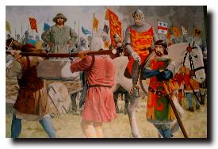
SCONE STONE GOES TO LONDON
Four years later, in 1296, the English monarch, Edward I (infamous as the "hammer of the Scots”) invaded Scotland and stripped Scotland of all emblems of nationhood. Among the booty that Edward's army removed was the legendary Stone.

Slide 7
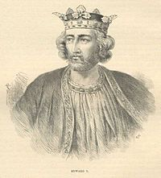
EDWARD I
Edward took a personal interest in relics and symbols of nationhood. When he conquered Wales in 1282 Edward had the ‘crown of King Arthur’ and other Welsh relics and treasures sent to Westminster in London.
When Edward conquered the Scots in 1296, he took Scotland’s holiest relic - the Black Rood - a piece of the True Cross that had belonged to Saint Margaret. Moreover, his army ransacked Scone Abbey, recovered the Stone and carried it to England.

Slide 8
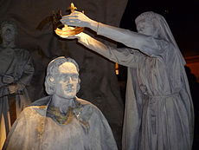
CORONATIONS AT SCONE
Scottish Monarchs, and those seeking to become Scottish Monarchs, continued to come to Scone to be crowned, including Robert the Bruce in 1306, James IV in 1488 and Charles II in 1651, Francis Edward Stuart in 1716 , his son Bonnie Prince Charlie also visited Scone in 1745.
These coronations were different however, since Edward I of England had stolen the stone in 1296.
1306 - Coronation of Robert The Bruce

Slide 9
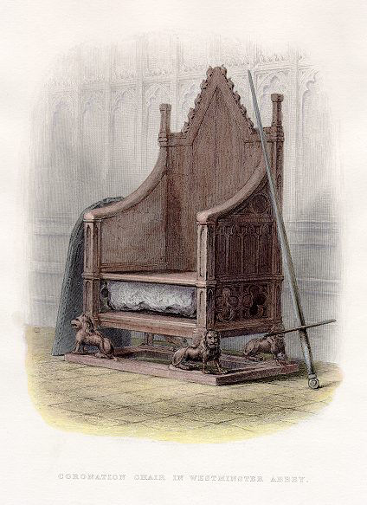
ST. EDWARD’S CHAIR
The Scone Stone was to be housed in a specially-built coronation chair in Westminster Abbey for the next 700 years.
The chair was named after Edward's namesake, Edward the Confessor, England's only canonized king and was kept in his shrine of St Edward's Chapel at Westminster Abbey.
The high backed gothic style arm chair was carved in 1297 from oak by a carpenter known as Master Walter, who was paid the considerable sum of 100 shillings for his work.
Under the seat of the chair is a platform and cavity which until 1996 contained the Stone of Scone.

Slide 10
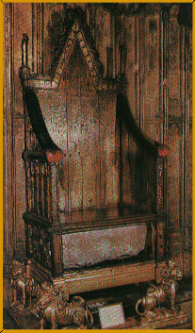
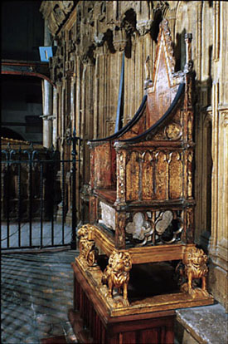
CORONATION CHAIR
All British sovereigns since 1308 have been seated in St. Edward's Chair at the moment of their coronations, with the exception of Queen Mary I (whose coronation chair was given to her by the Pope ) and Mary II (who was crowned on a copy of the chair). The last occasion was the coronation of Elizabeth II in 1953.

Slide 11
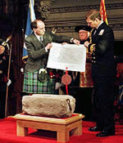
THE STONE RETURNS HOME
On St. Andrew’s day, November, 30, 1996 the Stone of Destiny was
returned to Scotland,
exactly seven hundred years after
King Edward I of England "carted it off
to Westminster Abbey" in 1296.

Slide 12
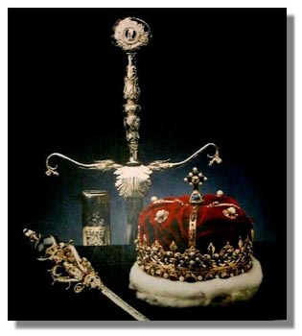
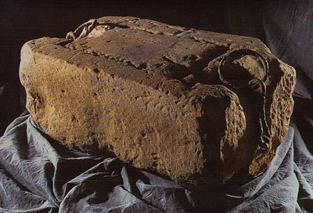
EDINBURGH CASTLE
The Stone, a large 152 kg block of red Perthshire sandstone, is now on display in Edinburgh Castle,
where it joined the other
Scottish royal regalia: crown,
scepter ,
sword and jewels
in a closely-guarded museum.

Slide 13
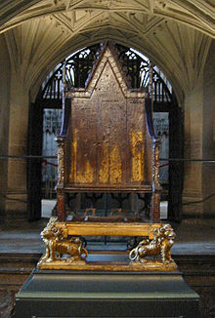
WESTMISTER ABBEY
In the event of a future coronation of a British monarch,
the Stone of Destiny will be temporarily replaced
under the Coronation Throne
at Westminster Abbey.

Slide 14
USEFUL SITES
http://www.scone-palace.net
http://images.yandex.ru
http://www.scone-palace.co.uk
http://www.expedia.com
http://wikimapia.org
http://www.insiders-scotland-guide.com
http://www.greatscotland.co.uk
http://www.tourist-information-uk.com
http://www.perthshire.co.uk
http://www.bbc.co.uk
http://britishcastle.co.uk
http://www.undiscoveredscotland.co.uk
http://www.gateway-to-the-scottish-highlands.com
http://www.theheritagetrail.co.uk

