Slide 1


Slide 2
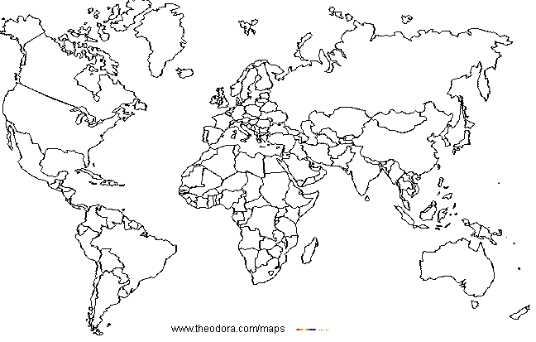
Great Britain
Russia
Italy
Japan
Greece
India
China
Egypt
Brazil

Slide 3
SUMMER HOLIDAYS

Slide 4
Why do you travel?
Why
to discover
new places
to learn
a language
to know the
history, culture
to make
friends
to know customs,
traditions
to visit new
places
to meet
people
to see the
sights

Slide 5
I can see … if I visit…
Big Ben and the Westminster Palace
The Tower Bridge
Stonehenge

Slide 6
I can see … if I visit…
Peterhof
St Basil’s Cathedral
The Kremlin
The Hermitage

Slide 7
I can see … if I visit…
The Coliseum
The Vatican
The Tower of Pisa

Slide 8

I can see … if I visit…
The pyramid of Giza
Sphinx

Slide 9
I can see… if I visit…
The Parthenon
The Taj-Mahal

Slide 10
I can see … if I visit…
The Great Wall
The statue of Christ

Slide 11
SUMMER HOLIDAYS

Slide 12

I can see … if I visit…
Sidney Opera House
White Bird Palace

Slide 13
I can see … if I visit…

Slide 14
HOMEWORK
Prepare a presentation about your summer holidays.

