Slide 1
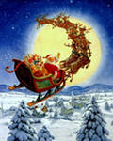
Christmas in
Great Britain and America

Slide 2
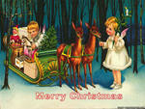
Christmas
cards

Slide 3
Christmas tree

Slide 4
Coloured lights

Slide 5
Christmas
Wreath

Slide 6
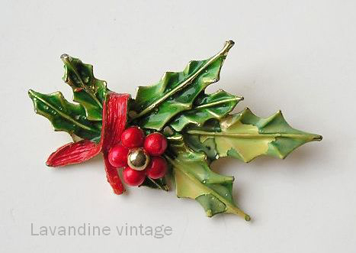
Holly

Slide 7
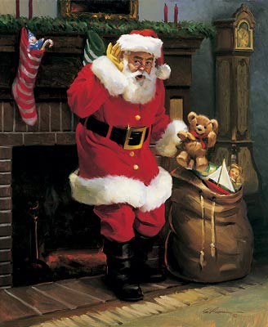
Santa Claus

Slide 8
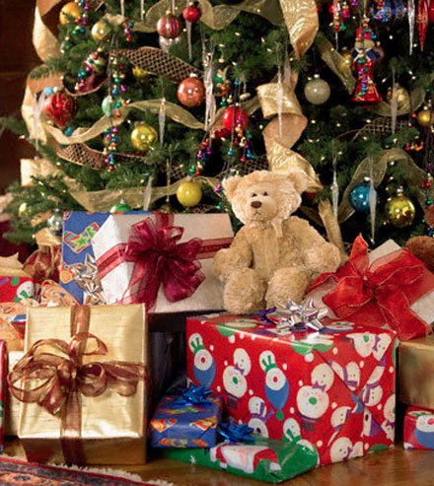
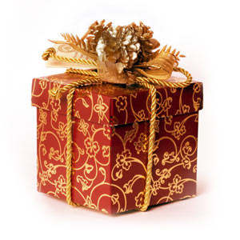
Presents

Slide 9
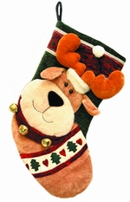
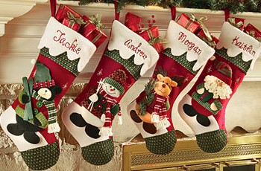
Stockings

Slide 10
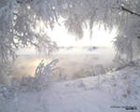
Snow

Slide 11
Snowman

Slide 12
Sledge

Slide 13
Reindeer

Slide 14
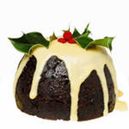
Christmas
pudding

Slide 15
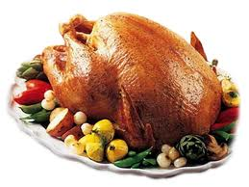
Turkey

Slide 16
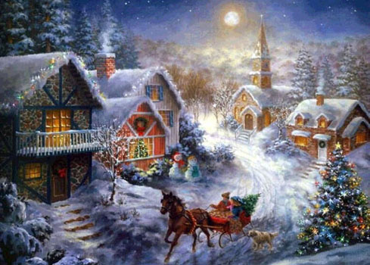
Merry Christmas
Turkey
We Wish You A Merry Christmas - Disney.flv

Slide 17
Homework.
1) Write what presents you would like to get for Christmas and why.
2) Write a Christmas card to your friend.

Slide 18
Thank you
Презентацию подготовила
учитель ГОУ СОШ №996 г.Москва
Кириченко Татьяна Витальевна

Slide 19
Используемые ресурсы
blogs.mail.ru
animated-images.su
http://www.liveinternet.ru/users/m_olga55/post172528598/
http://lana.do100verno.com/blog/107/17003
www.xrest.ru
www.proshkolu.ru
www.fotoregion.ru
http://lev-valt.ya.ru/posts.xml?tb=120&mint=1257022800&maxt=1259614799
alamandi-club.com
coolhtml.ru
www.vashsad.ua
http://images.yandex.ru/yandsearch?rpt=simage&ed=1&text=%D0%BE%D0%BB%D0%B5%D0%BD%D1%8C%20%D1%81%D0%B0%D0%BD%D1%82%D0%B0%20%D0%BA%D0%BB%D0%B0%D1%83%D1%81%D0%B0&p=60&img_url=img.sunhome.ru%2FUsersGallery%2FCards%2F85%2F19231145.jpg

