Slide 1
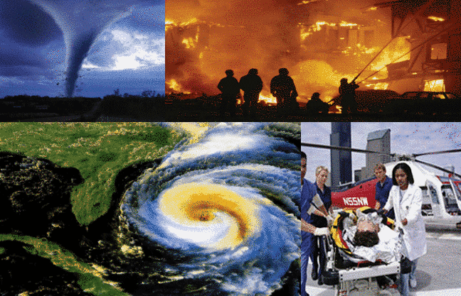
DISASTERS

Slide 2
A hurricane, a tornado, a drought, a volcano, a flood, an earthquake
is a large amount of water which quickly covers a place that is usually dry land.
A flood
An earthquake
is a sudden shaking of the ground.
A hurricane
is a very violent wind or storm.
is a very violent wind in the form of a funnel of air that spins at a great speed across land.
A tornado
is a mountain with a hole called a crater in the top. Sometimes lava and gases are released from the crater.
A volcano
is a long period of dry weather when there is not enough water.
A drought

Slide 3
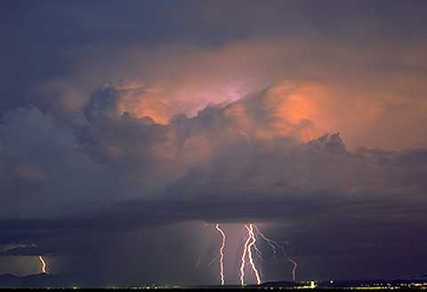
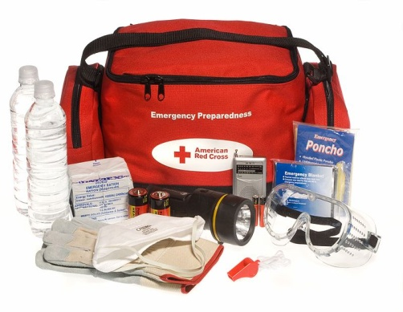
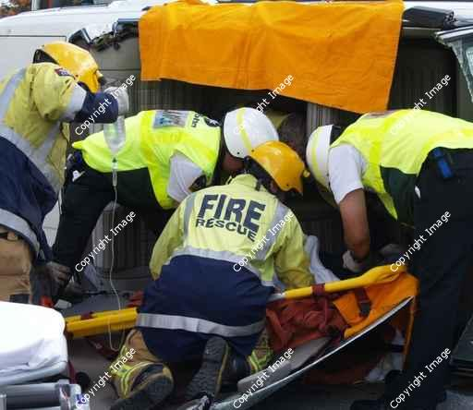
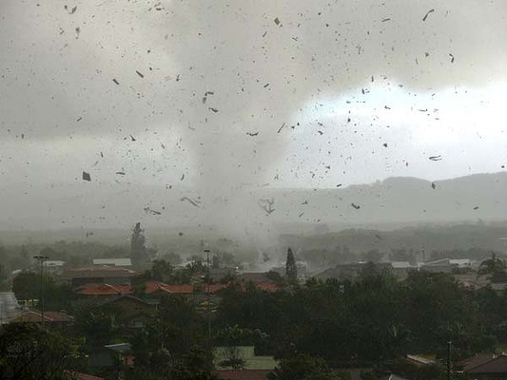
Emergency services, flying debris, thunderstorm, emergency supplies
Emergency supplies
Emergency services
Thunderstorm
Flying debris

Slide 4
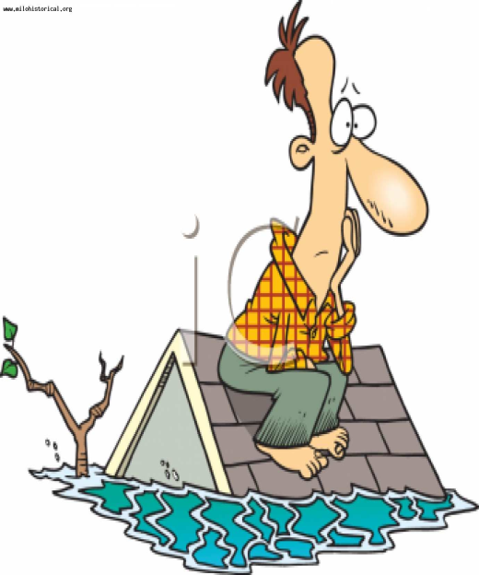
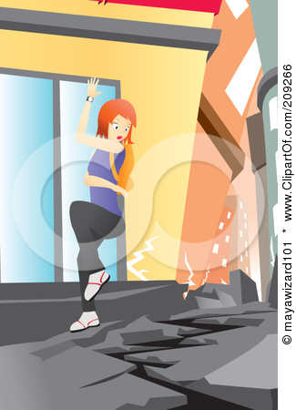
If there is …… do…….
If there is a tornado, go to the basement.

Slide 5
If there is water damage, you should not drink contaminated water.
Be prepared to evacuate the area.
Don’t go to the beach to see the wave. You won’t be able to escape.
If there is a flood, not go to the basement.
Don’t walk through the moving water if the river floods its banks
Remember if a tsunami is approaching land, keep away from the shoreline.

Slide 6
Homework
Ex.2p.17 (Wb)

