Slide 1
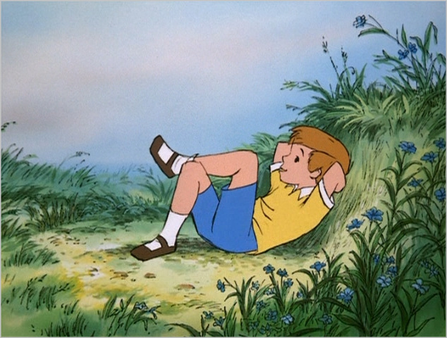
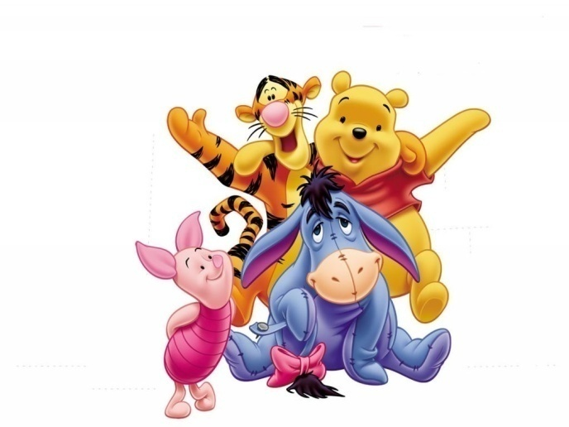
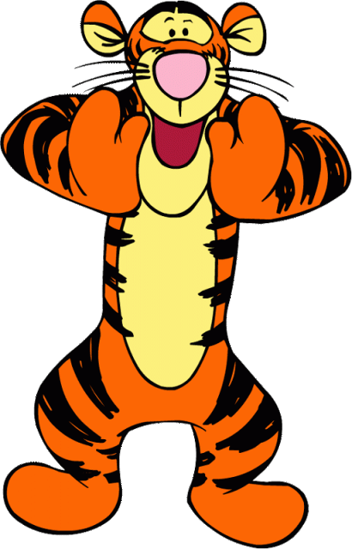
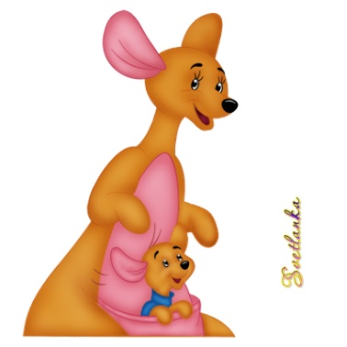
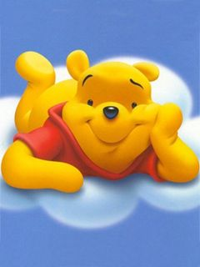
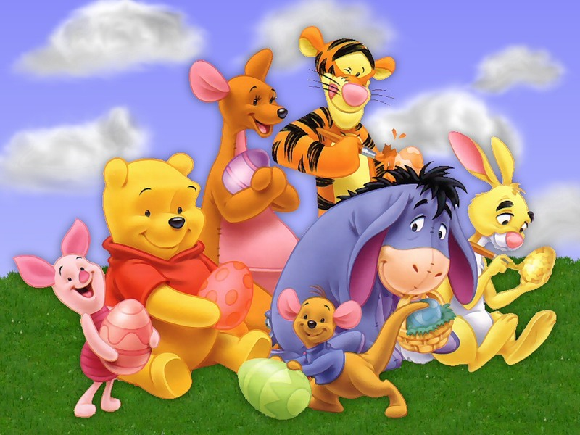
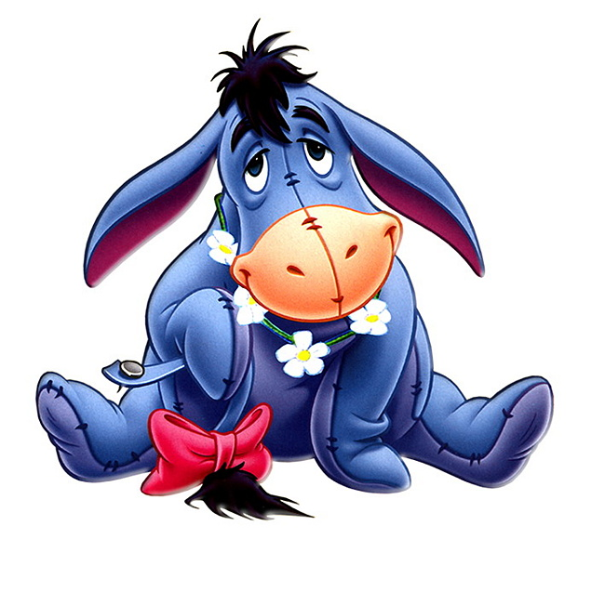
Welcome to the lesson

Slide 2
Look at the screen and give the English equivalents for the Russian ones.
директор небольшой подготовительной школы
математик
редактор университетского журнала
он опубликовал
незамысловатые юмористические стихи
остроумные произведения
книга в мягкой обложке
юмористические очерки
помощник редактора
обожаемый сын
плюшевый медведь
снял дом
иллюстрации
игрушка ожила
книга детских стихов
он был управляющим в книжном магазине
игрушки были «эвакуированы»

Slide 3
Alan Alexander Milne
-was born in London on January 18th 1882
-the headmaster of a small preparatory school
-wanted to become a mathematician
-became an editor
-published his first book in 1905
-a shilling paper-back collection of humorous essays
-the famous magazine “Punch”
-married in 1913
-was born on August 21, 1920
-bought him a teddy-bear
-wrote poems for him
-rented a house in the country
-was published in 1924
-gave A. Milne more details for his famous book
-were done by Ernest Shepard
-used his story-telling talents to describe how one little boy so loved his teddy-bear that…
-spent 6 years in the Army
-ran a bookshop
-were “evacuated” to America

Slide 4
Christopher’s toys
Winnie-the-Pooh
Tigger
Piglet
Kango
Roo
Rabbit
Eeyore

Slide 5
Tigger comes to the forest and has breakfast
Match the phrases in English with their Russian equivalents
1) on the contrary
2)anyhow
3) every now and then
4) to come in sight
5) help yourself
6)condensed milk
a) то и дело, время от времени
b) сгущенное молоко
c) во всяком случае, как бы то ни было
d) напротив, наоборот
e) появиться (попасть в поле зрения)
f) угощайтесь

Slide 6
Explain why
1) Pooh began to apologize saying,” Oh, Eeyore, I didn`t mean that I didn`t want to see you.”
2) Eeyore kept the patch of thistles for his birthday.
3) Tigger looked anxiously at Pooh when he saw thistles.
4) Tigger began running round in circles with his tongue hanging out.
5) Eeyore said:” … we all have our little ways,” when he asked Tigger to stop running about.
6) Tigger rushed out the house where Eeyore lived.
7) Pooh and Piglet didn`t speak on their way to Kanga.
8) the author mentioned that Pooh began feeling 11 o`clockish.

Slide 8
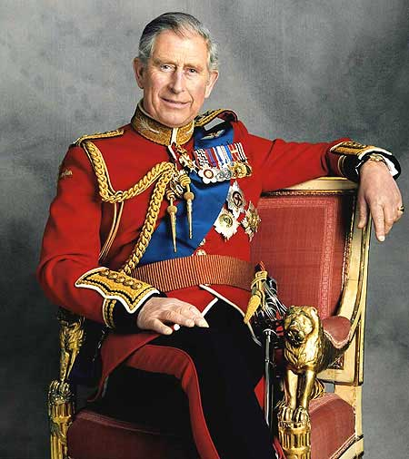
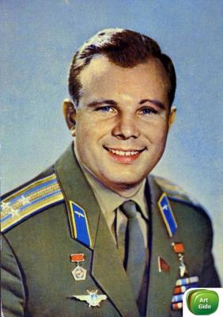
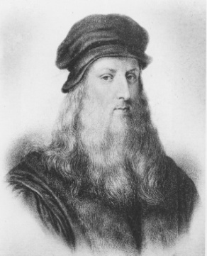
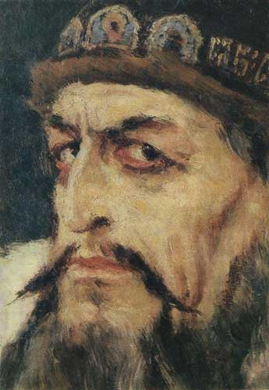
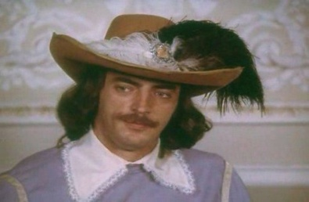
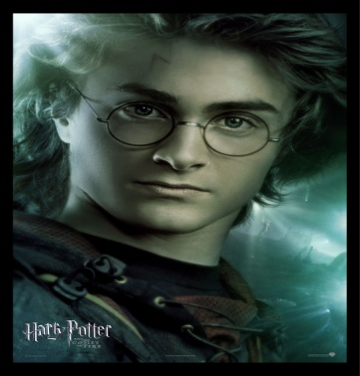
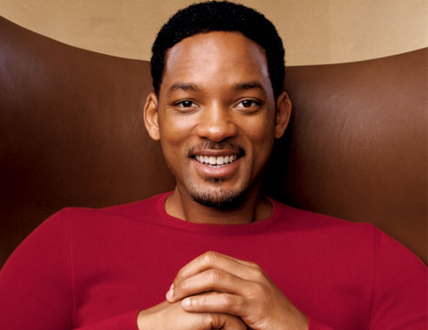
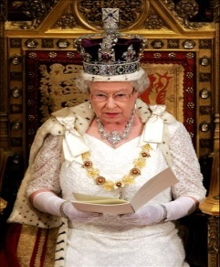
“It takes many kinds to make the world”
Appearance
Personality
Beliefs and opinions
People
are
different
in Dreams and plans for future
Behaviour and manners
Likes and dislikes
Education
Skills and experience

Slide 9
Now try to express your agreement or disagreement with the statements using the conversational formulas
a) People are both-different and alike.
b) Living in the same place, reading the same books make us alike.
c) Good-looking people are always kind and friendly.
d) Our personalities, tastes, likes and dislikes change with years.
e) Teachers and parents are never good friends to children.
f) Different people often get on well.
You agree : Just so.
I quite agree.
Sure.
Certainly.
That`s just what I was thinking.
You are not sure: Yes, but… I`m afraid, I don`t agree.
I don`t think you are right.
I can`t agree with you.
I`m not so sure.
You disagree: On the contrary! Certainly not.

Slide 10
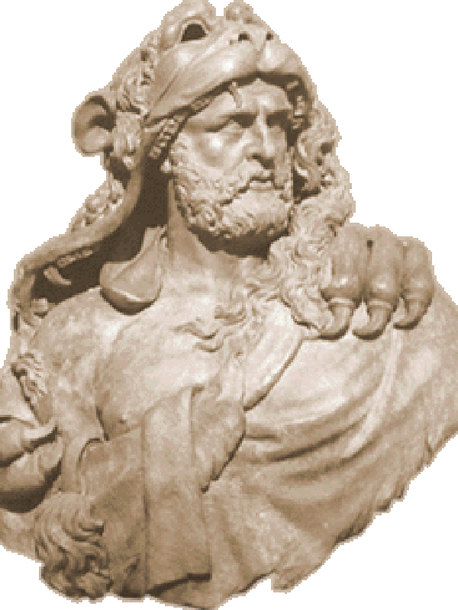
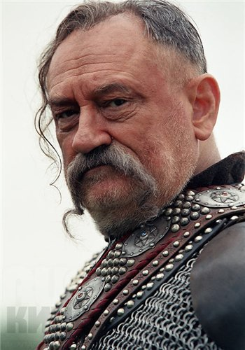
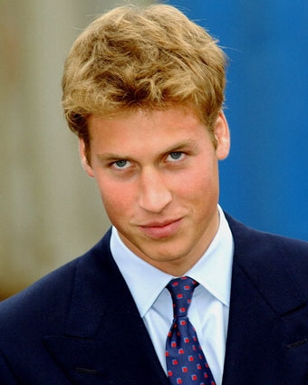
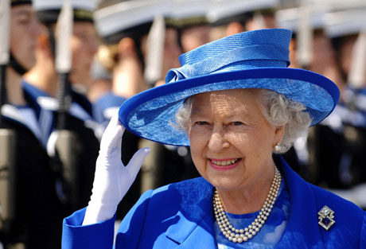
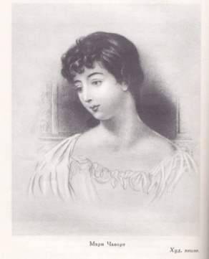
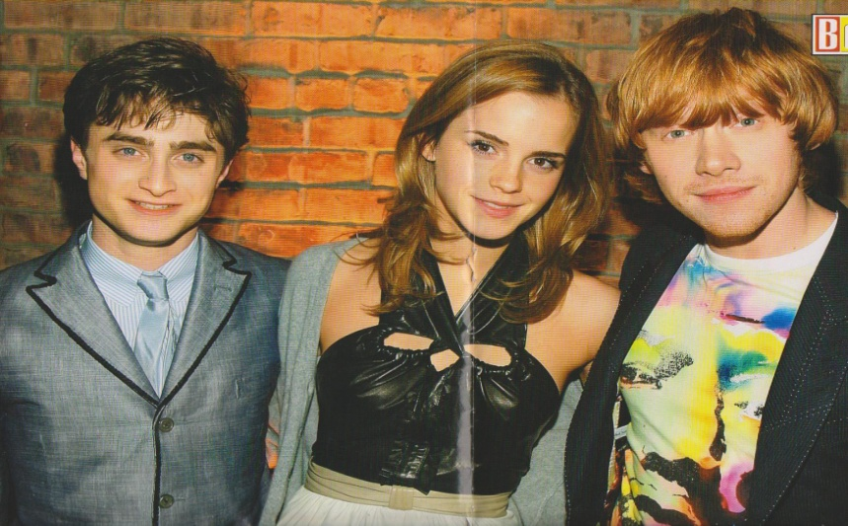
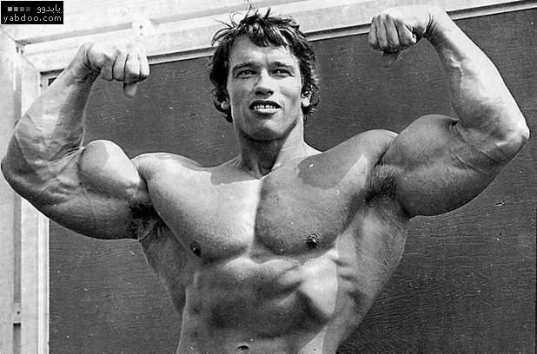
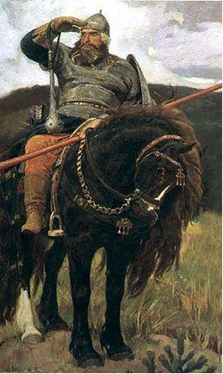
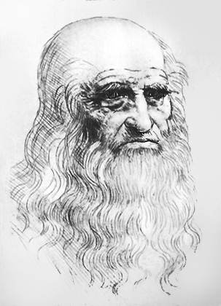
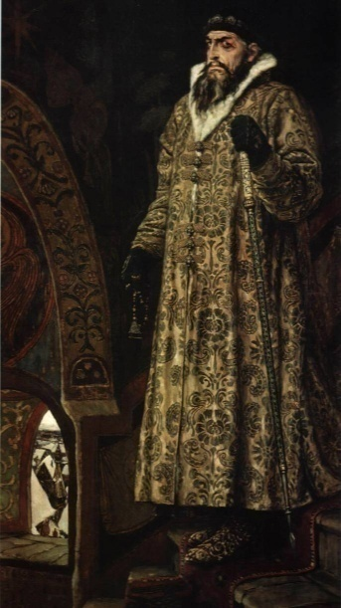
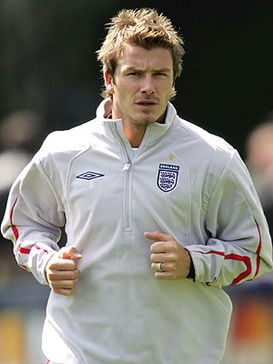
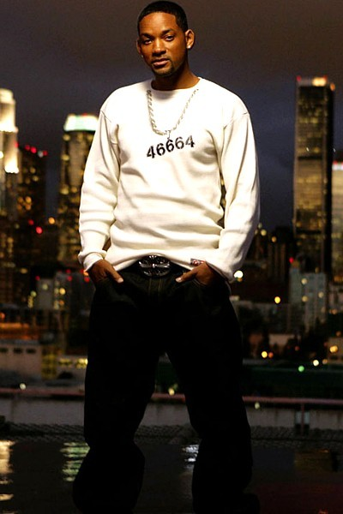
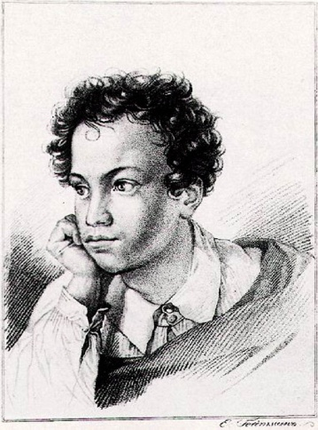

Slide 11
Can you complete the idea?
We all live on the planet Earth. We are different but…

Slide 12
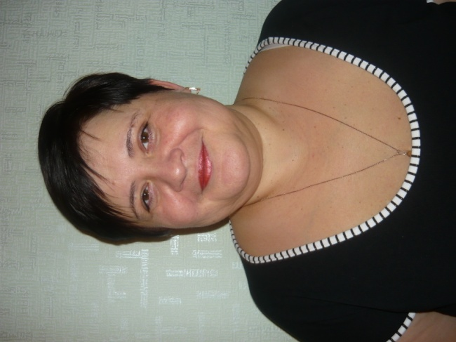
Презентация к уроку подготовлена учителем английского языка высшей категории МОУ «Хомутовскоя средняя общеобразовательная школа с углублённым изучением английского языка» Курской области Даниловой Ириной Николаевной

