Slide 1
what do you know about the cinema

Slide 2
The concept of the cinema first appeared in his French version - "motion picture" is the system of creation and the film developed by brothers Louis and Auguste Lumiere Jean. Officially, cinema dates back to December 28, 1895. On this day in India Show "Grand Cafe" on the Boulevard des Capucines (Paris, France) held a public demonstration of 'cinematograph of the Lumiere brothers. " In 1896, the brothers made a world tour with his invention, visiting London, New York, Mumbai.
Although the trial (even public) demonstration of films began in 1888. And in 1895, has passed a sufficient number of sessions "moving pictures", but their inventors usually do not know about each other, which later served as the cause of endless arguments about the movie pioneers. Public sessions are also paid the Lumiere brothers just happened to be the most popular and successful from a commercial point of view. Therefore, they considered to be the parents of cinema.
Brothers Louis and Auguste Lumiere Jean - The creators of cinema.

Slide 3
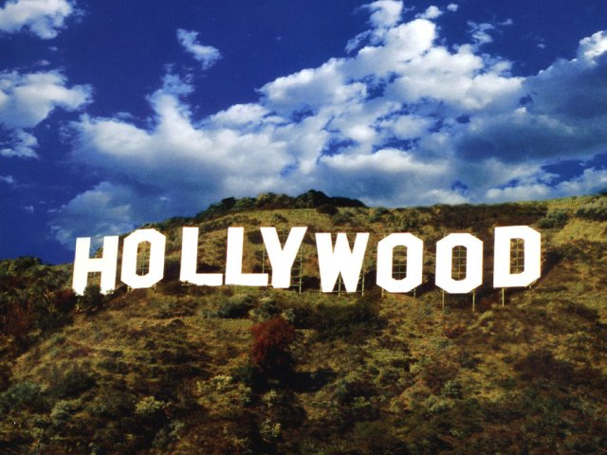

Slide 4
Hollywood
The main attraction in Los Angeles - Hollywood, the center of American cinema, the eternal "dream factory." Movie studios have long been moved to the suburbs, and kinogorod still live their myth.
Centre is Hollywood Boulevard, which is the Hollywood Walk of Fame. Now on the boulevard laid more than 2,000 stars with the names of great actors in Hollywood, look at that every year attracts about 20 million tourists. Hollywood's most beautiful place is the famous "Chinese cinema", in front of a movie star who immortalized himself imprints of their hands and feet.

Slide 5
The first film in Hollywood
Exactly 100 years ago, on March 10, 1910, released their first film, made at the world famous area of ​​Los Angeles - Hollywood. Silent picture called "The Old California," took its director David Wark Griffith.
In those days, Hollywood was a small hamlet a few miles from downtown Los Angeles. Before coming filmmakers chose to shoot Griffith his work in the so-called downtown Los Angeles, but the creator of the first Hollywood melodrama decided to drive a little further up the hill of Hollywood. Later it began to open up and the studios.

Slide 6
As reported by historians, the success of earlier provincial district primarily played the role geographical location. In California, almost all the year round sunshine, and the landscape in Hollywood extraordinarily diverse - on the one hand, close to the ocean, on the other hand, two steps mountains, forests and deserts. In addition, another important factor factor was the distance from the U.S. east coast, where at the beginning of the XX century was located Patent Trust Thomas Edison - the organization of the nine companies, which owned all rights to the film industry and film in the country.
"So if someone wanted to make a movie or show him, he was obliged to pay a lot of money to the trust. Therefore, many independent filmmakers traveled to Hollywood to be away from the trust. And it is their studio, and later turned in all the studios that we know it today ", - told the historian Harvey J. Cohen.

Slide 7
Жанры фильмов:
Action (action movie) - this genre is illustrated by the famous thesis of the "good to be with his fists." Films of this genre often do not possess a complex plot. The protagonist is usually faced with evil in its most obvious manifestation: crime, corruption, terrorism and murder. Finding no other way, the protagonist decides to resort to violence. Most often, the way he battles with the enemy meets a beautiful girl, they fall in love and in the end it always is taken prisoner and lover of all the forces trying to free his beloved. As a result of the destruction are dozens, sometimes hundreds of villains. And "happy End" (born happy end - a happy ending) - an indispensable attribute of militants.
For example: 1,2,3,4 Furious; 3 XXx; 3 XXx-2; Bald Nurse: Special Assignments - action comedy.

Slide 8
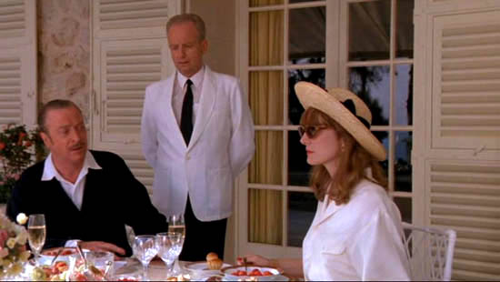
Melodrama - a work of this genre reveal the spiritual and sensual world of the heroes in a particularly striking emotional situations, often based on contrasts: good and evil, love and hate, etc.
For example: The main thing is not to be afraid; Burlesque; The Bodyguard; How do I know ....

Slide 9
Comedy - a genre that includes films that aim to arouse the viewer smile and improve his mood. Sitcom - it's a classic kind of comedy, based on the fact that the movie characters fall into the stupid, ridiculous situation. Parody - type comedy based on the parody of something (for example, to parody other films). Farce - a comedy with a light content of external purely comic relief.
For example: Taxi 1,2,3,4; 50 First Dates; Waterboy; No feelings.

Slide 10
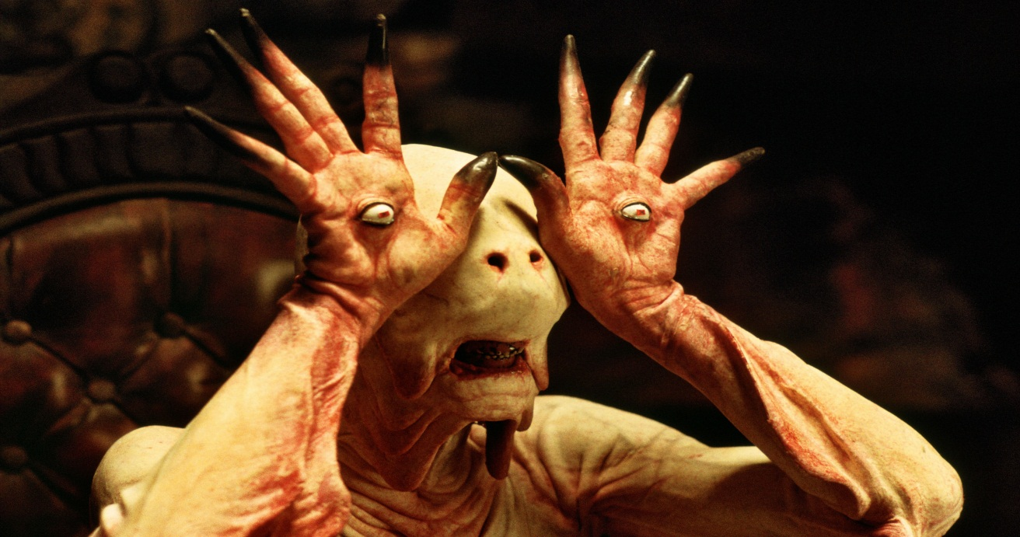
Horror - belong to this genre of films that are designed to scare the viewer, to instill a sense of anxiety and fear, create a tense atmosphere of terror and excruciating wait of somethingterrible. The plot of horror films are often built on the appearance of a serial killer in somequiet, does not predispose to the fear of the city. Another favorite subject - the emergence of a peaceful bloodthirsty monster (genetic mutant, alien, etc.). In the movies, there are oftenshocking pictures.
For example: Van Helsing; The Wolf Man; Saw 1,2,3,4,5,6,7; Pan's Labyrinth.

Slide 11
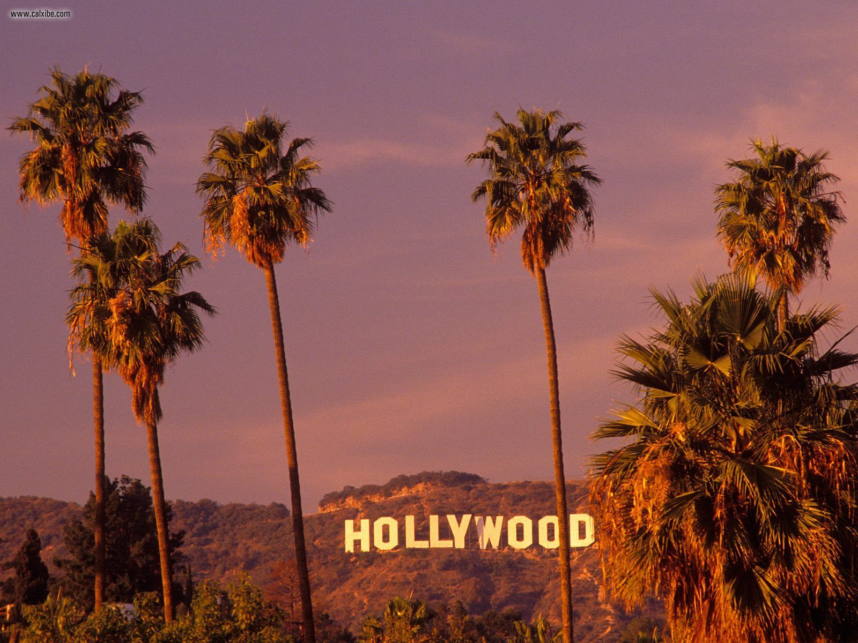
Landscapes of Hollywood

Slide 12
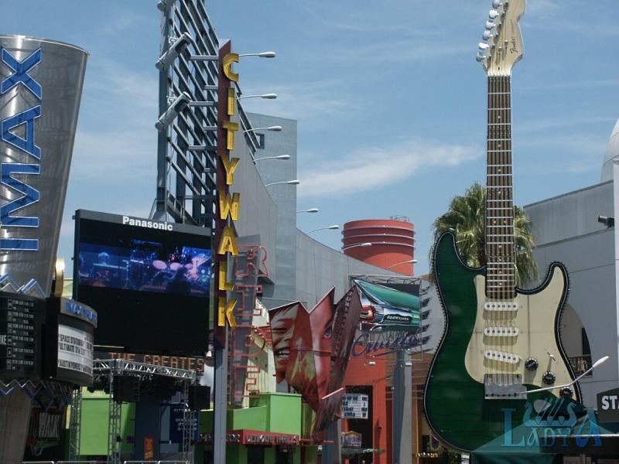

Slide 13
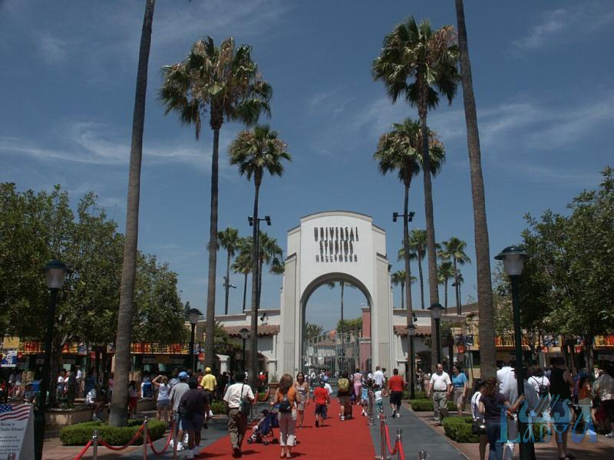

Slide 14
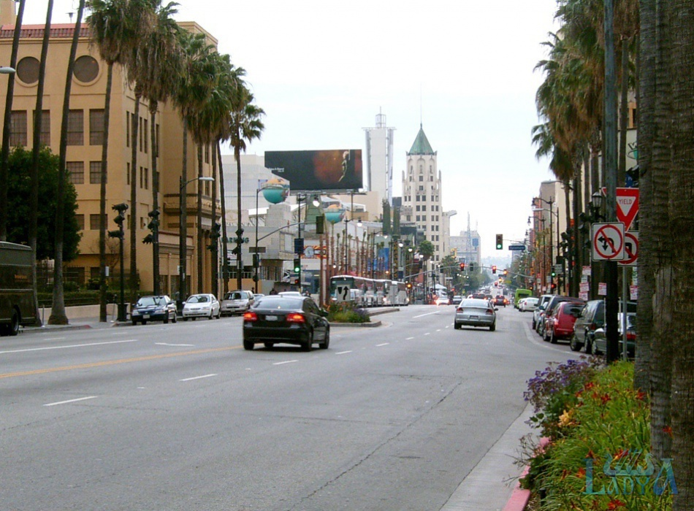

Slide 15
