Slide 1
Инфекционные заболевания Infectious diseases
Гигиена в больницах инфекционных заболеваний
The hygiene in the infections diseases hospitals

Slide 2
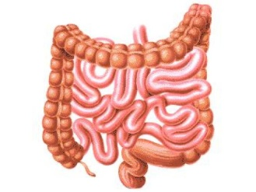
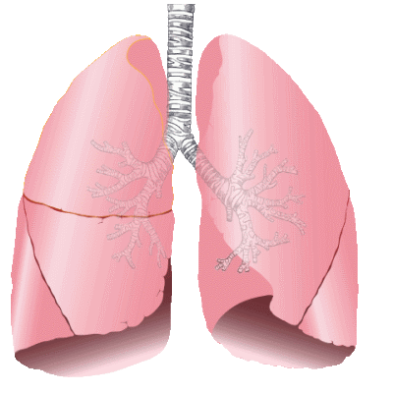
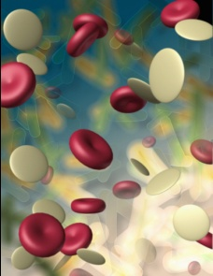
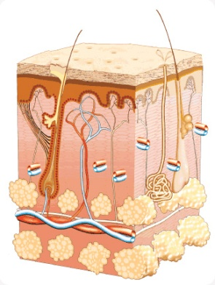
Infectious diseases are divided into 4 main groups:
Intestinal infectious diseases
Кишечные инфекции;
Infectious diseases of respiratory tract
Инфекции дыхательных путей;
Blood infectious diseases
Кровяные инфекции;
Infectious diseases of outer layers
Инфекции наружных покровов.

Slide 3
Intestinal infectious diseases are:
Typhoid fever
Брюшной тиф;
Dysentery
Дизентерия;
Cholera
Холера;
Virus hepatitis A
Вирусный гепатит A;
Poliomyelitis
Полиомиелит;
Salmonellosis
Сальмонеллез

Slide 4
Infectious diseases of respiratory tract are:
Grippe or Influenza (Flu)
Грипп;
Measles
Корь;
Whooping cough
Коклюш;
Chickenpox
Ветряная оспа;
Epidemic parotitis or Mumps
Эпидемический паротит;
Quinsy
Ангина;
Diphtheria
Дифтерия;
Scarlet fever
Скарлатина;
Tonsillitis
Тонзиллит.

Slide 5
Blood infectious diseases are:
Malaria
Малярия
Virus encephalitis
Вирусный энцефалит
Plague
Чума

Slide 6
Infectious diseases of outer layers are:
Epidemic stomatitis
Ящур;
Trachoma
Трахома;
Rabies
Бешенство;
Tetanus
Столбняк;
Gangrene
Гангрена;
Anthrax
Сибирская язва.

Slide 7
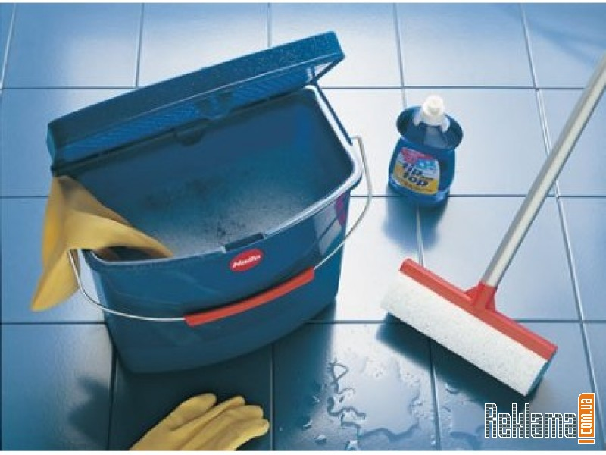
Hygiene
Hygiene is a friend of health!
Гигиена – подруга здоровья!

Slide 8
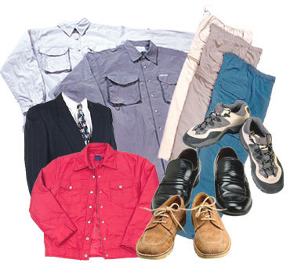
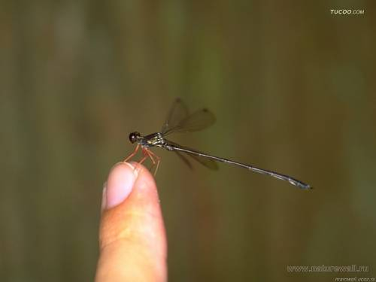
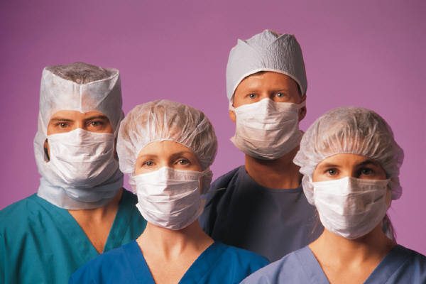
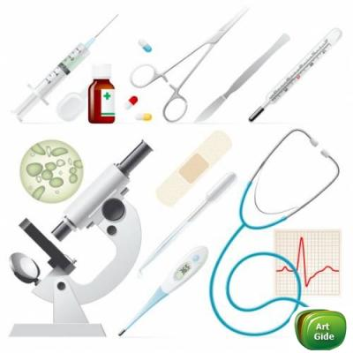
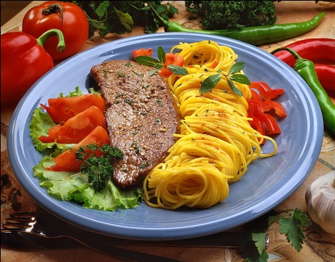
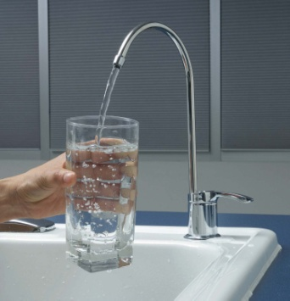
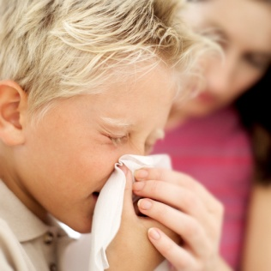
The sources of the infectious diseases: Источники инфекционных заболеваний:
Air
Medical Staff
A sick person
Food
Clothes
Medical instruments
Water
Insects &
animals

Slide 9
Test your knowledge of hygiene by doing this quiz!
1. What is MRSA?
a virus
a bacterium
an antibiotic
2. How do you catch MRSA?
by eating from dirty plates
from poor hospital hygiene
by drinking bad water
3. Which of these things has nothing to do with bacteria?
a wine making
yoghurt
the common cold

Slide 10
4. Which of these things is most important in stopping the spread of MRSA?
hospital staff should wash their hands between patients
cleaners should disinfect door handles
visitors should wear masks
6. How long should you wash your hands in hot water to be sure they are clean?
fifteen seconds
half a minute
one minute
5. When Florence Nightingale, founder of modern nursing, worked in hospital during the Crimean war, the death rate dropped from 60% to 2.2%. Why?
She made nurses wash their hands.
She gave her patients fruit and vegetables to eat.
The ventilation was improved.

Slide 11
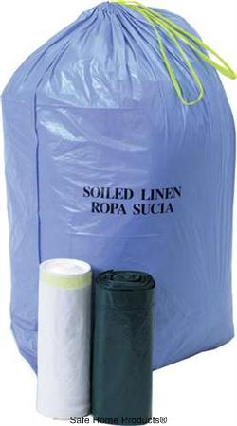
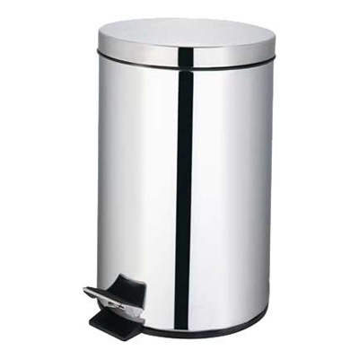
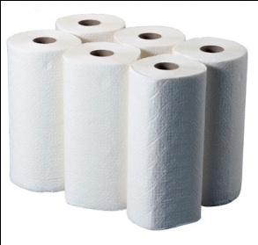
Hygiene equipments
Bin
Bucket
Paper towels
Detergent
Clinical waste disposal bag

Slide 12
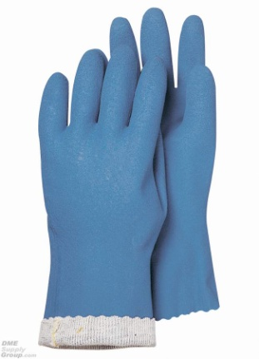
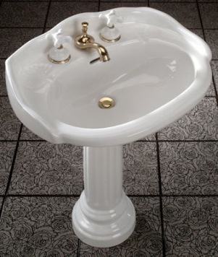
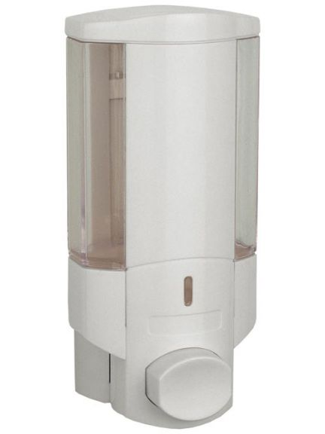
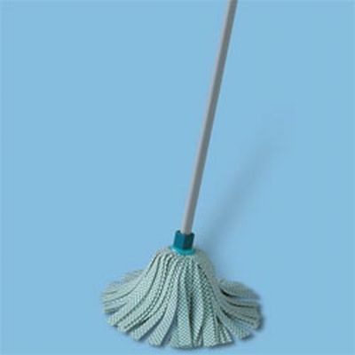
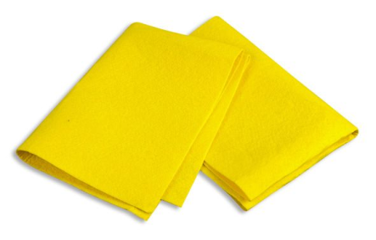
Disposable gloves
Mop
Sink
Cloth
Soap dispenser

Slide 13
A task to the dialogue
The door handles are | are not regularly cleaned.
Beds are |are not always cleaned between patients.
The toilets are cleaned three times | twice |once daily.
Floors are cleaned four times | twice | once daily.
The average time for cleaning up spillages of bodily fluids is 5 | 10 | 10-30 | more than 30 minutes.
Nurses’ knowledge of MRSA is good | fair | poor.
Nurses always | do not always wear gloves.

Slide 14
Key to the dialogue
The door handles are | are not regularly cleaned.
Beds are |are not always cleaned between patients.
The toilets are cleaned three times | twice |once daily.
Floors are cleaned four times | twice | once daily.
The average time for cleaning up spillages of bodily fluids is 5 | 10 | 10-30 | more than 30 minutes.
Nurses’ knowledge of MRSA is good | fair | poor.
Nurses always | do not always wear gloves.

Slide 15
Complete the sentences with the words below
An ------ will kill microorganisms.
Use a sterile ------ to get a sample from the back of the throat.
Our bodies have ways to kill ------ such as viruses and bacteria.
The old, the young, and the very ill are most ----- to hospital infection.
Staphylococcus is ------ to most antibiotics.
There is a risk of ------ from urine and blood.
Wash floors and door handles with ------.
A home doesn’t have to be ------, but it does have to be clean.
contamination
disinfectant
antimicrobial agent
susceptible
pathogens
resistant
swab
spotless

Slide 16
The key
1 – B
2 – D
3 – C
4 – F
5 – G
6 – A
7- E
8 - H

Slide 17
Conclusion
Everything is in your hands!... So, wash them frequently!
Всё в твоих руках!... Поэтому мой их чаще!

