Slide 1
How do You Spend Your Holidays?

Slide 2
Listen and Repeat
to put up a tent
to play the guitar
to go windsurfing
to swim
to speak English
to milk cows
to make jam
to make a campfire
to go by plane
to go by train
to go by car
to cook on the campfire
to find the way in the forest
to go horse-riding
to make friends
to pick berries and mushrooms
to bring in the harvest
to feed hens and chickens
to do shopping
to see places of interest
to take pictures
to go fishing
to lie in the sun

Slide 3
Help Olga Change her Story
clean
friendly
warm
big
lucky
the best holiday
the best
tasty
TV

Slide 4
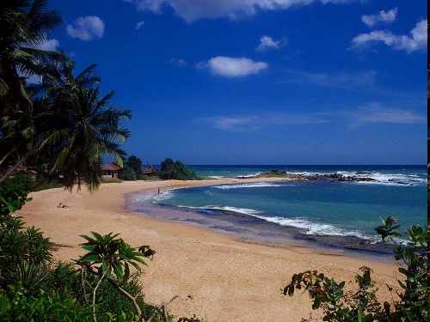
Anya’s Story

Slide 5
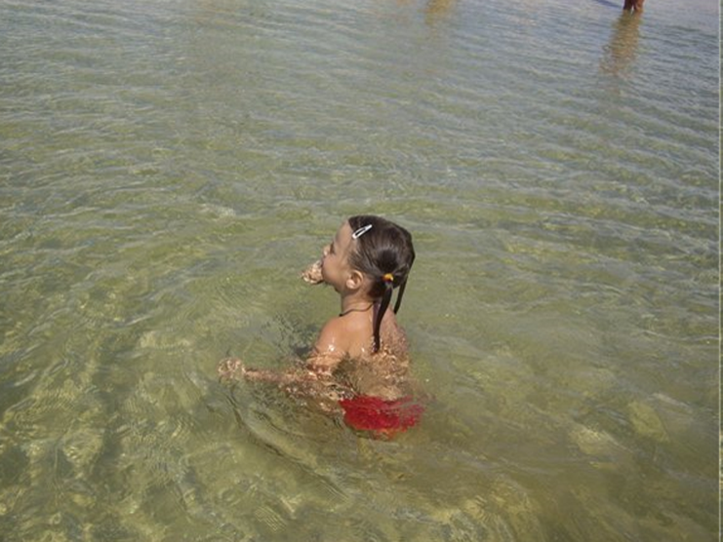

Slide 6
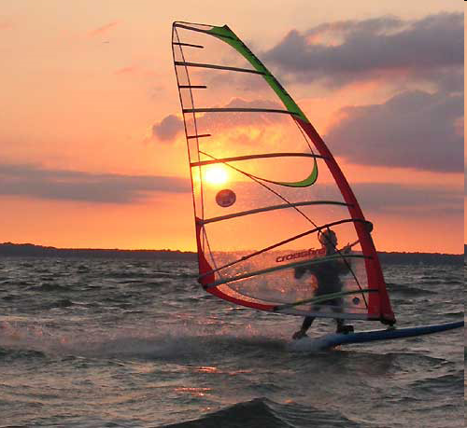

Slide 7
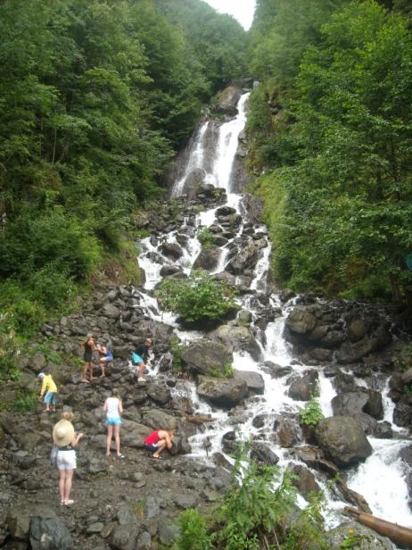

Slide 8
Compare Olga’s and Anya’s Stories
Place
Time
Weather
The sea
Activities
Opinion

Slide 9
As for me I like ... … best of all because…
To my mind … … is the best of all because…
I think … … is the best of all because…

Slide 10
Fill in the Table
If I go camping, I can… | If I go to the village, I can… | If I go abroad, I can… | If I go to a big city, I can…
put up a tent | milk cows | speak English | do shopping

Slide 11
If I go camping, I can… | If I go to the village, I can… | If I go abroad, I can… | If I go to a big city, I can…
put up a tent play the guitar swim make a campfire cook on the campfire find the way in the forest pick berries and mushrooms take pictures go fishing | milk cows swim make jam go horse-riding make friends pick up berries and mushrooms bring in the harvest feed hens and chickens go fishing | speak English go windsurfing make friends do shopping see places of interest take pictures | do shopping dance see places of interest take pictures go by underground

Slide 12
Listen to the dialogue between Rob and Mark. Complete the sentences.
Mark is…
in Italy;
in the Crimea;
in Spain.
The weather is…
cold;
hot;
sunny.
Rosy is…
sleeping;
dancing;
learning windsurfing.
Rosy is learning windsurfing…
in the swimming pool;
in the river;
in the sea.
Rosy is wearing…
a dress;
a special swim suit;
a jacket.
Mark is…
swimming;
playing football;
watching a film.

Slide 13
My summer Holidays
I went to… (the sea, the village, the city).
The place was…(wonderful, beautiful, amazing).
I went… (alone, with family, friends)
I got by … there. (car, plane, bus, train, boat).
I stayed at… (the hotel, my relatives, friends).
I …

Slide 14
Homework
Ex. C, p. 56
P.44, 46 – learn
Project p. 57.

