Slide 1
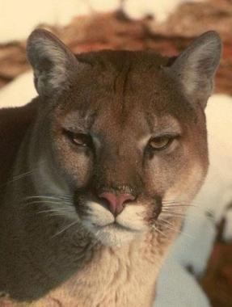
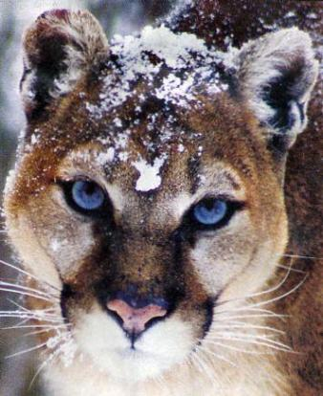
Endangered animals
The Puma

Slide 2
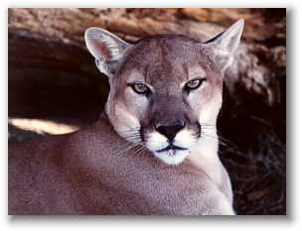
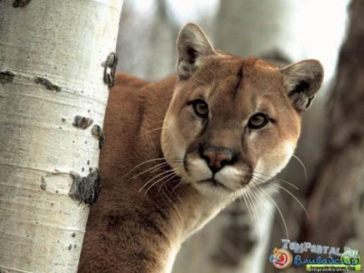
One of the American animals which does not occupy huge area is the puma.

Slide 3
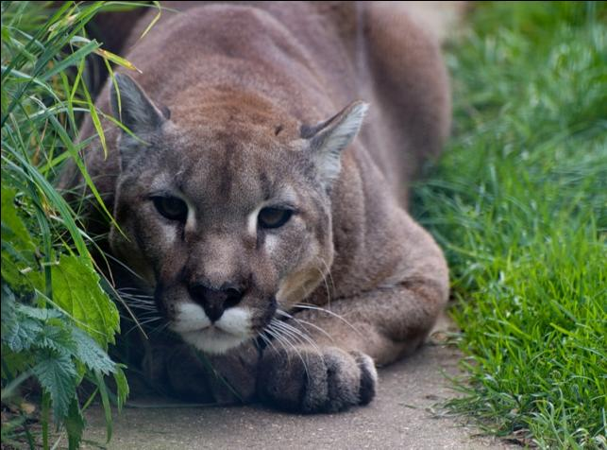
As a rule the puma lives on the territories covered with mountain woods that has given it the name a mountain lion. At the same time it is met in boggy jungle, flat tropical woods.

Slide 4
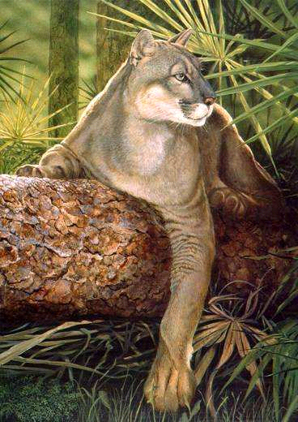
This mountain lion is the largest animal of the fauna of America. In length It reaches 197 sm., its weight is up to 105 kg.

Slide 5
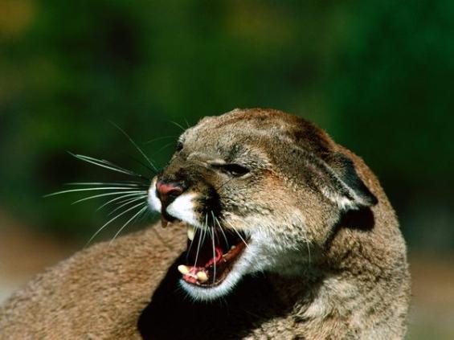
The puma has a strong body, a small head, strong legs, a long tail. The fur is rich, but short. The puma runs very quickly, perfectly climbs trees, if necessary it swims.

Slide 6
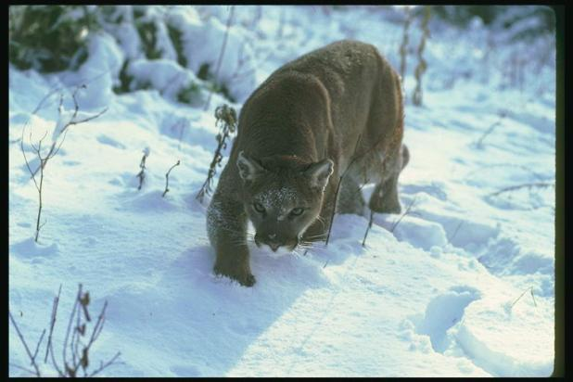
The puma hunts
different animals from
mice up to monkeys and deer. They live about 20 years.

Slide 7
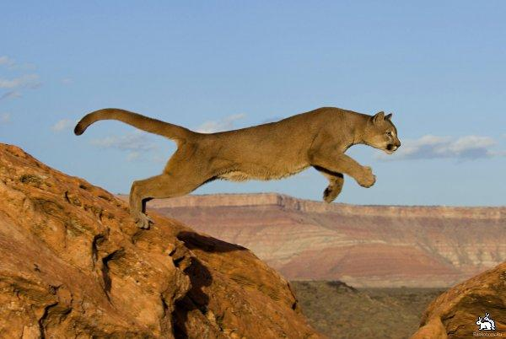
People should save this animal for the future!

