Slide 1
Information in the modern world

Slide 2
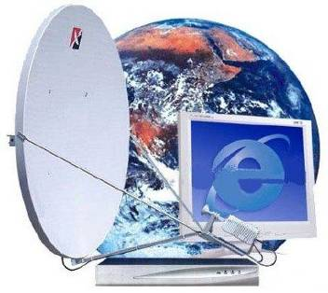
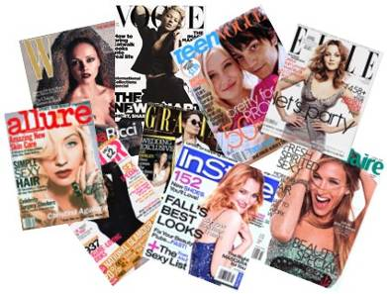
Mass media

Slide 3
Newspapers
Magazines
TV Radio
Internet
Mass Media

Slide 4
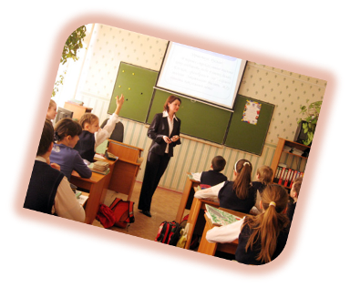
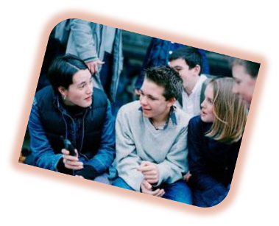

Slide 5
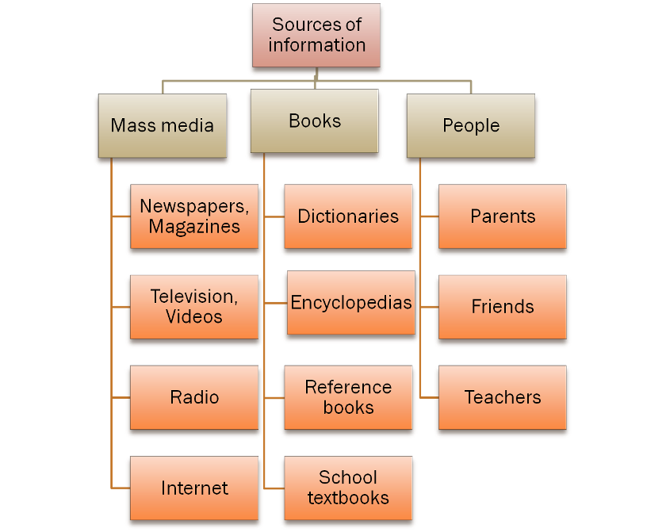

Slide 6
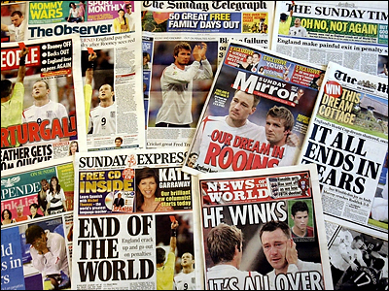
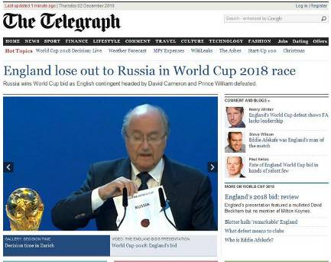
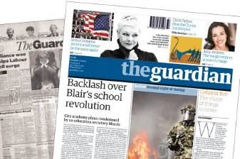
Press in Britain

Slide 7
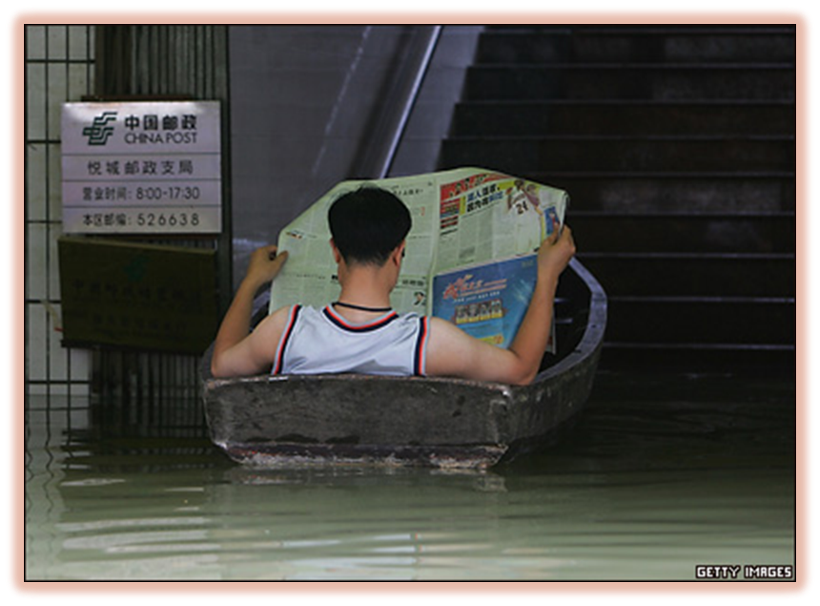
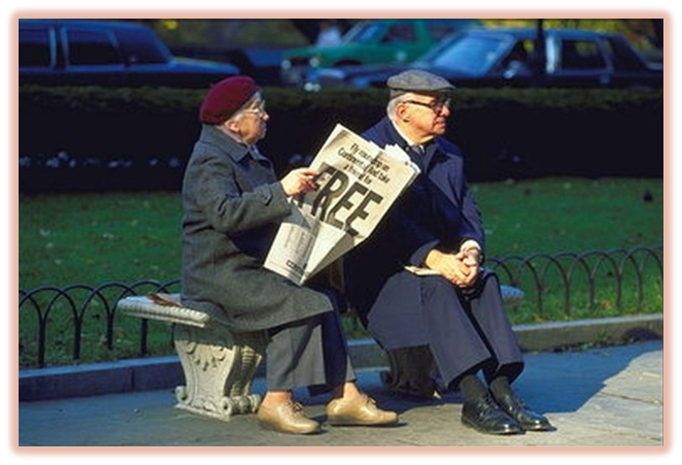

Slide 8
Press in britain

Slide 9
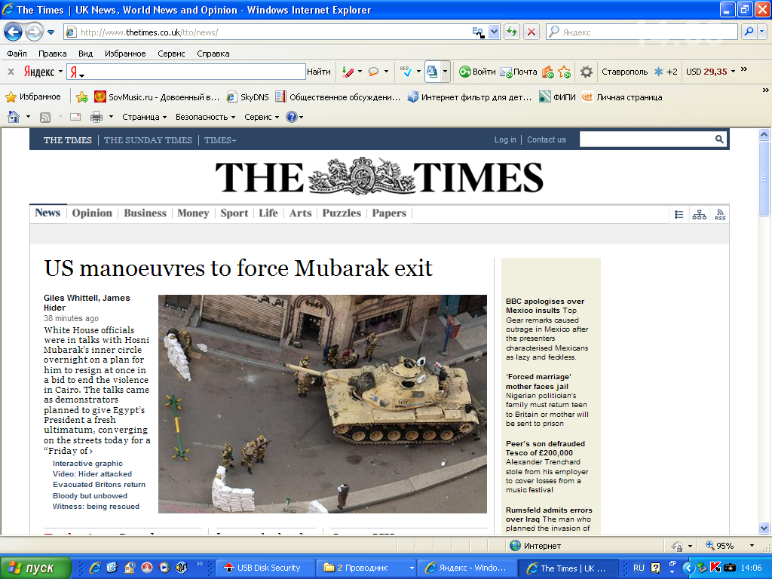

Slide 10
Problem: Is it real to find certain information in british press?
What should we do?

Slide 11
Findind information
headline
condensed
celebrity
crime
to focus on
intriguing
weather forecast
financial
tabloid
broadsheet

Slide 12
Finding information
1.Skim the text and find the names of two main kinds of the newspapers in Britain.
2. Scan the text and answer the questions.

Slide 13
Choosing information
Find the best Russian equivalents:
Tabloid
a)таблоид;
b) жёлтая пресса;
с) лёгкое чтение.
Broadsheet
a) независимая газета;
b) серьёзная газета;
с) широкоформатная газета

Slide 14
Which of this newspapers are tabloids and which ones are broadsheets ?

Slide 15
Broadsheets Tabloids
The Independent
The Times
The Guardian
The Sun
The Daily Express
The Daily Mirror
The Daily Mail
The Metro

Slide 16
use these expressions and speak about russian newspapers:
intriguing headlines
a weather forecast
crossword puzzles
celebrity gossip
an article about politics

Slide 17
Broadsheets | Tabloids
1.They are heavier. | 1.You can find jokes and crossword puzzles there.
2.Their information is always very reliable. | 2.Sometimes they don’t check their information and get in trouble.
3.Business people start their days with them. | 3.They publish a lot of photographs.
4.They always separate facts and comments. | 4.They write a lot of celebrities and their secrets, scandals and private life.
5.They sometimes write about small unimportant but interesting events. | 5.They publish horoscopes.
6.They publish the opinions of the best experts from all over the world/ | 6.More people buy them.
7.One of their main topics is politics. | 7.They use intriguing headlines.
8.They never publish gossip. | 8.They have a weather forecast.

Slide 18
Use the expressions:
- If I need information about…,
I’ll look for it in the …(tabloids,
broadsheets),
because they write a lot about…

Slide 19
Problem: Is it real to find certain information in british press?
1.Sort the newspapers according their format (broadsheets or tabloids).
2.Read the headlines.
3.Look at the photos.
4.Read some articles more attentively.

Slide 20
How to solve a problem ?
Step 1. Finding information.
Step 2. Comparing and analysing information.
Step 3. Defending your position.
Step 4. Making conclusions.
Step 5. Using practical knowledge.

Slide 21
Project

Slide 22
Prepare a talk about any Russian newspaper.
Ex.B, p.110.

Slide 23
How do you like the lesson?
Now I know
What is a broadsheet | What is a tabloid | How to find information | How to solve a problem | How to express my opinion
Mark by plus+ or minus -

