Slide 1
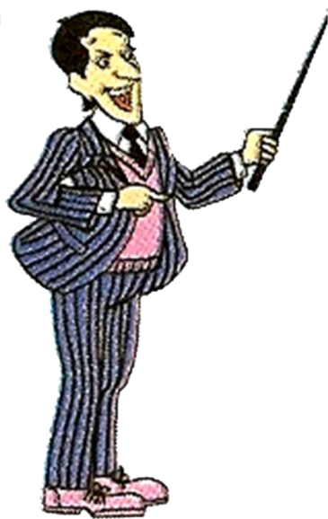
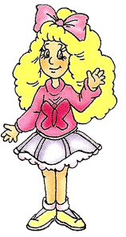
Hello! What`s your name?
Hello!

Slide 2
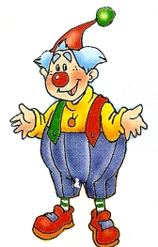
Hello! What`s your name?
Hello!

Slide 3
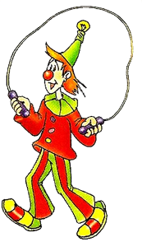
Hello! What`s your name?
Hello!

Slide 4
How old are you?

Slide 5
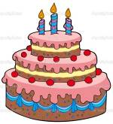
How old are you?

Slide 6
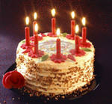
How old are you?

Slide 7
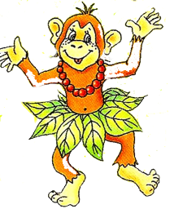
Who are you?

Slide 8
Who are you?

Slide 9
Who are you?

Slide 10
Can you swim?
Yes,

Slide 11
Can you count?
No,
not.

Slide 12
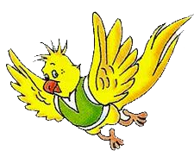
Can you fly?
Yes,

Slide 13
Can you dance?
No,
not.

Slide 14
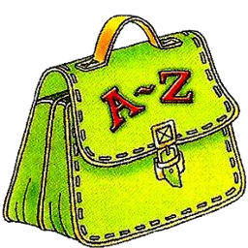
Have you got a bag?
Yes,

Slide 15
Have you got a rubber?
No,
not.

Slide 16
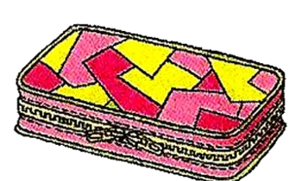
Have you got a pencil box?
Yes,

Slide 17
Where do you live?

Slide 18
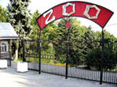
Where do you live?

Slide 19
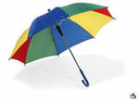
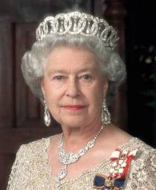
The ABC

Slide 20
The ABC
B -
- h
G -
- n
T -
Y -
- d
R -
- u

Slide 21
Goodbye!

