Slide 1
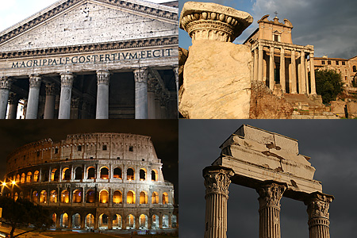
ANCIENT ROME

Slide 2
Put these new words under the categories. Can you guess what they mean? slave, law, glass, owner, to shop, criminals, aqueduct, bath, ancient, BC
I don’t know this word | I can guess the meaning of this word | I know this word | I use this word easily

Slide 3
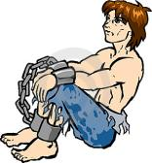
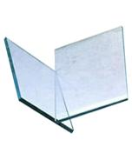
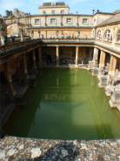
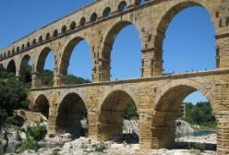
LAW(закон)
SLAVE
GLASS
BATH
OWNER is a person who HAS something
TO SHOP = to buy things in the shop
CRIMINAL is a person who breaks the law
ANCIENT = very old
BC – before Christ
AQUEDUCT

Slide 4
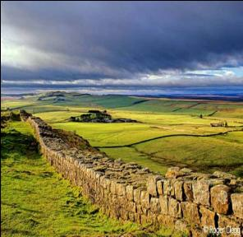
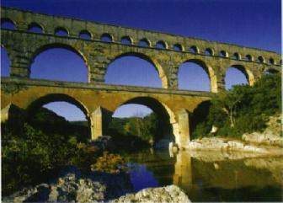
Do you know that the Romans - lived in England and Scotland and built there Hadrian’s Wall
- built Londinium (London)
- built aqueducts to
carry water to cities

Slide 5
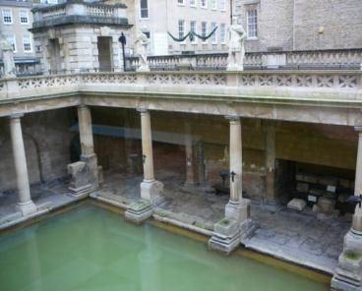
Do you know that the Romans - had baths with cold and hot water
- built good roads to ride
- made laws which we use today

Slide 6
The Romans believed that their city started in 753 BC. The Latin people made their homes on the seven hills near the River Tiber. This was a very good place to choose. There was an island in the river so the river was easy to cross. It was also 25 kilometers from Rome to the sea, so the city was safe from attack by foreign ships.

Slide 7
The Romans believed that their city started in 753 … . The Latin people made their homes on the seven … near the River … . This was a very good place to choose. There was an … in the river so the river was easy to cross. It was also … kilometers from Rome to the … , so the city was safe from attack by foreign ships.

Slide 8
According to the legend, the two brothers, Romulus and Remus, started Rome. Then Romulus killed Remus and became the first king of Rome. So the history of the most famous, powerful, richest ancient city began.

Slide 9
According to the legend, the two brothers, … and … , started Rome. Then … killed … and became the first … of Rome. So the history of the most famous, powerful and richest … city began.

Slide 10
Agree or disagree with the statements
The Romans got up early,
with the sun.
TRUE
2. People didn’t usually go out
in the evenings because the streets
were dangerous.
TRUE
3.There were police in the streets.
FALSE
4. Rich people had slaves and took their slaves when they went out.
TRUE
5. Poor people often gave dinner parties.
FALSE

Slide 11
6. There were no shops in Rome.
FALSE
7. The biggest shopping
centre was Trajan’s Market.
TRUE
8. There was only one
floor in the shop.
FALSE
9. Rome was a very quiet city.
FALSE
10. People came to Rome from the
country to sell food from their farms.
TRUE

Slide 12
Put these new words under the categories. Can you guess what they mean? slave, law, glass, owner, to shop, criminals, aqueduct, bath, ancient, BC
I don’t know this word | I can guess the meaning of this word | I know this word | I often use this word

Slide 13
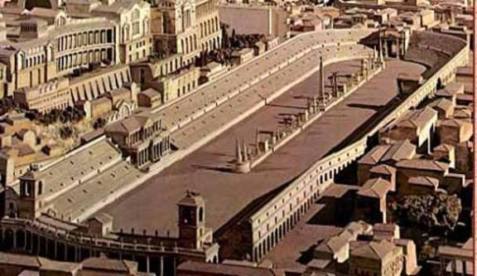
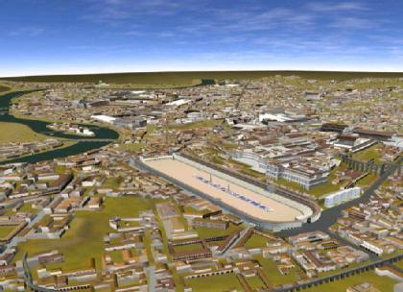
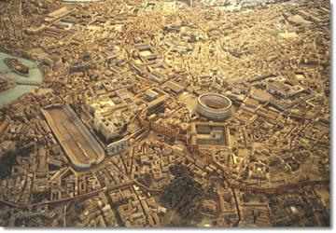
THE CITY OF ROME

Slide 14
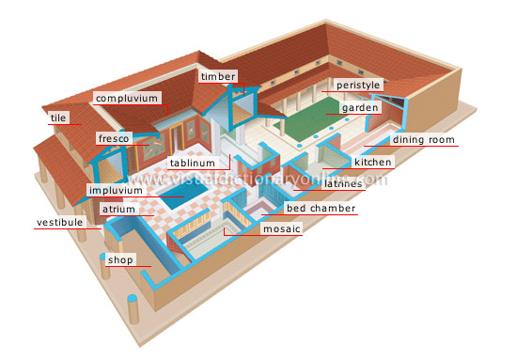
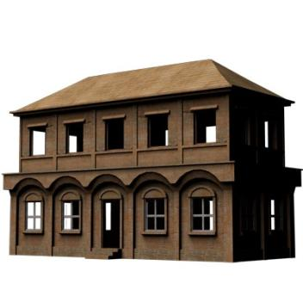
THE ROMAN HOUSE

Slide 15
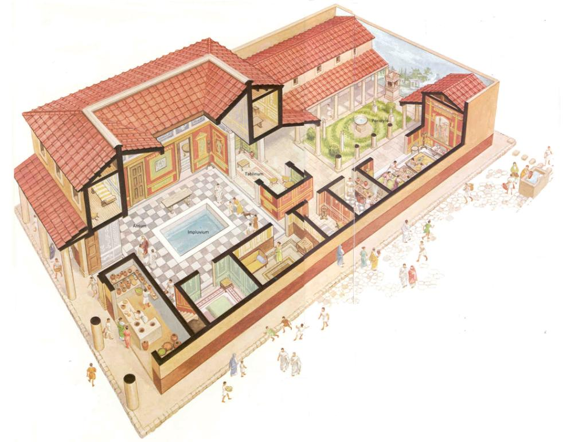

Slide 16
NOW WE KNOW THAT THE … ROMANS - built Rome in 753 … - had … - built … - washed in … - lived in houses with few … - had a lot of … in the streets - made … - did not use much…

Slide 17
NOW WE KNOW THAT THE ANCIENT ROMANS - built Rome in 753 BC - had slaves - built Londinium, roads, aqueducts - washed in baths - lived in houses with few windows - had a lot of shops in the streets - made laws - did not use much glass

Slide 18
THANK YOU !

