Slide 1
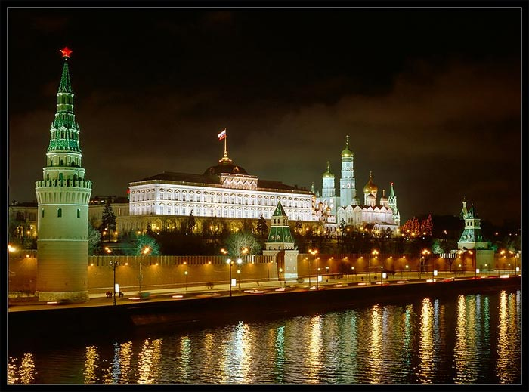
The Kremlin

Slide 2
Timeline
1156 wooden wall
1237 – 1293 was burnt
1367 white-stone wall (Prince Dmitry Donskoy)
15th century – red-brick wall (Tsar Ivan III)
17th century – towers

Slide 3
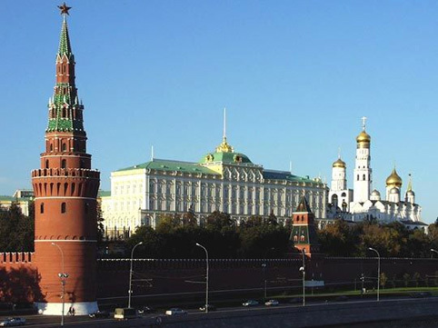
The Kremlin is the heart of the city and the country, the place, to which all Russian roads lead. The Kremlin is the oldest part of Moscow and the main tourist attraction.

Slide 4
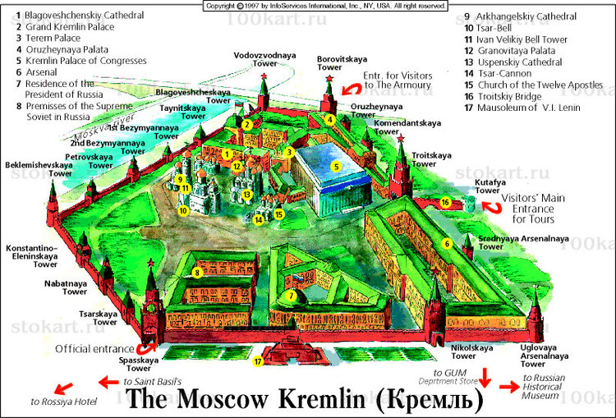
The Kremlin occupies a triangular plot of land covering the Borovitsky Hill on the north bank of the Moskva river. The first wooden Kremlin was erected by prince Yury Dolgoruky in 1156.

Slide 5
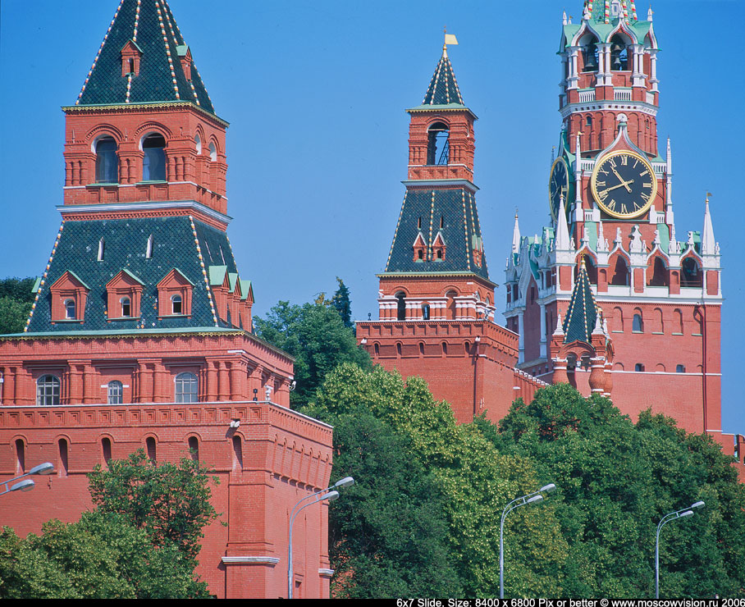
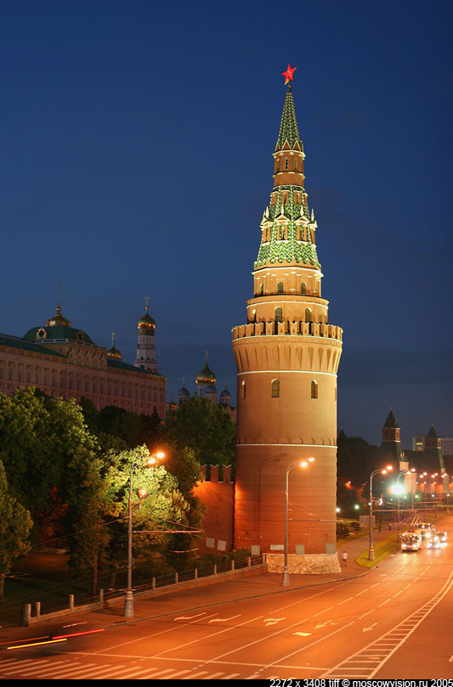
The towers of the Kremlin
In the end of the 17th century twenty towers of the Kremlin were constructed. The towers were built for decoration and had no military significance. Five of the towers were gates.

Slide 6
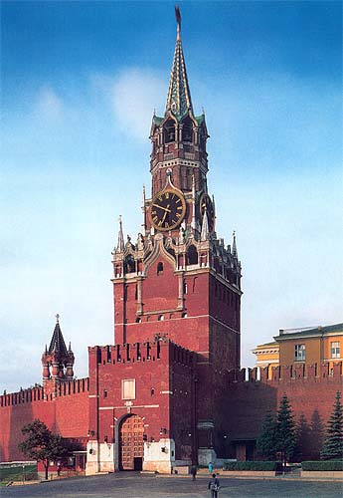
The Spasskaya Tower
The symbol of the Kremlin is the Spasskaya Tower. This tower is the Kremlin’s official exit on Red Square and is notable for its clock.

Slide 7
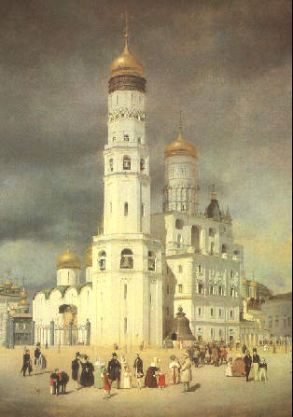
Ivan the Great’ Bell Tower
The Kremlin tallest structure is the Great’ Bell Tower. It was built in 1505 -1508.

Slide 8
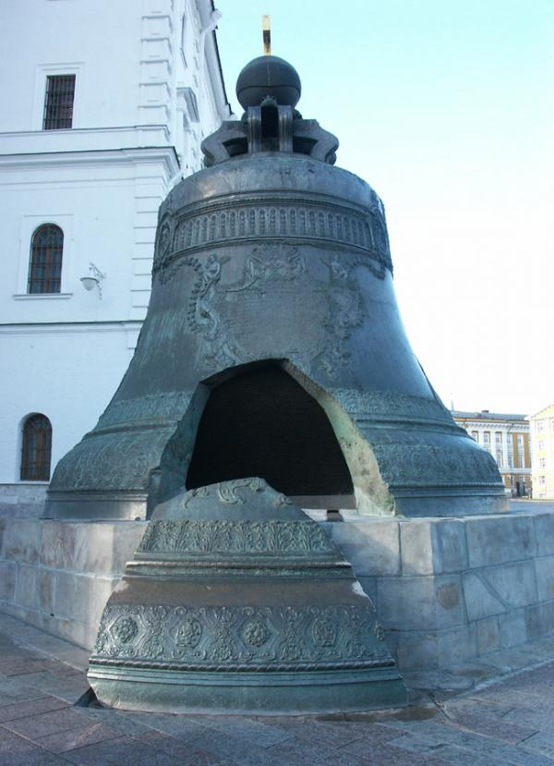
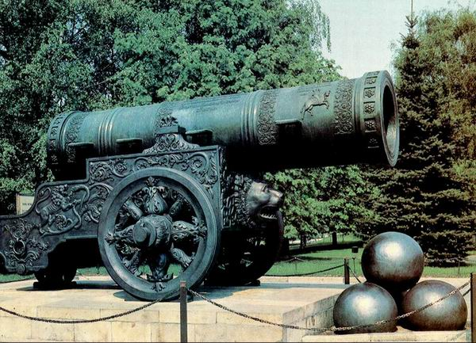
Tsar Bell & Tsar Cannon
Tsar Bell is the world’s biggest bell that never rang.
Tsar Cannon weighs 40 tons.

Slide 9
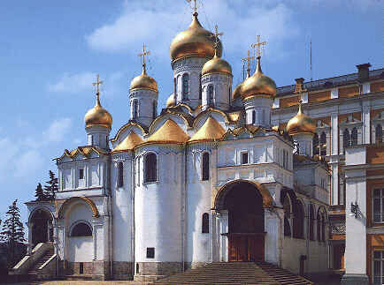
The Annunciation Cathedral
The Annunciation Cathedral was the Moscow Great Princes’ and Tsars’ home church. The cathedral was set for royal family ceremonies.

Slide 10
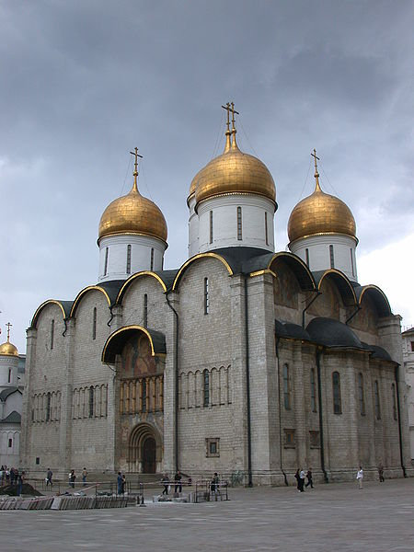
The Cathedral of the Dormition
In 1547 the coronation of Ivan the Terrible took place in this cathedral.

Slide 11
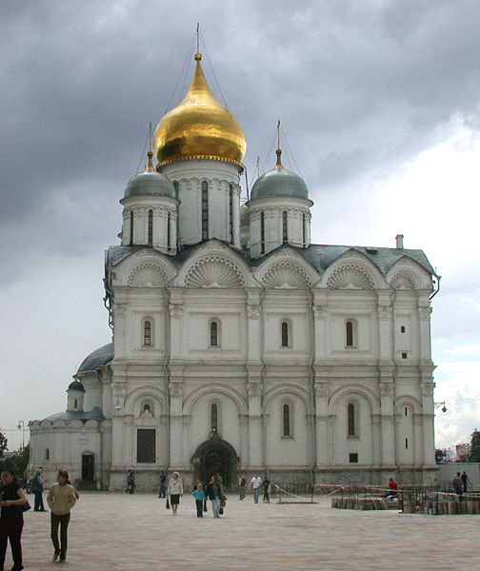
The Archangel’s Cathedral
Victories of the Russian military were celebrated in the Cathedral of the Archangel. Russian tsars and grand princes were buried there.

