Slide 1
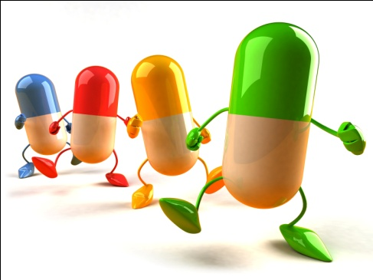
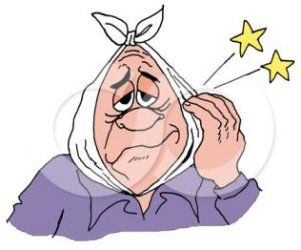
AT THE CHEMIST`S методическая презентация к уроку английского языка преподавателя Кудряшовой Ирины Степановны
МИНИСТЕРСТВО ЗДРАВООХРАНЕНИЯ РТ
ГАОУ СПО РТ «НАБЕРЕЖНОЧЕЛНИНСКИЙ МЕДИЦИНСКИЙ КОЛЛЕДЖ»

Slide 2
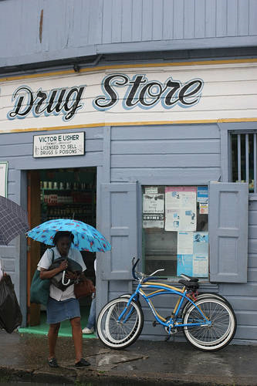
American English
Pharmacy. This can be a shop, part of a shop, or part of a hospital. Pharmacy is the usual word in American English. In British English, you usually refer to the part of a hospital, but A shop like this in the United States is called a drugstore.
British English
the usual word for a shop where medicines are prepared and sold is a chemist or a chemist's. In Britain chemists usually also sell other things, such as beauty and baby products.

Slide 3
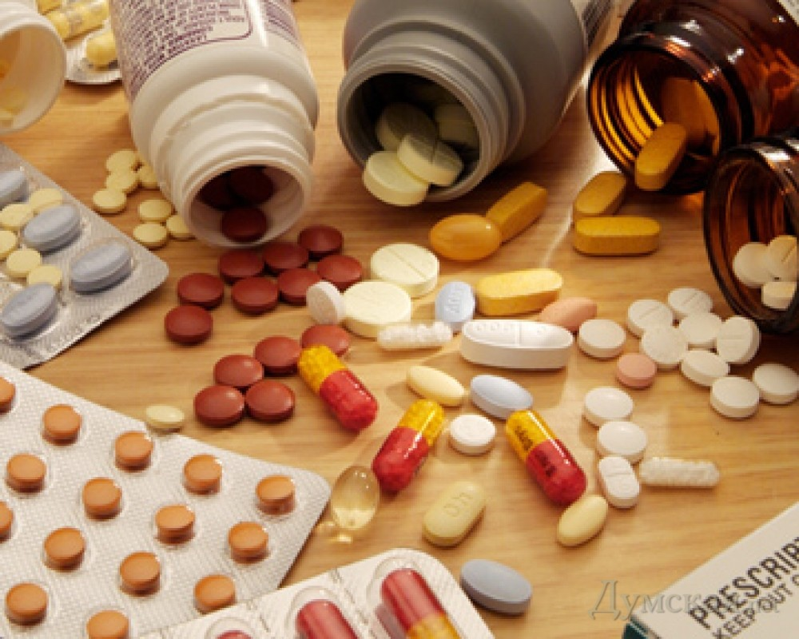
At the chemist`s.
On receiving a prescription from a doctor, all of us need medicines, which are ordered or bought at the chemist`s.
There are two departments at the chemist`s: at the at the chemist`s department one can have the medicine immediately, other drugs must be ordered at the prescription department.
All drugs are kept in drug cabinet. We can buy drugs for intramuscular and intravenous injections, for oral administration, for external use. We can buy tablets, suppositories, ointment, drops, pills, solutions and tinctures, mixture and powder.

Slide 4
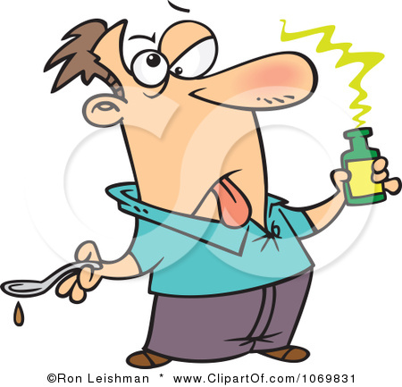
I am sick.

Slide 5
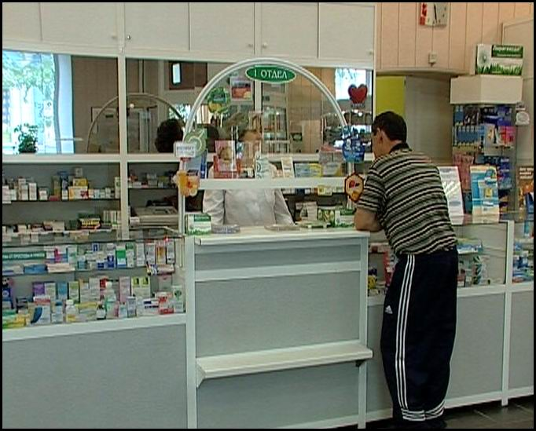
department
pharmasist
client
medicine
pharmasist

Slide 6
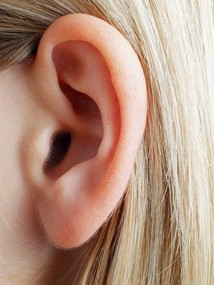
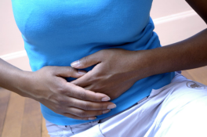
WORD BUILDING
ACHE
EARACHE
ACHE
BACKACHE
ACHE
STOMACHACHE
OR
?
?
ACHE
PAIN

Slide 7
WHAT IS THE DIFFERENCE?
ACHE
PAIN
the feeling you have when part of your body hurts
*The pain is getting worse.
a pain that continues for a long time but is not very sharp
*The ache in my leg muscles had almost gone.
*You won't feel any … during the operation. *The drug is often used to ease the … of dying cancer patients. *Kerry had to drive herself to the hospital when the labor … began.
*Lisa felt a dull … spreading up her arm.
*He told the doctor he was suffering from chest … .

Slide 8
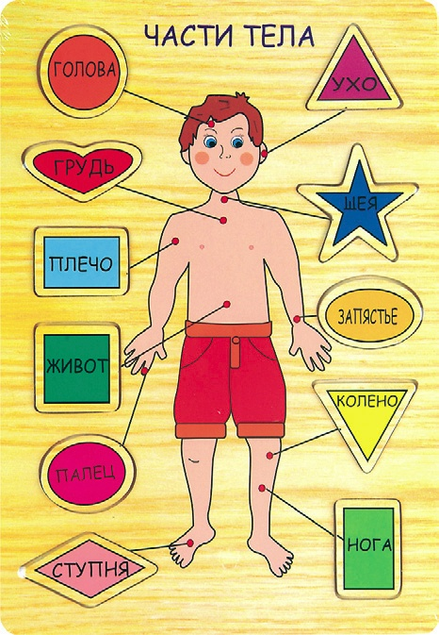
head
ear
chest
neck
arm
hand
stomach
knee
finger
leg
foot

Slide 9
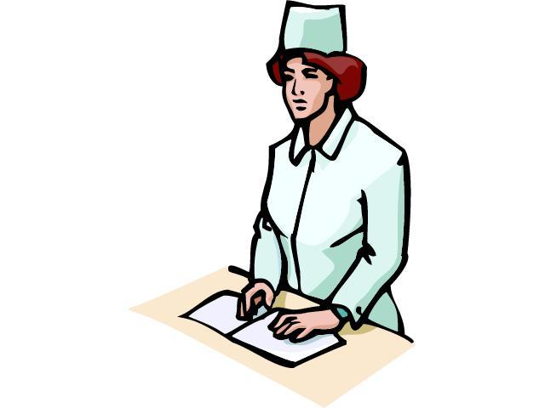
Can I help you?
What a pity!
Give me your prescription, please.
You should take it …
every hour
on an empty stomach
before / after meal
Be healthy!

Slide 10
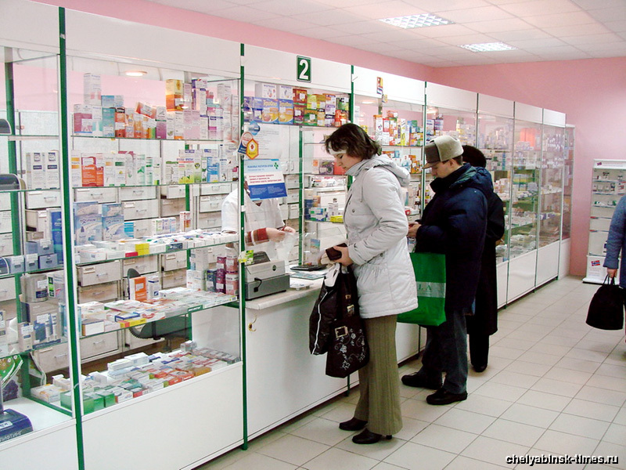
I have a _____ache.
Have you any medicine?
How should I take it?
Should I dissolve it in a milk?
Should I take it with water?
How long should I take this drug?

Slide 12
Список литературы:
Козырева Л.Г. Английский для медицинских колледжей и училищ. «Феникс», 2006.

