Slide 1
Урок-деловая игра
British Customs and Traditoons

Slide 2
A year in Britain

Slide 3
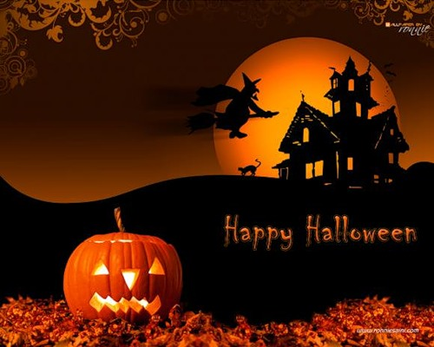
A year in Britain

Slide 4
A year in Britain

Slide 5
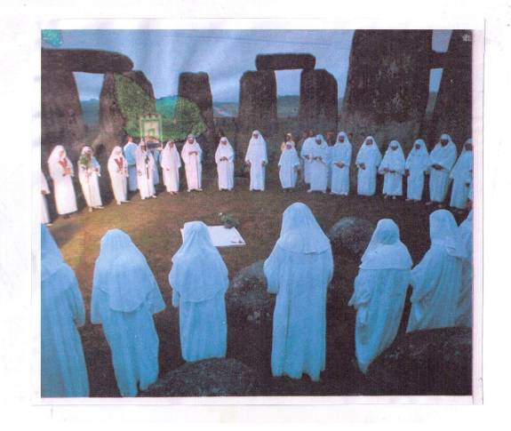
A year in Britain
Midsummer Day

Slide 6
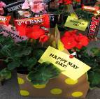
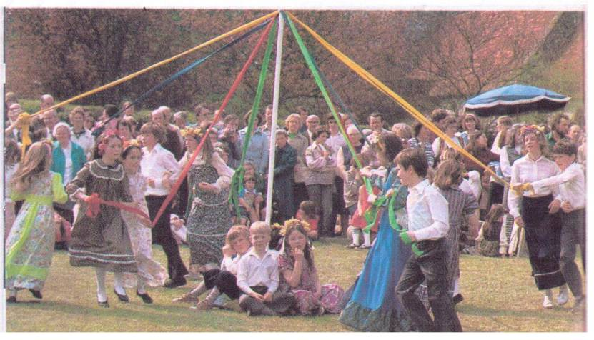
A year in Britain
May
Day

Slide 7
Red Nose Day

Slide 8
A year in Britain

Slide 9
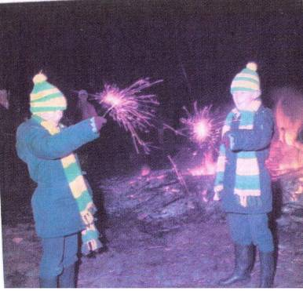
A year in Britain

Slide 10
Royal Traditions

Slide 11
Royal Traditions

Slide 12
Royal Traditions

Slide 13
Royal Traditions

Slide 14
Food and Drinks

Slide 15
Food and Drinks

Slide 16
Food and Drinks

Slide 17
Food and Drinks

Slide 18
Food and Drinks

Slide 19
Food and Drinks

Slide 20
Sports

Slide 21
Sports

Slide 22
The London to Brighton

Slide 23
Vintage Car

Slide 24
Flags and Emblems

Slide 25
Flags and Emblems

Slide 26
Flags and Emblems

Slide 27
Flags and Emblems

Slide 28
Flags and Emblems

Slide 29
The Arts

Slide 30
The Arts

Slide 31
The Arts

Slide 32
Superstitions

Slide 33
Ссылки
http://wwhttp://igimages.co.uk/blogimages2008/june/wimbledon.jpg
w.imagetext.ru/pics_max/images_698.gif
http://activerain.com/image_store/uploads/5/9/1/8/4/ar125774097848195.jpg
http://i068.radikal.ru/1001/24/09b549063d6f.jpg
http://content2.myyearbook.com/usercontent/fast/pimp_images/Animations/Flags/Europe/flags_79.jpg
http://www.partnershipsuk.org.uk/uploads/images/Wales%20flag.jpg
http://img90.imageshack.us/img90/5686/nordirlandfd1.png
http://ftp.sunet.se/pub/pictures/flags/great-britain.gif
http://img0.liveinternet.ru/images/attach/c/2/64/286/64286880_Queen_841227371.JPG
http://attachments-blog.tut.by/59055/files/2011/10/english-breakfast-tea.jpg
http://mega-travel.com.ua/upload/fck/image/uk-fullerspub.jpg
http://abelrobinson.files.wordpress.com/2008/08/mqp9.jpg
http://srochnaja-prodazha-odnokomnatnyh-kvartir.ru/?eaf=opera-tickets-at-movie-theaters-_P4rpyo5kPftu4/om2B7Ebs2QJIj_pRizSYsPcUclFYTRTVYyynEdorvDepKdBEW1fenV2eK8xgtkM3YmigWkh57E0FFWTqCNRzMCyyZkO9CXmsNYqoRTpL6ulQDosYQY92jCKRmHg==u1b.jpg

