Slide 1
White Fang
By Jack London
Maria Tselishcheva
Form 7B

Slide 2
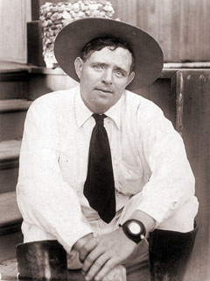
Jack London

Slide 3
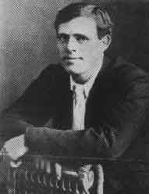
Jack London was born in San Francisco in 1876

Slide 4
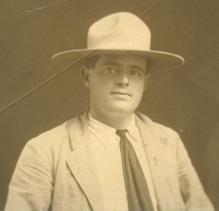
He had a lot of profession.

Slide 5
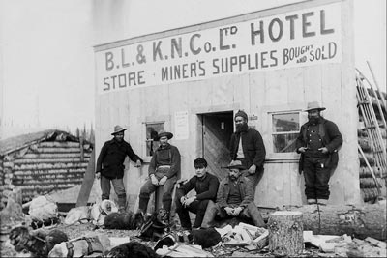
He lived in Alaska for some years and wrote about poor people in his stories.

Slide 6
Jack London died in 1916. This is his grave in America.

Slide 7
His famous books:
1) The iron heel
2) Theft
3) Call of the ancestors
4) Love for life
5) God of his fathers
6) Costar
7) Foray into the oyster pirates
8) Daughter of the snow
9) Game
10) Moon Valley
11) Sea wolf
12) Smock Bell’u

Slide 9
My favorite book by Jack London is White Fang.
This book was published in 1906.
It is about living in the North.
The book is about hard life of the wolf and the attitude to the people.
The book is about love, devotion, good and evil.
It has been adapted for the screen numerous times.

Slide 10
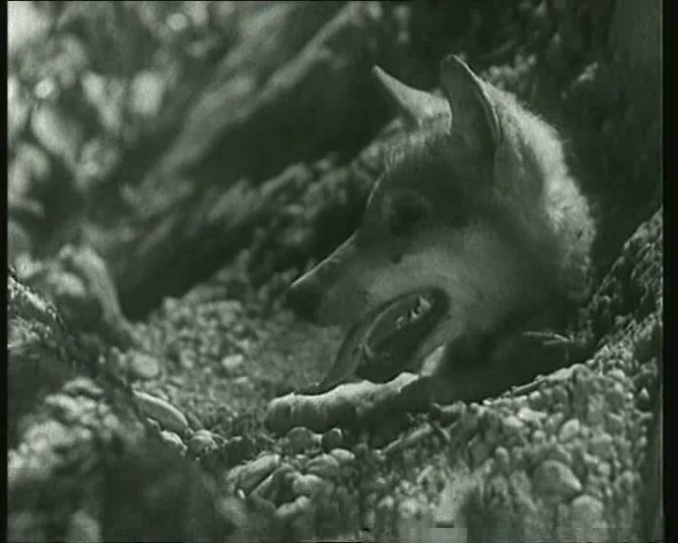
This is White Fang

Slide 11
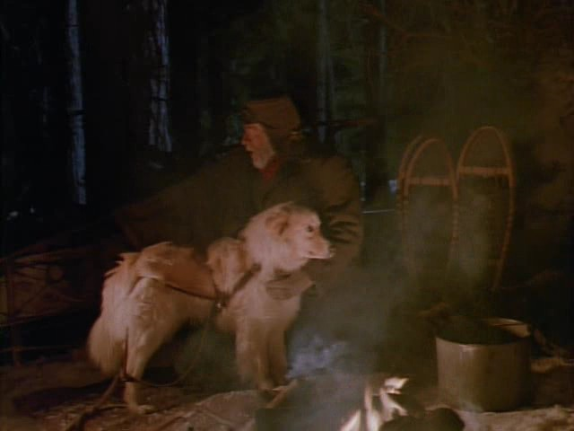
This is his master.

Slide 12
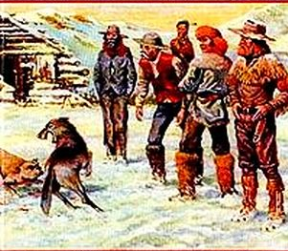
Dogs often took part in the fights and people bet a lot of money.

Slide 13
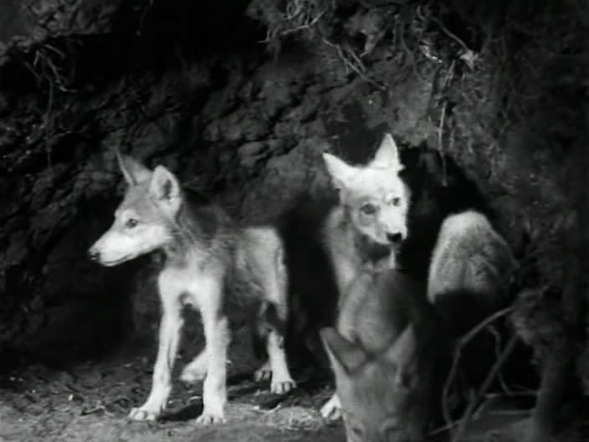
The wolf met love and had a family. These are his cubs.

Slide 14
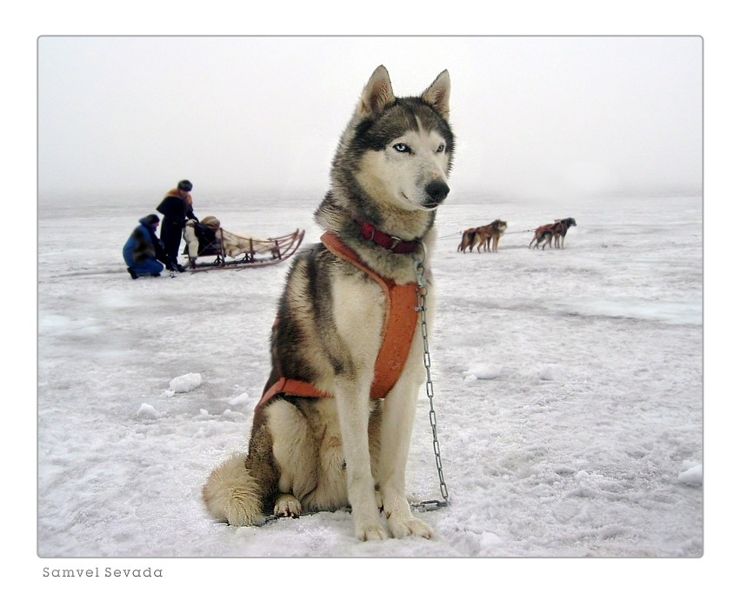
The happy wolf.

Slide 15
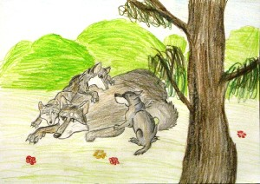
My illustration to the novel.

