Slide 1
National Standards
of Great Britain
and the USA

Slide 2
British English | American English
bus
cinema
repair
test
autumn
chips
engine

Slide 3
British English | American English
bus | coach
cinema | movies
repair | fix
test | exam
autumn | fall
chips | French fries
engine | motor

Slide 4
enormous belong immediately define words quotation appear helmet

Slide 5
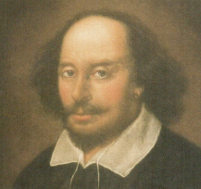
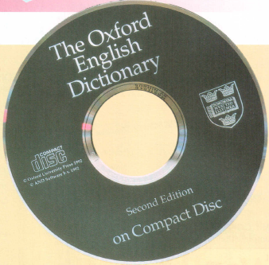
William Shakespeare

Slide 6
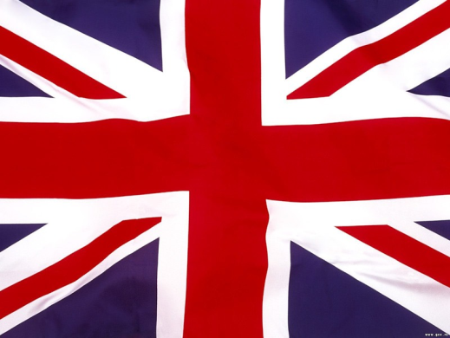
apartment cab elevator gas sidewalk vacation
pavement lift taxi holiday flat petrol

Slide 7
weighs sixty-six kilos you can see him
twenty enormous books
goes home after school
global language
to look up a word
between 10000 and 15000 everyday words
isn’t just a star
examples of them the answer is

Slide 8
weighs sixty-six kilos you can see him
twenty enormous books
goes home after school
global language
to look up a word
between 10000 and 15000 everyday words
isn’t just a star
examples of them the answer is

Slide 9
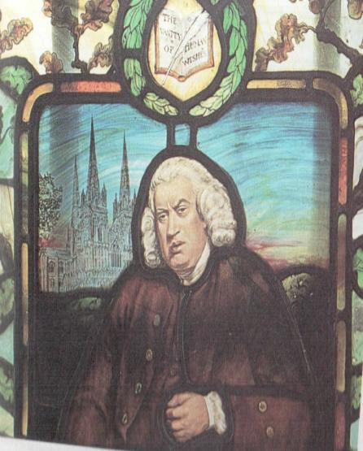
1. The house in Fleet Street belonged to a famous man. 2. Dr Johnson was a painter. 3. He finished the dictionary in 1855. 4. The dictionary contained over 40 thousand words. 5. The English language hasn’t grown during the last 100 years. 6. The dictionary works with the help of a computer.

Slide 10
OK, I’ve done that. The computer has found the word immediately. The English language has grown a lot bigger since then. Dictionaries have changed a lot in the last few years. The information hasn’t appeared on the screen yet. Have I done that right?

Slide 11
PRESENT PERFECT
Shows the action that finished by the present moment
have / has + Ved / V³
+ | - | ?
OK, I have done that. | The information hasn’t appeared on the screen yet. | Have I done that right? – Yes, I have. / No, I haven’t.
The computer has found the word immediately.

Slide 12
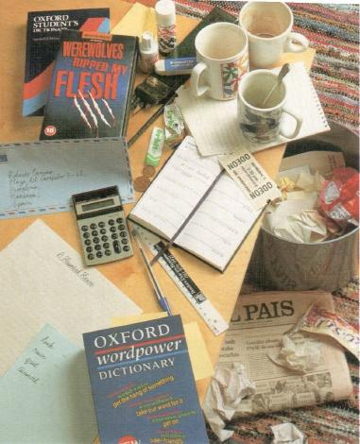

Slide 13
look up new words write to Robert write composition buy dictionary cinema – 2.30 tidy room ring dentist take video back buy pencils do washing up
have / has + Ved / V³
He has phoned the dentist.
He hasn’t tidied the room yet.

