Slide 1
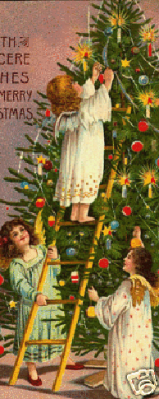
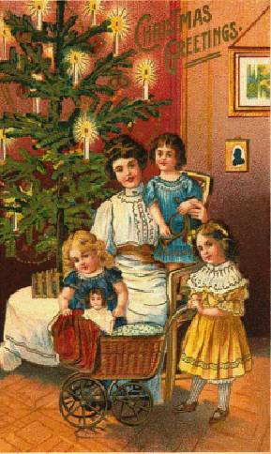
Christmas in Britain
This holy festival called Christmas celebrates the birth anniversary of the son of God, Jesus Christ, on 25th December every year.

Slide 2
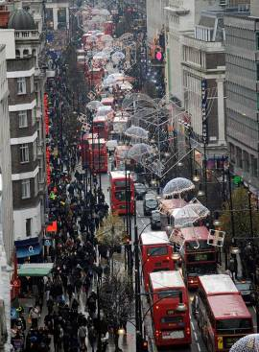
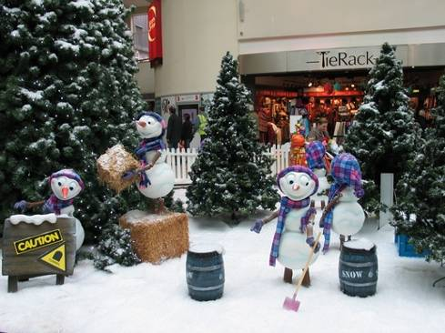
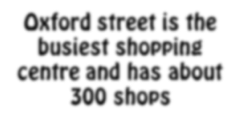
Christmas Eve
Oxford street is the busiest shopping centre and has about 300 shops
Christmas tree has become a central part of the Christmas festival. Christmas gifts are placed beneath the tree.

Slide 3
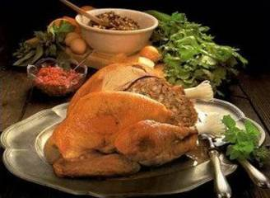
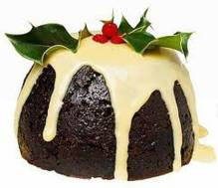
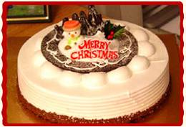
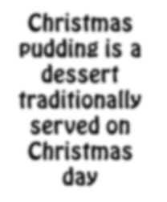
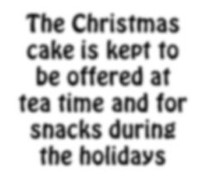
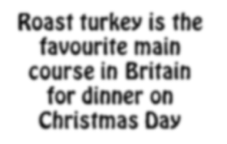
Christmas dinner
Christmas pudding is a dessert traditionally served on Christmas day
The Christmas cake is kept to be offered at tea time and for snacks during the holidays
Roast turkey is the favourite main course in Britain for dinner on Christmas Day

Slide 4
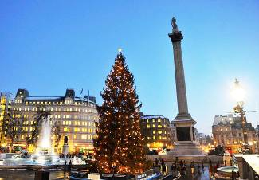
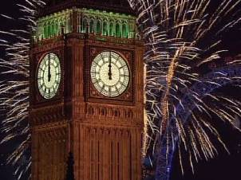
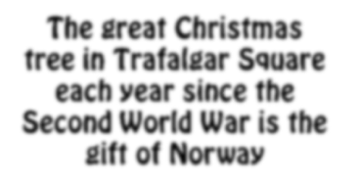
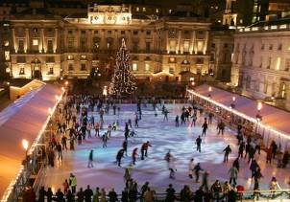
Christmas in London
Big Ben strikes twelve
The great Christmas tree in Trafalgar Square each year since the Second World War is the gift of Norway
Christmas ice skating in London

Slide 5
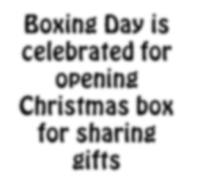
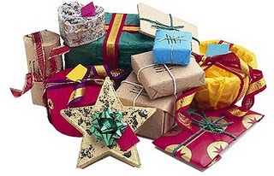
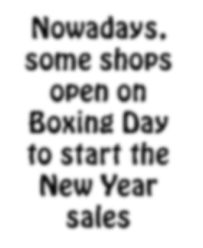
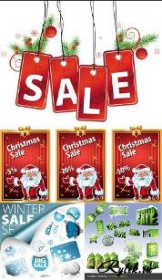
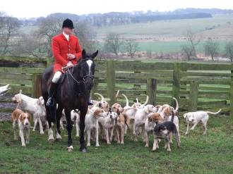
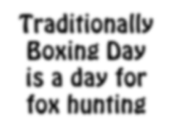
Boxing Day
Boxing Day is celebrated for opening Christmas box for sharing gifts
Nowadays, some shops open on Boxing Day to start the New Year sales
Traditionally Boxing Day is a day for fox hunting

