Slide 1
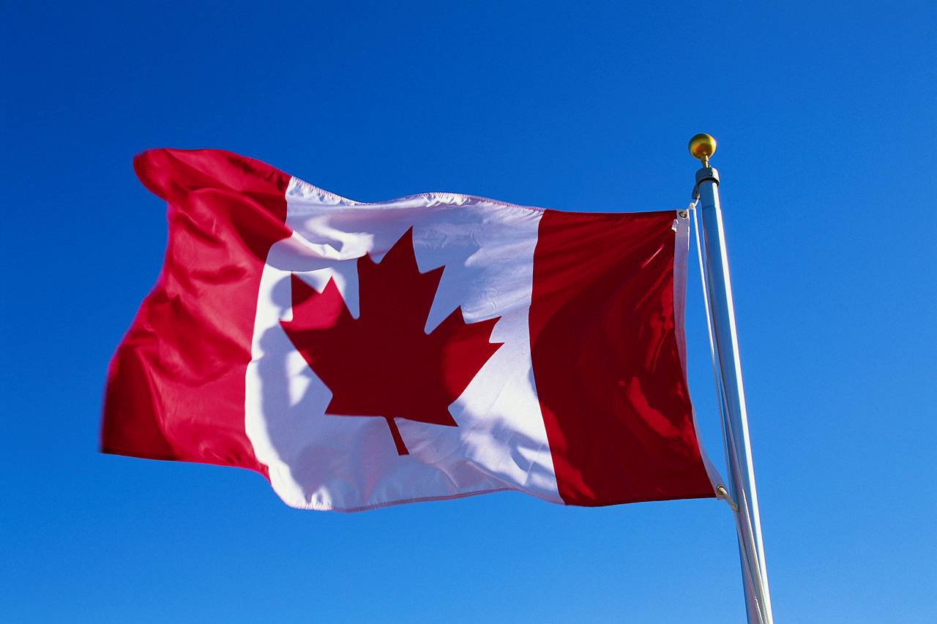
Canada.

Slide 2
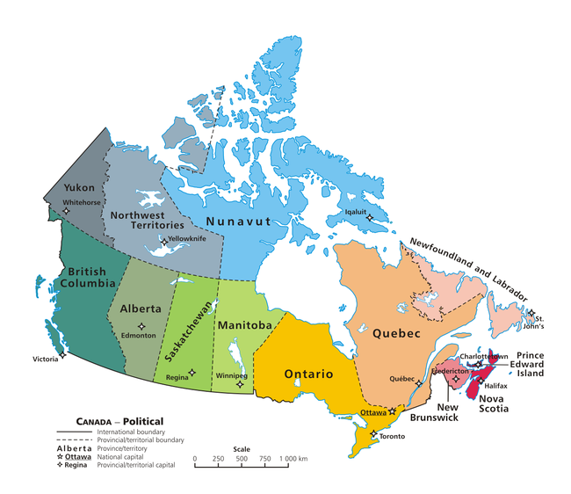

Slide 3
Plan:
1. Canada
2. Location of Canada
3. National flag
4. Heraldic
5. Anthem
6. History
7. Population
8. Relief
9. Climate
10. Flora
11. Fauna
13. Minerals
14. Traditions and Customs
15. National dishes

Slide 4
Canada.
Canada is a country in North America, ranks second in terms of area. Washed by three oceans. Borders with other big country - America. Canada's border with the United States is the longest border in the world.
Russia 17 075
Canada 9 971
China 9 598
USA 9 519
Brazil 8 547
Australia 7 682
India 3 287
Argentina 2 780
Kazakhstan 2 725
Sudan 2 506

Slide 5
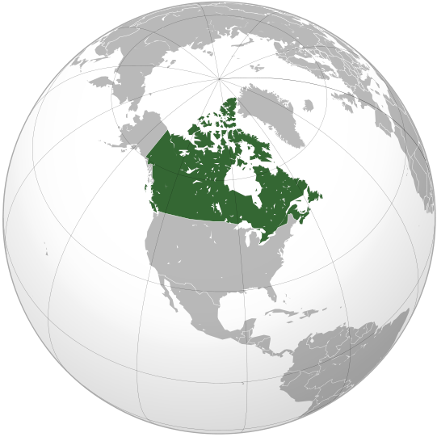
Location of Canada.
Canada is situated near America and near Greenland. Canada is located in the Northern Hemisphere. This country has the way to the Arctic Ocean, the Pacific and the Atlantic Ocean

Slide 6
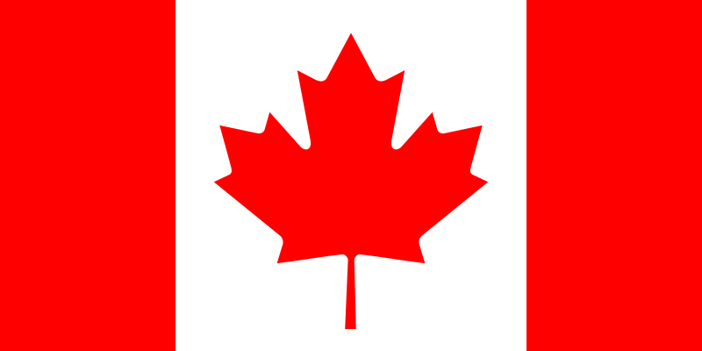
National flag.
The state flag was confirmed by the Canadian Parliament in 1964, after lengthy debate (then already created for over 2,600 designs!). The flag shows two Oceans washing the coasts of Canada - Pacific and Atlantic – and country located between oceans. Maple Leaf shows the unity of the nation. Red - Color of the UK. White - the color of the French monarchy.

Slide 7
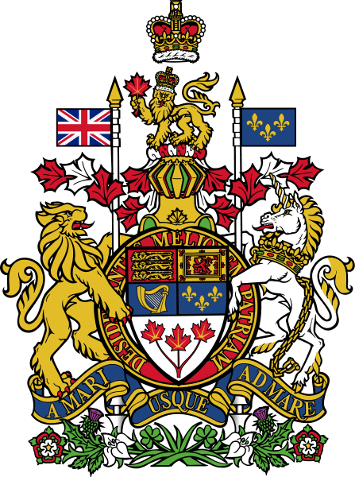
Heraldic.
Heraldry of Canada - one of the official state symbols of Canada. Originally Canada had its own heraldry. It was first created in 1868 as the emblem of the Canadian Confederation. Canadian heraldry is very similar to the English heraldry.

Slide 8
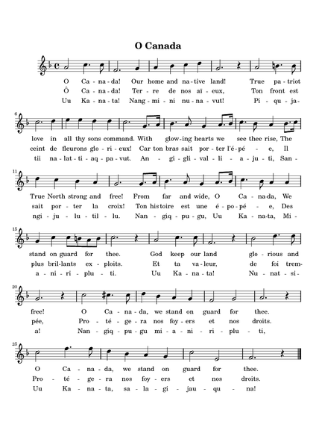
Anthem.
For the first time the Canadian anthem was performed June 24, 1880 in Quebec by Joseph Vezina. Then it was a song in French, which was called "Song of the nation." In 1908, a teacher from Montreal, Robert Stanley Weir wrote the words to songs in English. Now the words of the anthem is the same as they were writing in 1908. Officially «O Canada» became the anthem of Canada in 1980.

Slide 9
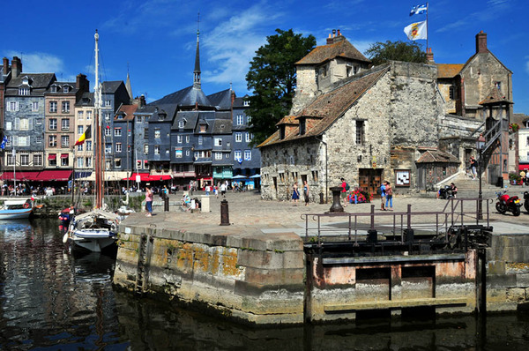
History

Slide 10
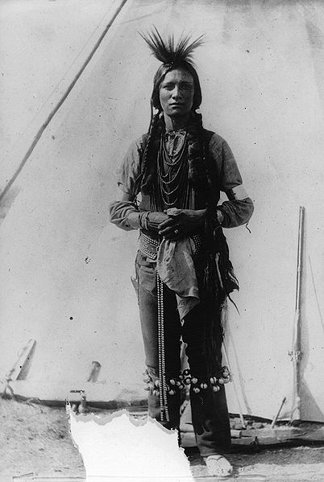
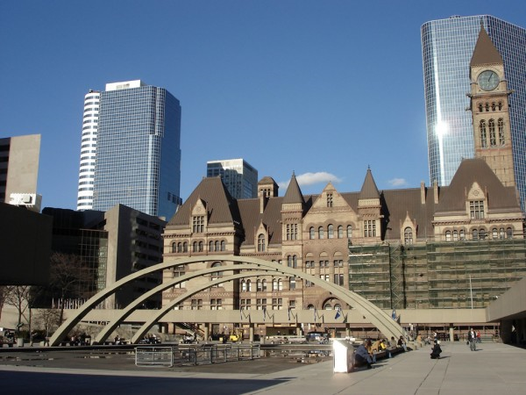
The word "Canada" comes from the language of the Indians and it means "village". Aboriginal people in Canada were American Indian tribes. The first Europeans who has appeared on Canadian soil around 1000 years ago were Icelandic Vikings.

Slide 11
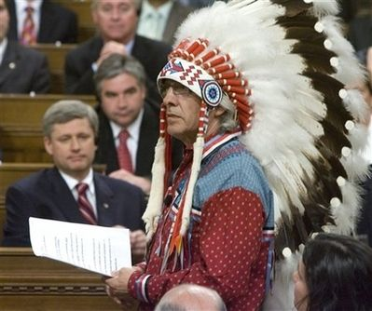
The population of Canada
The first immigrants from Europe arrived in Canada in the 15th century. They were mainly from England and France, so now people speak
English and French in Canada.
The population of Canada is 31 million people.
Among the native peoples of Canada are , Iroquois , Eskimos .
Most Indians live on reservations. On the Arctic coast settled around 17 thousand Eskimos.
Life is expectancy in Canada, 75 years for men and 82 years for women.
This is one of the highest rates in the world.

Slide 12
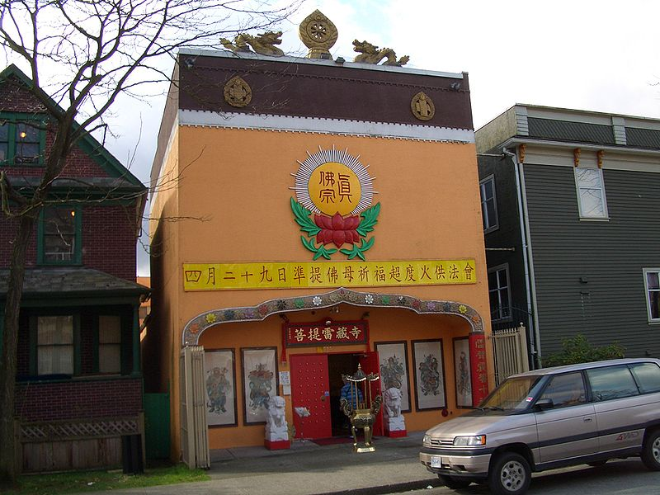
Characteristic.
Language: French and English
Religion: Christians - 85%
Atheists – 9%
Muslims – 4%
Buddhists – 2%
People: Canadians, French, English, Africans, Arabs, Chinese.

Slide 13
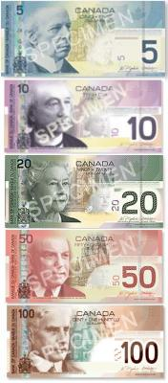
Currency.
The main currency in Canada – Canadian dollar.

Slide 14
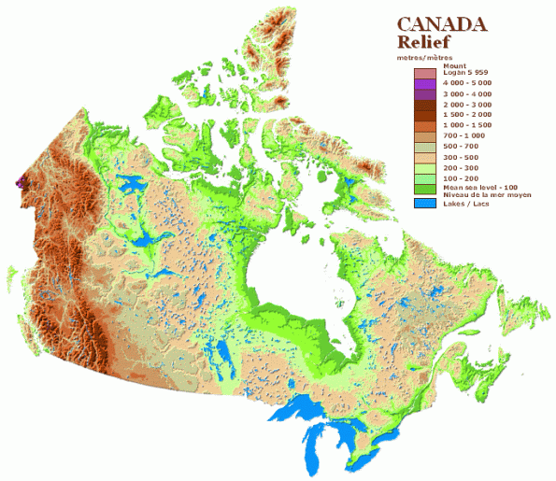
Relief.
The central part of the mainland and the adjacent land the Canadian Arctic Archipelago are plains, which are located no higher than 200 m above sea level, there are: the Hudson Bay lowlands, Lavreptiyskaya hill, its height reaches 1000 m and has a typical lake and hilly terrain. The Great Plains, whose height from 500 to 1500 m, and the Western suburbs of Canada occupied the Cordillera mountain system. The height of the Cordillera 3000 - 3500m, highest mountain Logan 6,050 m .Appalachian Mountains are located in eastern part of North America.

Slide 15
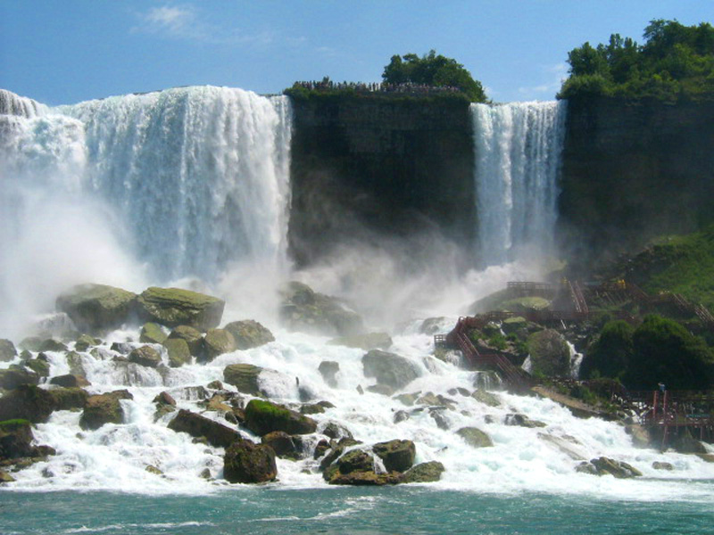
Climate.
Climate in most parts of Canada is moderate, gentle and to the north - the subarctic. Average January temperatures range from -35 C in the north to +4 C in the south Pacific coast. Average July temperatures are about +21 C in the south and from -4 C to +4 C on the islands Canadian Arctic Archipelago. The Arctic Circle temperatures are almost always below zero.

Slide 16
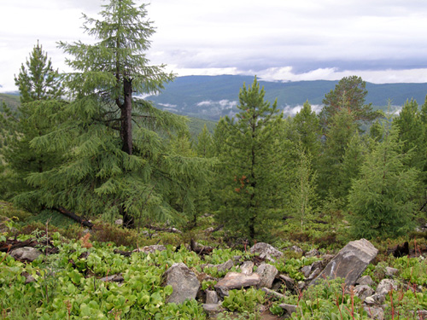
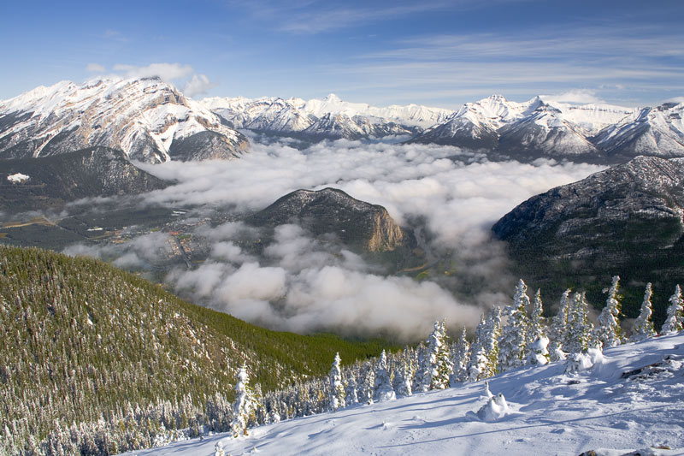
Much of the land of Canada - tundra and taiga. Grown only 8% of the land, and more than 50% of the territory covered by forests, which are rich in valuable species of timber. Of particular value are the conifers: a giant arborvitae, balsam fir, black and white spruce. To the south and south-east of the country is characterized by poplar, yellow birch and oak. Maple is a symbol of Canada.

Slide 17
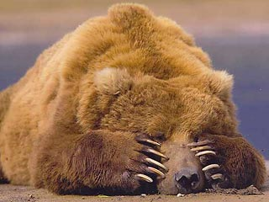
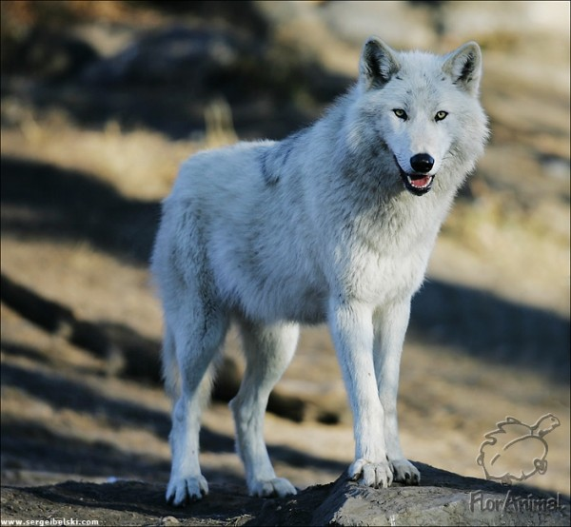
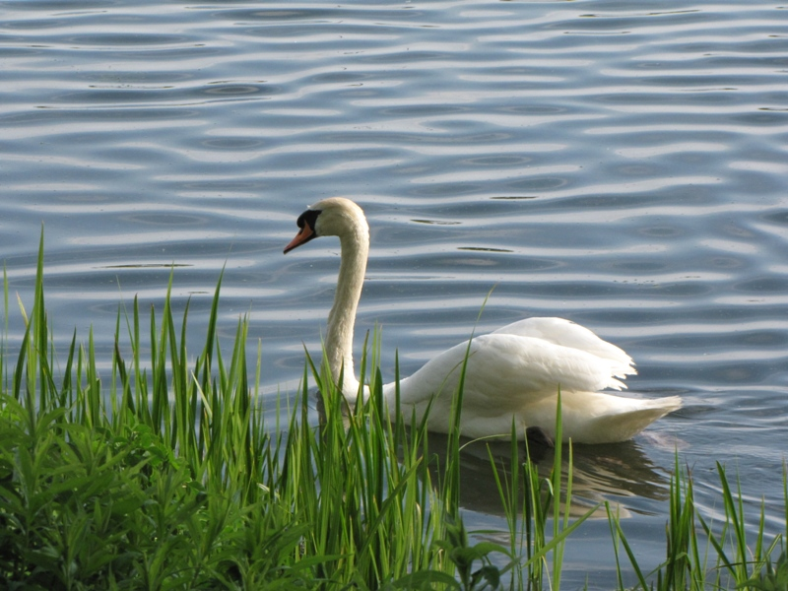
Animals.
Much of the land of Canada - tundra and taiga. There are many animals in forests: foxes, wolves, bears, hares, lynxes, elks and another. In the steppes - field mice, moles and gophers.

Slide 18
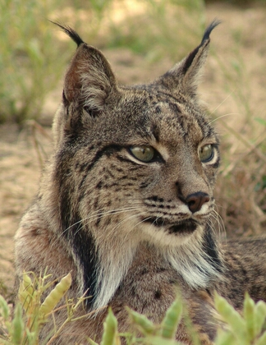
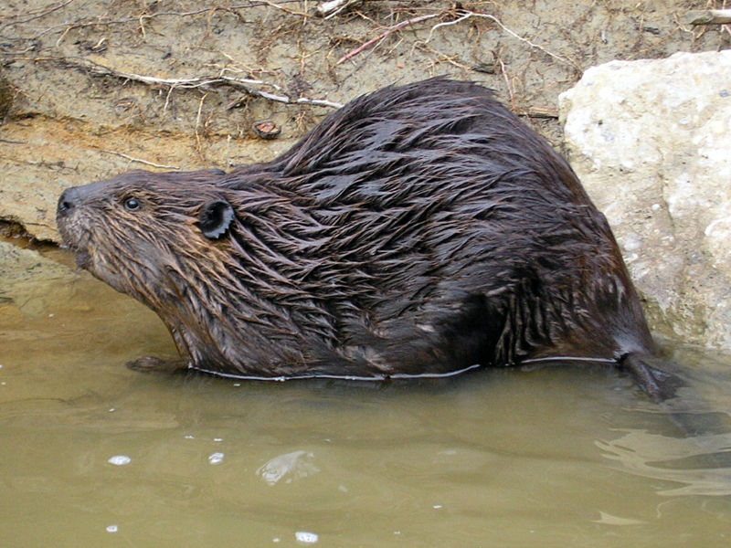
Symbols of Canada.
The lynx is one of Canada’s symbol. Its length is nearly 90 cm. It eats small animals. It is very beautiful.
Beaver lives on land and in water, excellent diving and swimming. It can stay underwater for up to 15 minutes. It eats mainly the bark of trees and beaver can eats grass.
B
E
A
V
E
R
L
Y
N
X

Slide 19
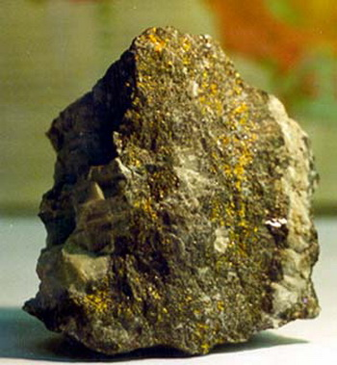
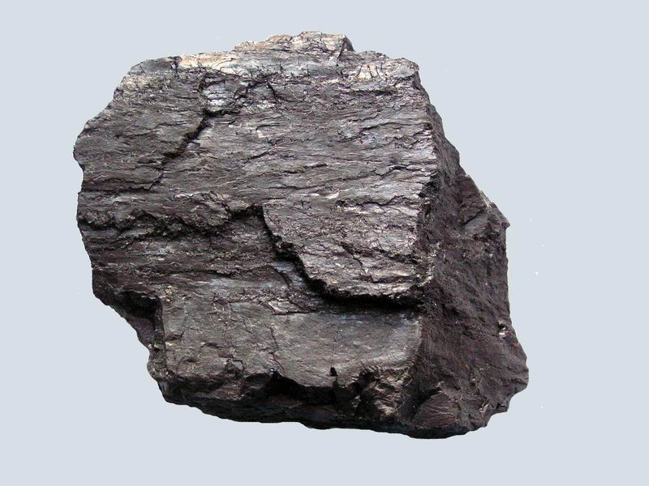
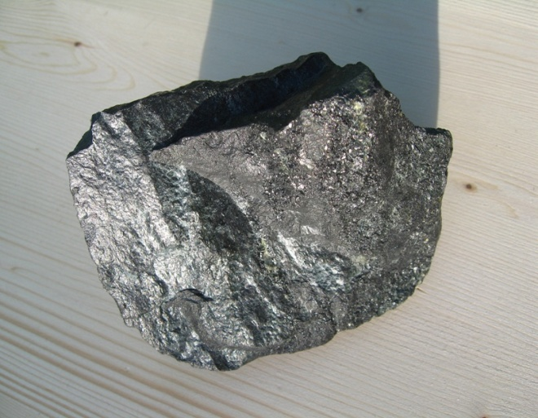
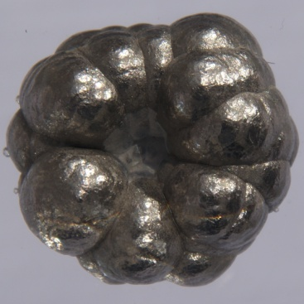
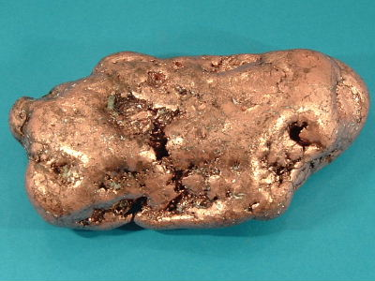
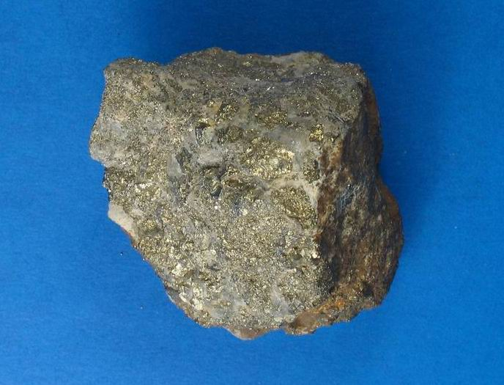
Minerals of Canada
Canada is rich in mineral resources. Country produces oil, natural gas, coal, iron ore, nickel, copper, polymetallic ores, uranium, gold and silver.

Slide 20
Traditions and customs of Canada.
New Year – first of January.
Thanksgiving Day – the second Monday in October.
Easter – a Good Friday and the first Monday after Easter.
Christmas – eleventh of November.
Day of Canada – first of July.

Slide 21
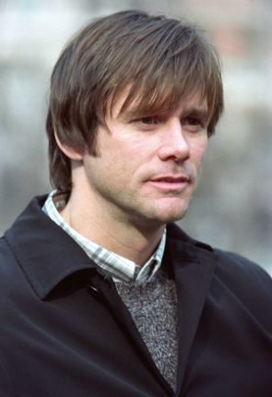
Famous people.
Jim Carrey was born in Canada.
James Cameron was born in Canada.

Slide 22
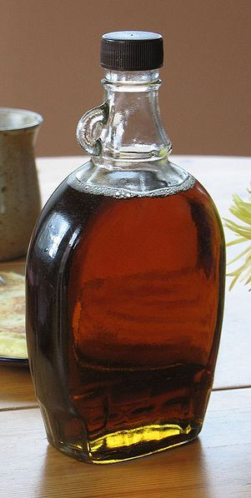
National dishes.
The main part of the Canadian food - Quebec food, as recipes of French cooking historically and geographically nearer Canada.
Maple syrup

Slide 23
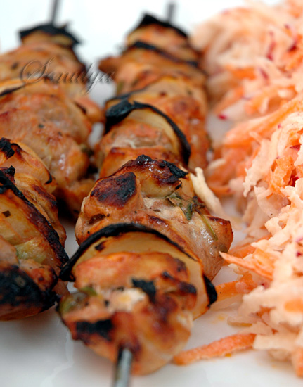
Broshett Fillet.
Everyday dishes Canadians are natural meat dishes such as steak, roast beef. The best dish of Canadian food - Broshett Fillet it is fried slices of roast fillet of chicken, bacon, mushrooms and onions.

Slide 24
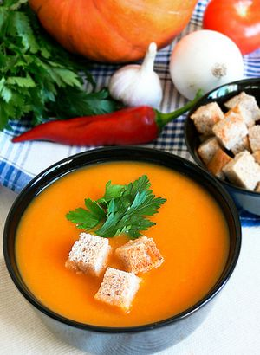
Pumpkin soup.
On the first Canadians like to eat light soups. It's a delicate soup with milk, onions and peppers. This soup is usually the first dish from the Canadians. It is very dietary and tasty soup. Canadians eat this soup with toasts

Slide 25
Thanks.

